Slide 1
New Faculty Orientation: Fall 2022
Joshua Morgan & Katie-Dean Moore
Office of the Vice President for Faculty Development and Advancement

Slide 2
Academic Integrity at FSU
Process is educational & non–adversarial
FDA helps to resolve allegations
Resolving academic misconduct requires due process
Option A: Informal, educational resolution
Option A cannot involve a misconduct grade penalty!
Option B: Formal escalation to FDA
Option B can involve a grade penalty
Notes:
Grade penalties may not be applied in cases of alleged academic dishonesty unless they are implemented via a formal process. This protects the instructor from grade appeals and litigiousness grounded in failing to adhere to University policy.
Instructors reserve the right to listen to a student's explanation, weigh the preponderance of evidence, and determine whether an informal warning is more educational than pursuing formal allegations.
In such cases, you can implement a re–do of the assignment within a specified deadline; based on the student's re–submission, a grade can then be given (with no penalties; just a routine evaluation of the work based on assignment parameters/rubrics/learning objectives).

Slide 3
How FDA Helps
Consulting with instructors
Checking for prior violations
Prompting students to respond to allegations
Removing unauthorized course content online
Enforcing policy & sanction accountability
Notes:
Mention holds, records audits, & reinstating in courses (i.e., no drops/withdrawals/changing grading basis of course)

Slide 4
Academic Honor Policy
You’re responsible for reading & upholding the Academic Honor Policy
There are 7 possible violations
Location of all documents, guides, & forms
https://fda.fsu.edu/academic-resources/academic-integrity-and-grievances/academic-honor-policy
Have a graduate/teaching assistant?
The assistant must speak with the instructor of record, & then that instructor must contact FDA

Slide 5
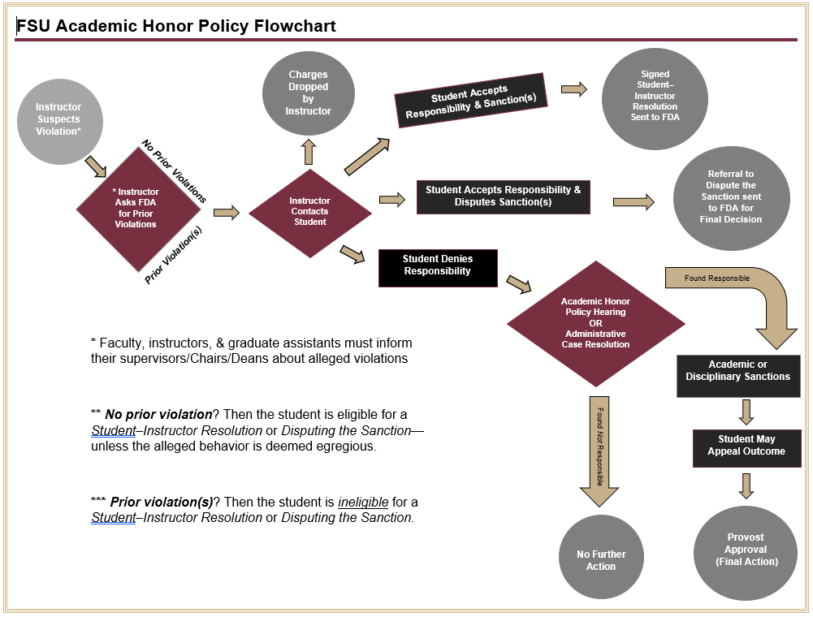

Slide 6
Best Practices
Use recorded Zooms or email correspondence with students.
Share all relevant evidence of the allegations with students.
Give students 5 class days to decide upon a resolution.
Mark final grade as "Incomplete" when a student's case is unresolved.
Implement an AHP Canvas quiz during Week 1

Slide 7
Resolving Allegations
AHP processes are conducted in an educational and non–adversarial manner!
Student–Instructor Resolution
Student admits to the violation; signs a form to accept the instructor’s sanctions
AHP Hearing
Student denies the violation; instructor brings the case before an AHP panel of students & faculty
Disputing the Sanction
Student admits to the violation but does not accept the proposed sanctions; OFDA reviews the case & issues a final decision
Administrative Case Resolution
Student’s case is straightforward (based on the evidence) and/or the student admits to the violation—yet they are ineligible for a Student–Instructor Resolution; ACR expedites the process in lieu of a hearing.
Note: AHP Hearing Referrals are also used when students have prior violations or violations that are considered egregious

Slide 8
Prevention
Implement a syllabus quiz & AHP quiz
Be approachable
Design courses proactively
Projects, A/B/C test versions, randomized questions, restrictive time limits, open–book/note
Implement low–stakes assignments
Consider due–date & holiday conflicts
Scaffold: Rough–draft opportunities, etc.
Notes:
Proactive2-1000x550.jpg (1000×550) (compexit.co.uk)

Slide 9
Prevention (cont.)
Encourage Students to…
Treat online environments with respect (same as in–person)
Timely notification of any testing issues
e.g., illness, noise, lack of privacy, accommodations
Consider…
Emailing FDA to see if we can do a brief AHP presentation
Especially if you need a substitute lecture / were going to cancel class
Preparing students to verify claims when asking for exceptions
Set the expectation in your syllabi & Canvas sites
Be kind during the unexpected
Promote proactivity/good time management for predictable events

Slide 10
Resources
FSU Libraries Citation Guides
FSU Libraries Technology Rentals
FSU English Dept.’ Plagiarism Activities
iThenticate
Honorlock Room Scan Example
Honorlock Checklist for Students
The Academic Honor Policy Webpage

Slide 11
Honorlock
What Is It?
An artificial intelligence-based (A.I.) exam proctoring platform
Mandated? Depends…
Your academic unit may or may not require it…
Syllabi are required to mention if Honorlock will be used
Should I Use It?
Pros:
Records student’s exam screen, webcam view, & audio
Integrated into all Canvas courses
Has a live–proctor chat function if students experience technical issues
Cons:
Low–quality A.I.
Requires high–volume/frequency reviews
Exacerbates anxiety
Circumstantial evidence
Requires Google Chrome browser

Slide 12
Policy Revisions
“Attempting” is now part of all violations
“Egregious” violations are better operational defined
Hearing panelists’ tie–votes → automatic “not responsible”
Instructors may designate students as eligible/ineligible for early records expungement
Appeal reviews are handled unilaterally by a Faculty Appellate Officer

Slide 13
Questions?
Email jlmorgan@fsu.edu & kd.moore@fsu.edu
Thank you!

