Slide 1
UFF-FSU
United Faculty of Florida
Florida State University Chapter
The Collective Voice of FSU Faculty
Matthew Lata
Professor of Music
UFF-FSU Chapter President

Slide 2
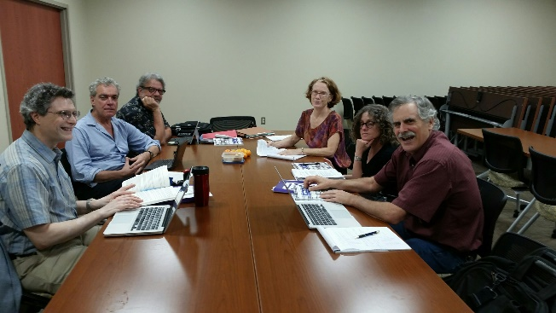
What is the United Faculty of Florida?
A union that is run by and for faculty
A democratic, member-supported voice for higher education faculty at FSU and Statewide
Recognized by a full faculty vote in 2003 as your sole bargaining agent
Affiliated with Florida Education Assoc., National Education Assoc., American Fed. of Teachers, AFL-CIO

Slide 3
Who Does UFF Represent?
All faculty with the exception of those in the Colleges of Law and Medicine
Tenured
Tenure Track
Specialized Faculty (Non-tenured)
Includes regular, visiting, provisional, research, teaching, affiliate or joint appointments

Slide 4
UFF-FSU Bargains for Faculty
Our collectively bargained contract specifies:
Terms and Conditions of Employment
Salary
Benefits
Promotions
Tenure
Sabbaticals and leaves
Academic freedom

Slide 5
This is YOUR contract, whether you are a Union member or not.
You can access the full agreement at:
http://uff-fsu.org/wp-content/uploads/2019/12/BOT-UFF-CBA-2019-22-V2019-11-18-Final-Covers.pdf
Notes:
http://uff-fsu.org/wp-content/uploads/2019/12/BOT-UFF-CBA-2019-22-V2019-11-18-Final-Covers.pdf

Slide 6
Just a few of our results
Over the years, some of the highest promotion raises in Florida
Negotiated salary increases for all faculty and increased sabbaticals
Clear path for promotion and multi-year contracts for specialized faculty
Fairness in assignments, evaluations, and the tenure process

Slide 7
What else do we do?
Protect faculty interests and rights through collective bargaining, consultations, and contract enforcement
Grievance and legal representation
Surveys to identify faculty views and concerns
Workshops
Informational meetings and luncheons
Advocacy for faculty in state government
Social events

Slide 8
Why is Membership Important?
A strong faculty voice is a hallmark of a great university.
Every member added gives us a stronger voice at the bargaining table.
On campus: UFF is an equal partner in negotiating with the FSU administration.
Off campus: UFF provides a strong voice in a challenging political environment (e.g., financial support, security, anti-tenure, anti-union).

Slide 9
Speaking of Representation…
UFF policy
Faculty member must be a dues-paying member of UFF to be eligible for representation in case of grievance
Must be a member when the incident occurred
Non-members must represent themselves or retain their own counsel
NOTE: membership is not automatic! You must complete a membership form to become a UFF member.

Slide 10
More reasons to join:
Free $1 million professional liability policy
Dues are tax deductible
Access to our workshops, events, and services, including free life insurance policies and legal representation
Diverse friends → diverse scholarship!
It’s the right thing to do!

Slide 11
We’re fun, too!
Monthly meet and greets, a luncheon series with guest speakers, nights at the opera and at the ballpark, and other events.
STAY TUNED!!

Slide 12
Support the UFF-FSU Chapter
Help make FSU a better place to work.
Protect your rights as an employee.
A strong UFF-FSU Chapter means a strong faculty voice.
JOIN UFF-FSU TODAY!
http://uff-fsu.org/get-involved/join/
Thank you for your time!
!

Slide 13
If you have questions, please contact:
Matthew Lata (Chapter President) – matthewlata@gmail.com
Lisa Schelbe (Co-Membership Chair) – lschelbe@yahoo.com
Anne Barrett (Co-Membership Chair) – abluestock@gmail.com

