Slide 1
Student Affairs
New Faculty Orientation
August 2022
Amy Hecht, Ed.D.
Vice President for Student Affairs

Slide 2
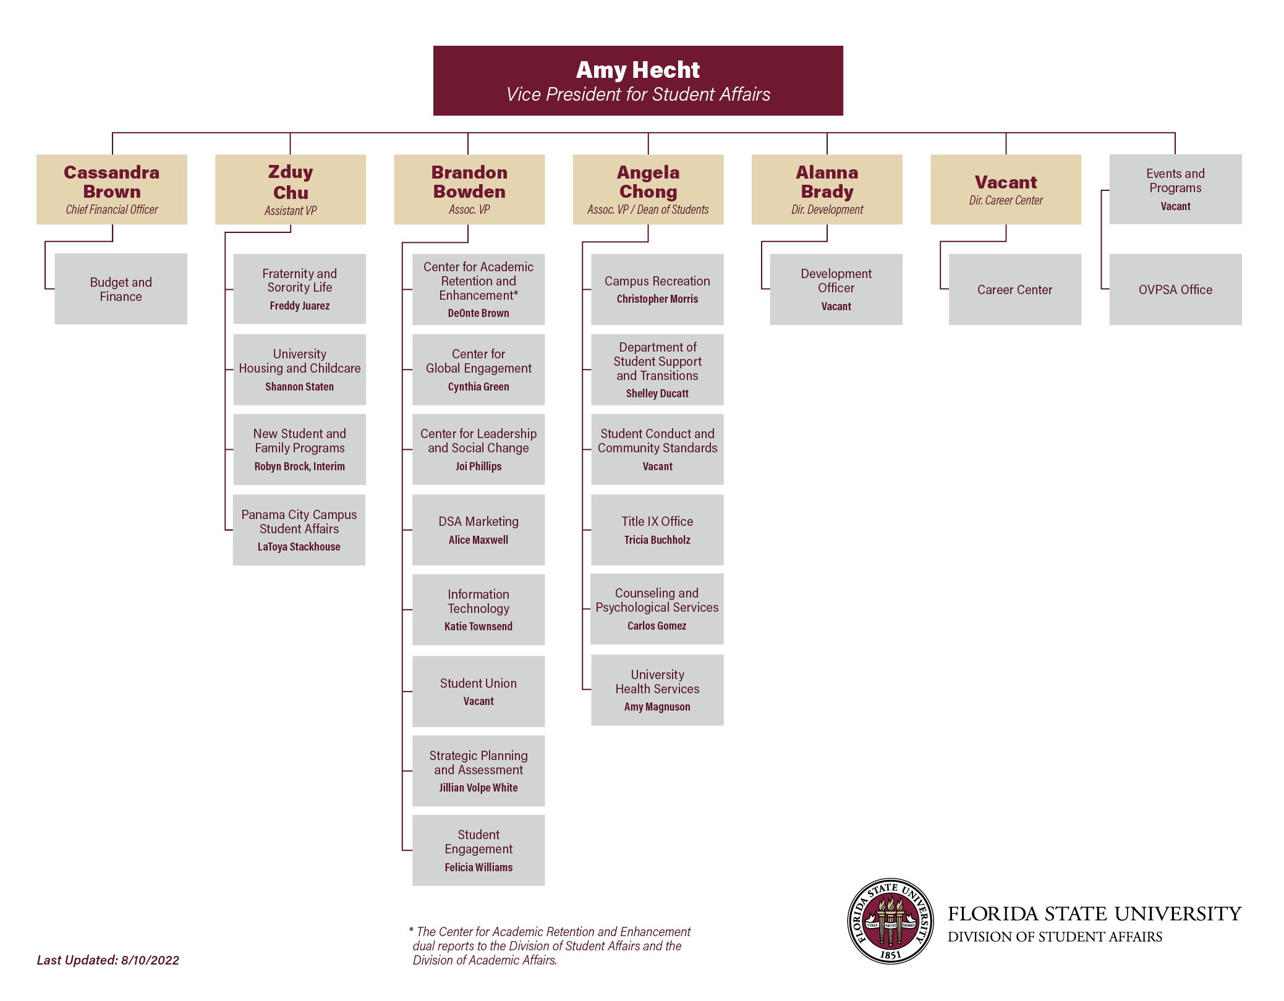

Slide 3
Student Affairs at FSU
Inclusive Campus Community
Center for Leadership and Social Change (RISE and CORE)
Center for Global Engagement
Student Union
Student Life
Fraternity and Sorority Life (FSL)
Housing and Childcare
New Student and Family Programs (NSFP)
Panama City Campus Student Life

Slide 4
Student Affairs at FSU
Health and Wellness
University Health Services (UHS)
Counseling and Psychological Services (CAPS)
Campus Recreation
Department of Student Support and Transitions (DSST)
Title IX
Student Conduct and Community Standards
Career Readiness

Slide 5
Learn More

Slide 6
Office of Accessibility Services
Case Management
Investigations & Assessment
Victim Advocates
Withdrawal Services
Food Pantry

Slide 7
Student Support & Transitions
Office of Accessibility Services
Provides academic accommodations for students.
Case Management
Assists students with emotional support, advocacy, identification of resources.
Investigations and Assessment
Investigates student organizations that alleged to have violated University policies.
Victim Advocates
Provides confidential support to students who have been victims of a crime.
Withdrawal Services
provides support to students and their families when a student’s enrollment is unexpectedly interrupted due to unforeseen circumstances. Students who leave FSU mid-semester must withdraw through this office.

Slide 8
Food for Thought Pantry
Provides assistance to current students facing food insecurity.
The pantry partners with Second Harvest of the Big Bend to keep the shelves and freezers stocked. But also relies on support from the FSU community to stock necessities.
Amazon Wish List
The Pantry is open from 8:00am to 5:00pm Monday through Friday and is located in University Center A, Suite 4148.

Slide 9
1-on-1 Counseling
Group Therapy
Art Therapy
Training for Faculty and Staff

Slide 10
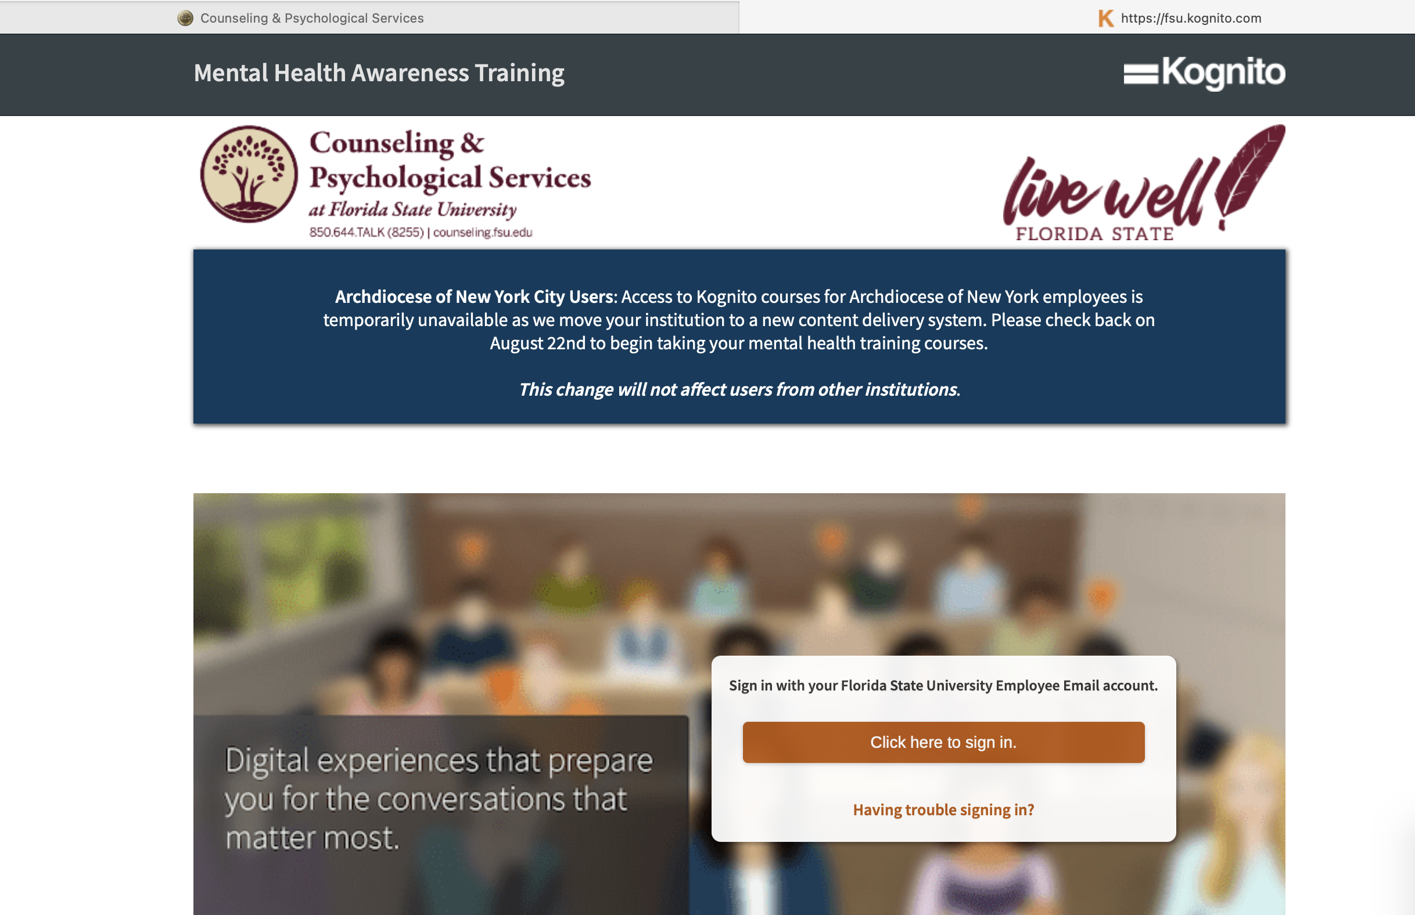
Training for Faculty
Kognito Training

Slide 11
Promoting Well-being in Learning Environments

Slide 14
Career Center
Job & Internship Fairs
Networking Events
Mock Interviews
Resume & Cover Letter Resources
Career Liaisons
Garnet & Gold Scholar Society
Notes:
- FSU Career Center provides comprehensive career services to students, alumni, employers, faculty/staff and other members of the FSU community.

Slide 15
Garnet & Gold Scholar Society
Facilitates involvement & recognizes the engaged, well-rounded undergraduate student who excels within & beyond the classroom
In the areas of International, Internship, Leadership, Research and Service
Must meet the criteria in 3 of the 5 areas & complete a Synthesis Reflection to graduate as a member of the Garnet and Gold Scholar Society.
Notes:
The Garnet and Gold Scholar Society facilitates involvement and recognizes the engaged, well-rounded undergraduate student who excels within and beyond the classroom in the areas of International, Internship, Leadership, Research and Service.
An undergraduate student who meets the criteria in three of the five areas and completes a Synthesis Reflection will qualify to graduate as a member of the Garnet and Gold Scholar Society.
1,831 inductees to date.

Slide 17
Center for Global Engagement (CGE)
Provides orientation, immigration advising, and support to over 2,400 international students on F & J Visas (including those completing Optional Practical Training following graduation) and family members, to over 250 international scholars and faculty.
Offer a variety of educational, social, and cultural programs for all students throughout the year.
International Coffee Hour held every Friday 5:00 – 6:30 p.m. while classes are in session.
Notes:
Engage Your World Lecture Series, International Bazaar, Global Café (offer delicious lunches from around the world sponsored by various groups)…visit the CGE website to sign up for their listserv and receive information on special events and programs. Beyond Boarders (a short term exchange program) and international exchanges for students with over 45 institutions. CGE also offers a global competency citizenship certificate and offers free training and workshops on Intercultural Communication to any student group or FSU department/college.

Slide 19
Center for Leadership and Social Change
Provides service learning opportunities
Leads FSU efforts on civic engagement and voting efforts
Offers trainings and programs such as Safe Zone, multi-cultural leadership conference
Coordinates Service Scholars
Notes:
civic responsibility as an integral part of a liberal arts education at Florida State University and to recognize students with an outstanding record of service and leadership. Admission to the program is reserved for first-year students who have demonstrated excellence in service and leadership in planning and promoting community involvement among their peers.
The Service Scholar program is a four-year, comprehensive, co-curricular program. Service Scholars will complete a minimum of 75 service hours per semester (45 hours for first-semester first-year students) while maintaining a 2.75 GPA, participate in individual and group service projects, attend monthly program meetings, receive and provide peer mentorship, engage in coursework tailored to each year in the program, and promote community participation among their peers. The program includes an annual $3,000 scholarship, which is automatically renewed each year, provided requirements are met. For many Scholars, the program becomes a second family – a supportive community of service-minded student leaders.

Slide 23
Student Union
New Student Union
Bowling
Art Center
Ballroom and meeting spaces
Student Organization offices
Food: Panera, Pizza, Starbucks, Panda Express
Restaurant and Bar in lower level to open soon
Bookstore
Askew Student Life Center
Movie Theatre
Gaming Program

Slide 24
New Initiatives

Slide 25
Recovery Community
LIFT (Living Intentionally, Finding Togetherness) is FSU’s collegiate recovery community
Provide three levels of support to students identifying as being in recovery from substance abuse and allies.
Building community (substance free programs, activities and spaces)
Offer clinical support (individual and group therapy and utilizing support networks within the greater community)
Provide developmental support through existing services and a dedicated graduate assistantship that links the community to wellness, career, and leadership opportunities

Slide 26
Academic Partnerships & Opportunities
Center for Global Engagement
Global Citizenship Certificate
Beyond Borders Program
Center for Leadership and Social Change
Leadership Studies Certificate
Center for Academic Retention & Enhancement (CARE)
Career Center
Incorporate professional skills into your course with the Canvas ProfessioNole Ready Badge
University Housing
Living Learning Communities

Slide 27
Academic Partnerships & Opportunities
Campus Recreation
Athletic Training Program
Join and work out conveniently on campus!
University Health Services
Nursing program
University Counseling Center
Suicide Prevention Research Team
The Resilience Project
Graduate Assistantships

Slide 28
Academic Partnerships & Opportunities
Visiting Scholars
Research, Grant, Training, & Presentation Opportunities
Participate in Trainings
Allies/Safe Zone
NCBI (Diversity and Inclusion)
Mental Health First Aid
Don’t cancel that class!
Request an employability skills workshop
Health and Wellness Presentation

Slide 29
Thank You Amy Hecht, Ed.D. Vice President for Student Affairs ahecht@fsu.edu

