Slide 1
Welcome!
Amy R. Guerette & Craig Stanley
Office of Faculty Development and Advancement
Notes:
Welcome to Florida State University! FSU was founded in 1851 as the West Florida Seminary. In 1905, it became the Florida State College for Women, before finally becoming coeducational in 1947 and gaining its current name, Florida State University.

Slide 2
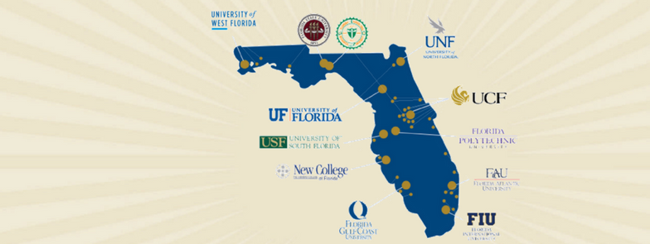
Florida Board of Governors (BOG) & State University System (SUS)
Notes:
Amy
Florida Board of Governors (BOG) is a 17-Member governing board that serves as the governing body for the Florida State University System (SUS). There are 12 institutions represented in the State University System.

Slide 3
History of Florida State University
1851-1857
1863
1901
1905
1909
1947
West Florida Seminary
The Florida Military College and Institute
Florida State College
Florida Female College
Florida State College for Women
Florida State University
Notes:
Amy
Institutional History
1851/1857: West Florida Seminary
• Located on the hill where Westcott Budling stands
• Became co-ed the following year when it absorbed the Tallahassee Female Academy
1863: Name Changed to The Florida Military and Collegiate Institute
• 1891 focused on what we would call today higher education – awarded bachelor degrees
1901: Florida State College
• 4 departments – the College, the School for Teachers, the School of Music, and the College Academy
1905: The state legislature reorganized 6 state institutions into two – one for men at the University of Florida and one for women at the Florida Female College (male students moved to Gainesville)
1909: Florida State College for Women
• Grew to become the 3rd largest women’s college in the nation
• However, after World War II, veterans demand for men’s education increased dramatically
1947: Florida State University
• Arts and Sciences, Education, Home Economics, and Music
• In the 50’s added Library Science, Social Welfare (later split into Social Work and Criminology), Business, Journalism (later discontinued), and Nursing

Slide 4
Campus Locations
The University owns a total of 1,715.5 acres in Leon, Bay, Collier, Franklin, Gadsden, and Sarasota counties. Sites are leased in various counties in Florida, and other locations overseas.
Main Campus: 485.7 acres in Tallahassee, Leon County.
Panama City Branch: 25.6 acres in Panama City, Bay County.
Republic of Panama: Located in the City of Knowledge, across from the Panama Canal
International Programs Study Centers: London, England; Florence, Italy; Panama City, Republic of Panama; and Valencia, Spain
Main/Tallahassee Campus
Panama City Campus
Republic of Panama Campus
Study abroad centers in London, Florence, Valencia, and Panama
Regional medical campuses
Notes:
Craig

Slide 5
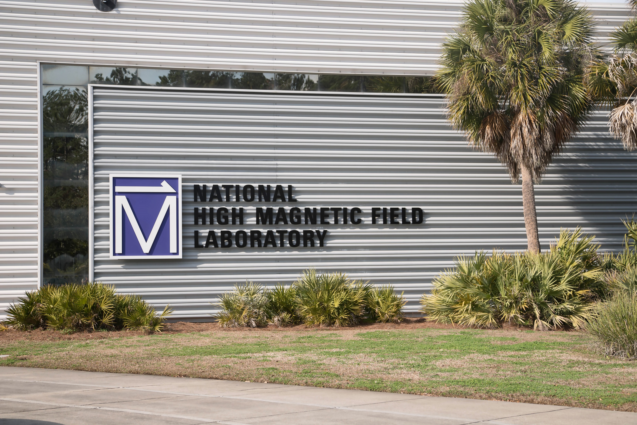
Tallahassee Campus: A Few Unique Features
Innovation Park
Home to the National High Magnetic Field Laboratory and FAMU/FSU College of Engineering
FSU Coastal & Marine Laboratory on the Gulf Coast
FSU Lakefront Park
FSU Innovation Hub
FSU Flying High Circus
FSU Bowling and Billiards
Notes:
Craig

Slide 6
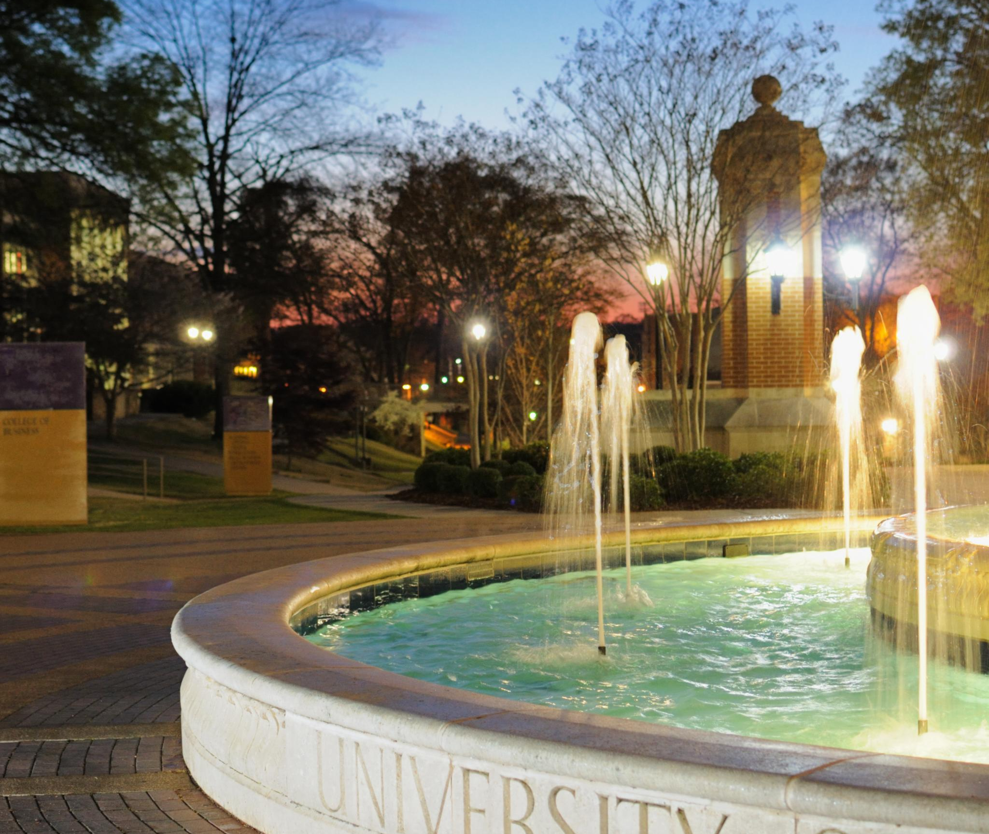
Colleges at FSU
College of Applied Studies*
College of Arts and Sciences
College of Business
College of Communication and Information
College of Criminology and Criminal Justice*
College of Education, Health, and Human Sciences
College of Engineering (FAMU/FSU)
Moran College of Entrepreneurship*
College of Fine Arts
Dedman College of Hospitality*
College of Law*
College of Medicine
College of Motion Picture Arts*
College of Music*
College of Nursing*
College of Social Sciences and Public Policy
College of Social Work*
*No departments
Notes:
Amy
FSU has 17 colleges offering undergraduate and graduate programs.
College of Applied Studies*
Panama City Campus; 2010
College of Arts and Sciences
Oldest and largest College – larger than many universities
Located ALL over campus!
College of Business
Rovetta next to the Union but getting a fancy new building on St. Austine
College of Communication and Information
Merged in 2009
College of Criminology and Criminal Justice*
College of Education, Health, and Human Sciences
Education was 2nd oldest and Health/Human Sciences 3rd oldest
Merged in 2023
College of Engineering (FAMU/FSU)
Joint College with FAMU – Innovation Park
Moran College of Entrepreneurship*
Established in 2017
College of Fine Arts
Arts are highly valued at FSU
Dedman College of Hospitality*
Established in 2017
College of Law*
College of Medicine
Established 2001
College of Motion Picture Arts*
College of Music*
4th oldest college; national reputation
College of Nursing College of Social Sciences and Public Policy College of Social Work*

Slide 7
Academic Offerings
We offer 271 distinct Degrees:
97 Bachelors
101 Masters
6 Specialist
63 Doctoral
4 Professional
And 551 unique Majors:
188 Bachelors
216 Masters
18 Specialist
127 Doctoral
8 Professional
Additionally, we offer our degree programs in a variety of formats such as BS/MS Pathways and Joint Graduate Pathways! Certificate programs are also popular among our students.
Notes:
Amy

Slide 8
FSU's Student Body
Over 42,000 students from all 50 states and over 130 countries
Undergraduate enrollment: 31,933
Graduate & Professional enrollment: 10,582
First-year retention rate: 96%
Four-year graduation rate: 75%
Notes:
Craig
FSU has over 42,000 students from all 50 states and over 130 countries. 31,933 of these students are pursuing undergraduate degrees, while 10,582 are pursuing graduate or professional degrees. FSU's first-year retention rate is 96%, well above the national average. Four-Year graduation rate is 75%.

Slide 9
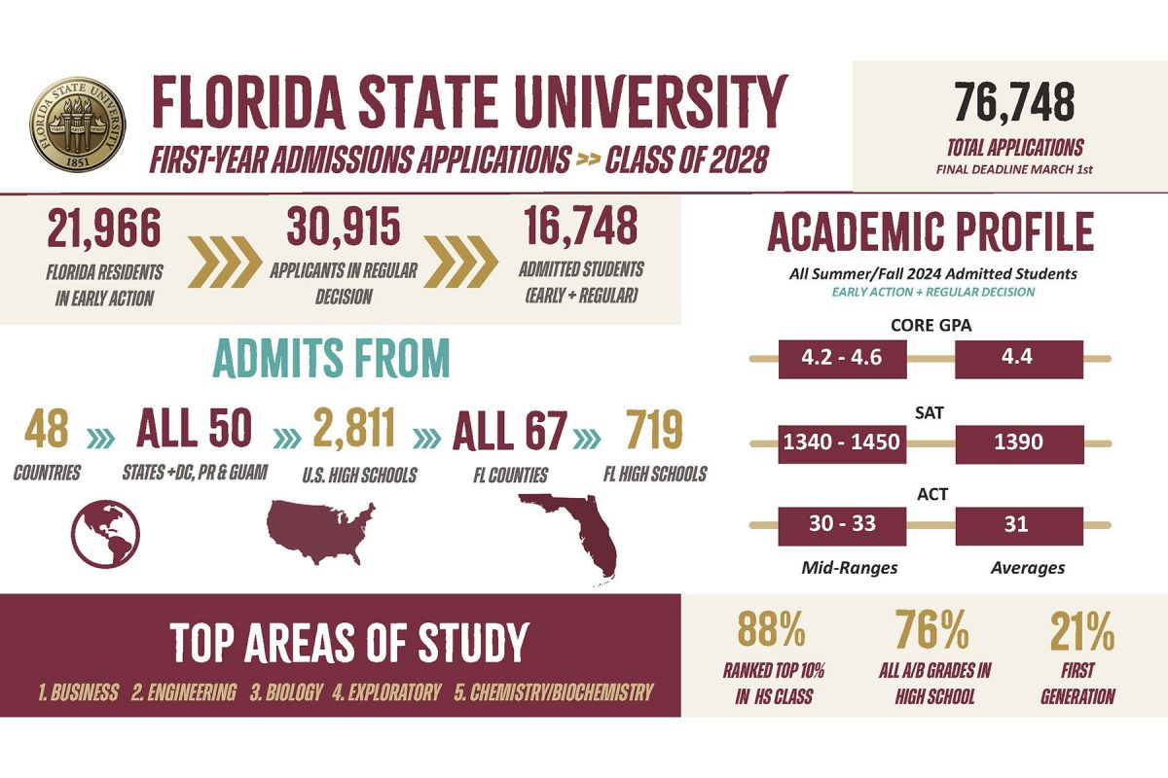
Notes:
Craig

Slide 10
Enrollment Breakdown
College | Total Students | Graduate Students | Degrees Offered
Arts and Sciences | 10,556 | 1,734 | 86
Business | 6,940 | 639 | 15
Social Science and Public Policy | 4,633 | 743 | 26
Education, Health, and Human Sciences | 3,793 | 1,471 | 40
Communication and Information | 2,523 | 888 | 13
Engineering | 2,466 | 466 | 22
Criminology and Criminal Justice | 1,744 | 269 | 4
Social Work | 1,173 | 997 | 3
Medicine | 1,145 | 641 | 6
Law | 1,069 | 1,069 | 5
Fine Arts | 1,069 | 277 | 17
Nursing | 1,046 | 173 | 4
Music | 922 | 305 | 17
Hospitality | 624 | 39 | 3
Entrepreneurship | 546 | 30 | 4
Applied Studies | 463 | 281 | 7
Motion Picture Arts | 171 | 67 | 3
Notes:
Amy

Slide 11
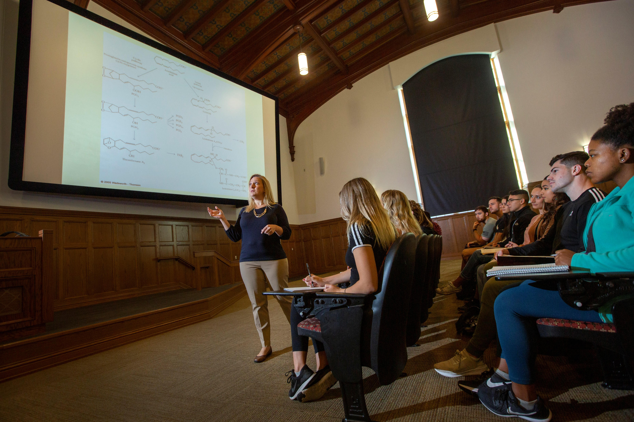
FSU Faculty
With over 2,000 faculty members, FSU provides a 17:1 student-to-faculty ratio.
Approximately 92% of faculty hold the highest degree in their field.
Over 74% of upper-division classes are taught by salaried faculty.
FSU professors hold numerous awards and recognitions for their contributions to their field through their scholarship and creative works.
Notes:
Craig
Florida State University boasts a diverse and accomplished faculty over 2,000 members strong, providing a 17:1 student-to-faculty ratio. Approximately 92% of faculty hold the highest degree in their field. FSU professors hold numerous awards and recognitions for their contributions to their field.

Slide 12
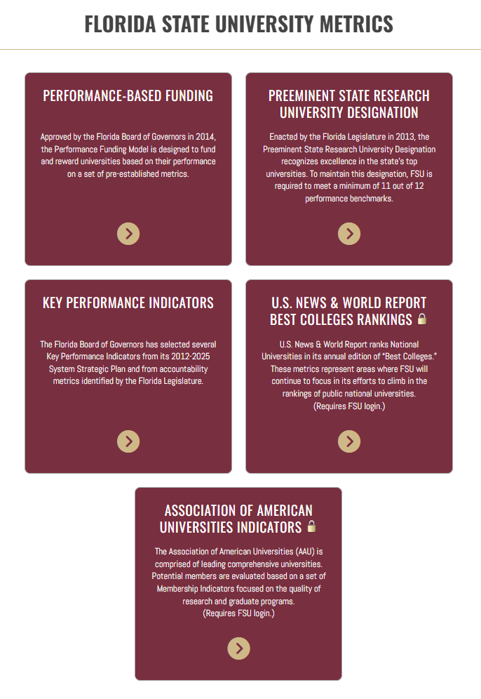
Pursuit of Excellence
Florida State University Metrics
Notes:
FSU is a top public research university, ranked #23 among public universities by U.S. News & World Report. FSU is also one of four institutions within the SUS to have earned pre-eminence status. FSU also aspires to join the AAU. Due to the high quality of our faculty and students, FSU has earned an excellent reputation that amplifies the work we do. Learn more about these metrics by visiting our IR website.

Slide 13
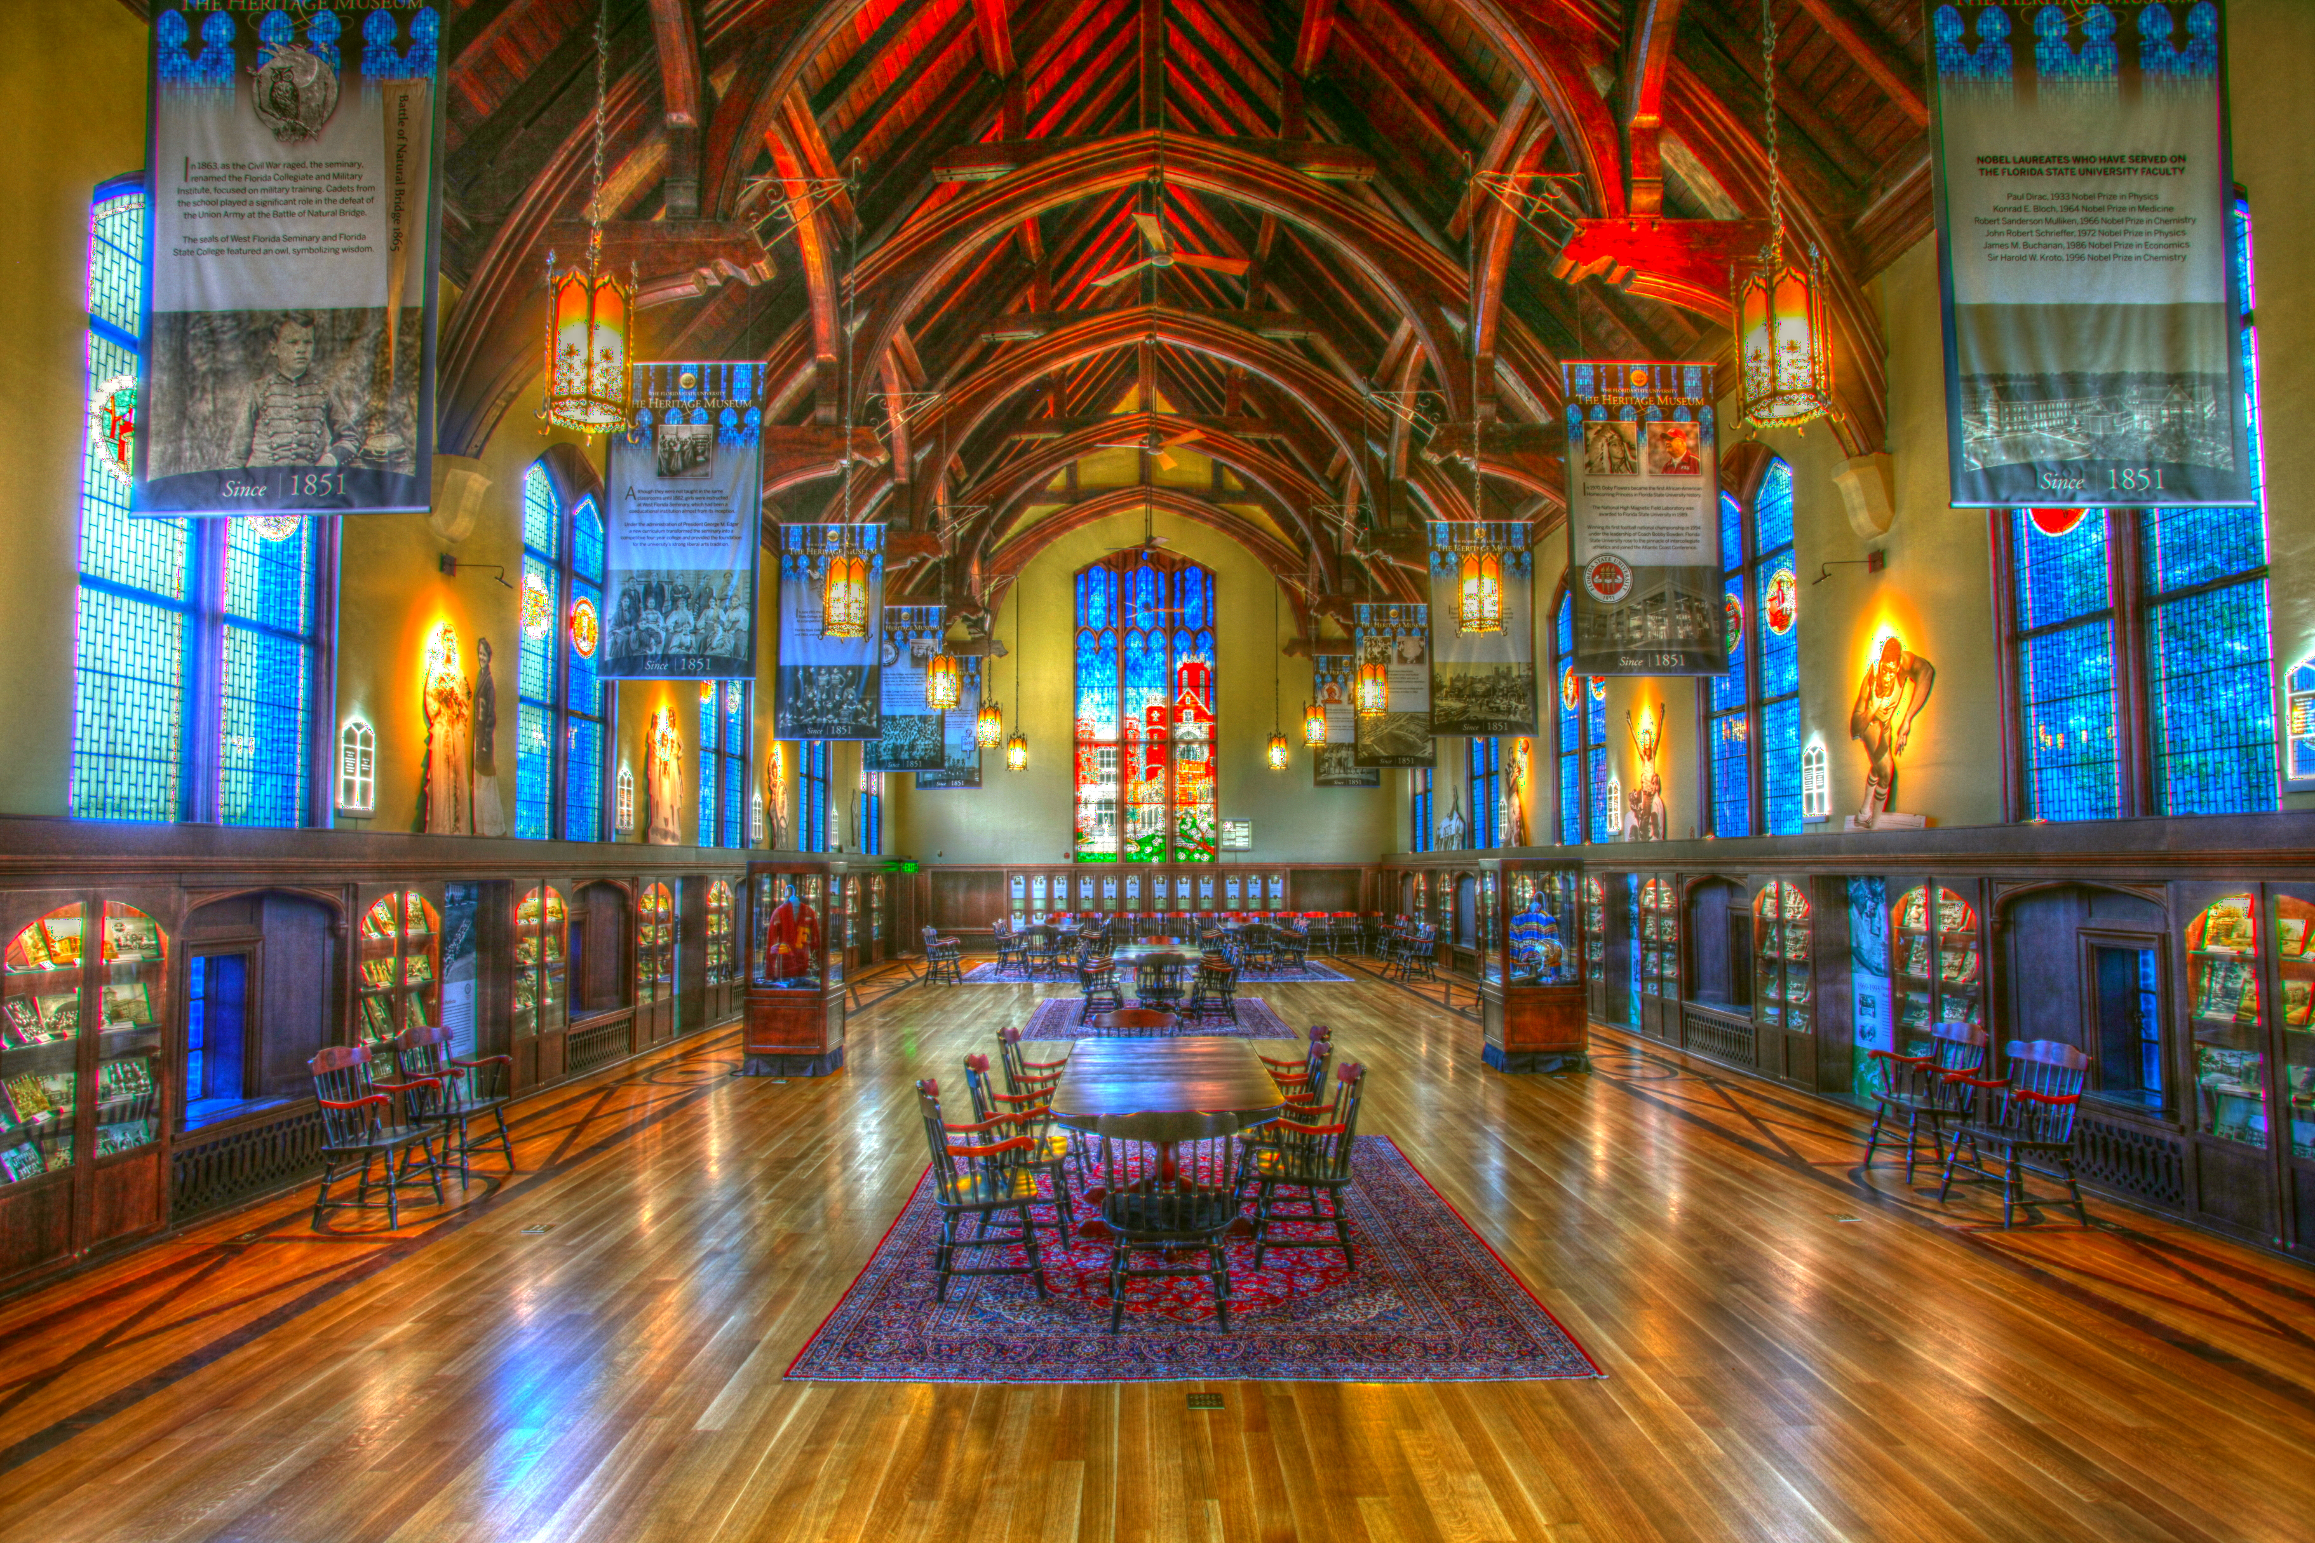
Welcome To FSU!!

