Slide 1
Deans & Chairs
Kyle Clark
Senior Vice President for Finance & Administration
October 22, 2024

Slide 2
Fund Definitions

Slide 3
Education & General (E&G)
Largely Appropriated by the State Legislature, including General Revenue (primarily Florida’s sales tax revenue) and Lottery. Also includes tuition and certain fees
Spending must result in a direct, specific benefit to the University
Tuition Differential must be spent to enhance undergraduate education

Slide 4
Designated
Non-E&G
Collected or set aside for a specific purpose, including funds administered by central offices or administrative departments
Student Activities
Primarily Activity and Service (A&S) fee revenues
A&S fee spending should benefit the student body
Technology Fee – Spending should enhance instructional technology resources
Vending – Spending must result in a general benefit to the University

Slide 5
Auxiliary
Non-E&G
Primarily sales to University departments, students, faculty, staff and others
Includes some student fees, for example:
Health
Transportation Access
Market Rate Distance Learning
Spending should be consistent with its mission/purpose

Slide 6
Restricted
Non-E&G
Financial activity related to sponsored research
Includes the University’s charter schools
Spending must
Comply with all university and agency requirements
Follow the terms of the contract/grant

Slide 7
Capital Projects
Non-E&G
To track the financial resources used to acquire, construct, renovate or remodel a major capital asset
Funds appropriated by the state legislature for capital projects, along with funds transferred from within the university and from component units for capital projects

Slide 8
Component Units
Non-E&G
Direct Support Organizations (DSO)
Legally separate not-for-profit corporations that operate exclusively to provide the university with supplemental resources
Includes Seminole Boosters, International Programs Association, Foundation, Research Foundation, Medical Practice Plan, and others

Slide 9
FY 2024-2025 Operating Budget

Slide 10
Budget Timeline
Budget Training
New budget requests are compiled for review
Component unit budgets are compiled
BOG detailed budget & position reports are prepared
Board of Governors approves
the budget
Requests for new budget allocations
Detailed budget reviews occur
January
March
May
July
September
February
April
June
August
Budget training, workshop, & entry dates are announced
High-level budget calcs including tuition & fees are finalized
Operating budget presented to Board of Trustees
Operating budget submitted to the Board of Governors
Budget entry occurs
New budgets are booked in OMNI

Slide 11
2024-2025 Total Operating Budget Summary
 | 2023-2024 | 2024-2025
Education & General - State Support | $805,183,345 | $937,468,379
Education & General - Tuition and Fees | 238,918,305 | 246,948,346
Designated | 97,154,941 | 88,880,058
Auxiliary | 425,239,039 | 433,441,908
Restricted | 520,128,750 | 583,679,742
Debt Service | 27,542,774 | 29,761,724
Capital Projects | 347,411,462 | 519,758,280
Component Units | 164,801,025 | 162,454,627
Total | $2,626,379,641 | $3,002,393,064

Slide 12
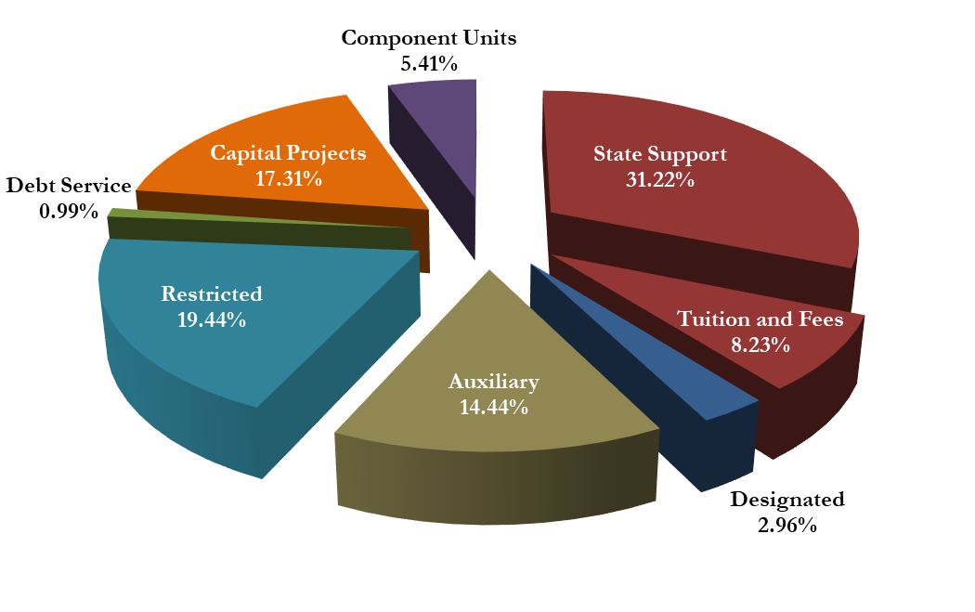
2024-2025 Total Operating Budget Summary
Total E&G
39.45%

Slide 13
Total Budget Highlights
Operating budget of $3,002,393,064
Net of internal sales
Excludes cash transfers within the university
Overall total increase of 14.3%

Slide 14
E&G Top Spending Categories
Category | Expense | % of E&G
Wages & Benefits | $822,723,545 | 69%
Equipment & Supplies | $65,133,022 | 5%
Financial Aid | $54,805,668 | 5%
Professional & Other Services | $46,272,828 | 4%
Utilities | $30,178,573 | 3%
IT, Network, Telecom, & Software | $18,799,086 | 2%
Repairs & Maintenance | $16,352,130 | 1%

Slide 15
Designated Top Spending Categories
Category | Expense | % of Designated
Financial Aid | $48,967,305 | 43%
Wages & Benefits | $37,430,904 | 33%
Equipment & Supplies | $10,783,596 | 9%
Professional & Other Services | $8,285,116 | 7%
IT, Network, Telecom, & Software | $5,247,026 | 5%
Travel | $1,769,436 | 2%

Slide 16
Auxiliary Top Spending Categories
Category | Expense | % of Auxiliary
Wages & Benefits | $196,946,799 | 36%
Professional & Other Services | $69,605,582 | 13%
Utilities | $50,866,675 | 9%
Equipment & Supplies | $42,214,589 | 8%
IT, Network, Telecom, & Software | $28,329,938 | 5%
Repairs & Maintenance | $24,504,355 | 5%

Slide 17
Restricted Budget Income by Source
Source | Income
Federal Grants | $284,774,006
State Grants | $177,956,499
Non-exchange Transfers | $149,290,011
Other Grants & Donations | $102,109,361
Research Overhead Transfers | $51,450,000
All Others | $16,329,316
City & County Grants | $3,537,484
Sales of Goods and Services | $2,878,644

Slide 18
Restricted Top Spending Categories
Category | Expense | % of Restricted
Financial Aid | $213,116,575 | 34%
Wages & Benefits | $199,934,302 | 32%
Equipment & Supplies | $54,287,628 | 9%
Research Subrecipient Partners | $40,620,740 | 7%
Professional & Other Services | $32,972,433 | 6%
Travel | $10,639,108 | 2%

Slide 19
2024-2025 Capital Projects
Project | Amount
Doak Campbell Stadium Seating Enhancements | $141,000,000
Legacy Hall – College of Business | $75,000,000
Football Operations Facility | $68,000,000
FSU/TMH Academic Health Center | $38,000,000
Interdisciplinary Research & Commercialization Building | $35,000,000
Doak Campbell Stadium Improvements | $10,000,000
Mag Lab Primary Electrical | $10,000,000
All Others – over 200 projects under $3M | $142,758,280
Total | $519,758,280

Slide 20
2024-2025 Component Units
Component Unit | Amount
Seminole Boosters, Inc. (includes FSU Financial Assistance, Inc) | $77,031,759
FSU International Programs Association, Inc. | 25,943,000
FSU Foundation, Inc. | 16,369,493
Florida Medical Practice Plan, Inc. | 13,528,471
FSU Athletics Association, Inc. | 4,795,465
FSU Research Foundation, Inc. | 4,786,400
John and Mable Ringling Museum of Art, Inc. | 3,242,150
FSU Alumni Association, Inc. | 1,892,622
FSU Magnet Research and Development, Inc. | 74,844
FSU College of Business Student Investment Fund, Inc. | 10,000
FSU Real Estate Foundation, Inc. | 0

Slide 21
Total Budget Wages and Benefits
Category | E&G | Designated | Auxiliary | Restricted | Total
Faculty | $448,039,379 | $2,909,960 | $16,211,727 | $79,382,432 | $546,543,498
Staff | $280,373,042 | $22,707,141 | $162,205,629 | $71,011,055 | $536,296,867
Graduate Assistants | $55,570,380 | $4,612,222 | $3,255,130 | $18,124,720 | $81,562,452
Other* | $34,060,650 | $7,055,596 | $14,987,363 | $24,501,256 | $80,604,865
Postdoctoral Associates | $4,680,093 | $145,985 | $286,950 | $6,914,839 | $12,027,867
Total | $822,723,544 | $37,430,904 | $196,946,799 | $199,934,302 | $1,257,035,549
* Temporary Employment, Student Employment, and Associated Fringes

Slide 22
Total Budget Top Spending Categories
Category | E&G | Designated | Auxiliary | Restricted | Total
Wages & Benefits | $822,723,545 | $37,430,904 | $196,946,799 | $199,934,302 | $1,257,035,550
Capital Projects | - | - | - | - | $519,758,280
Financial Aid | $54,805,668 | $48,967,305 | $12,186,105 | $213,116,575 | $329,075,653
Equipment & Supplies | $65,133,022 | $10,783,596 | $42,214,589 | $54,287,628 | $172,418,835
Professional & Other Services | $46,272,828 | $8,285,116 | $69,605,582 | $32,972,433 | $157,135,959
Component Units | - | - | - | - | $162,454,627

Slide 23
Tuition and Fees
Tuition
Tallahassee Campus
No increase since 2013-2014

Slide 24
FSU’s Operating Budget is Larger than
92 Countries
American Samoa | Eritrea | Lesotho | Saint Pierre and Miquelon
Andorra | Eswatini | Liberia | Saint Vincent and the Grenadines
Anguilla | Falkland Islands (Islas Malvinas) | Madagascar | Samoa
Antigua and Barbuda | Faroe Islands | Malawi | San Marino
Aruba | Fiji | Maldives | Sao Tome and Principe
Bahamas, The | French Polynesia | Marshall Islands | Seychelles
Barbados | Gabon | Mauritania | Sierra Leone
Belize | Gambia, The | Micronesia, Federated States of | Solomon Islands
Benin | Gibraltar | Monaco | Somalia
Bermuda | Greenland | Montenegro | South Sudan
Bhutan | Grenada | Montserrat | Suriname
British Virgin Islands | Guam | Nauru | Tajikistan
Burundi | Guernsey | New Caledonia | Timor-Leste
Cabo Verde | Guinea | Niger | Togo
Cayman Islands | Guinea-Bissau | Niue | Tokelau
Central African Republic | Guyana | Norfolk Island | Tonga
Chad | Haiti | Northern Mariana Islands | Turks and Caicos Islands
Comoros | Holy See (Vatican City) | Palau | Tuvalu
Congo, Republic of the | Isle of Man | Pitcairn Islands | Vanuatu
Cook Islands | Jersey | Rwanda | Venezuela
Djibouti | Kiribati | Saint Helena, Ascension, & Tristan da Cunha | Virgin Islands
Dominica | Kosovo | Saint Kitts and Nevis | Wallis and Futuna
Equatorial Guinea | Kyrgyzstan | Saint Lucia | Zimbabwe
92
Source: The World Factbook, CIA.gov

Slide 25
Recruitment & Retention

Slide 26
Recruitment
National Advertising: To reach top talent nationwide, the University pays to advertise all jobs posted on the FSU Careers site with Inside Higher ED.
External Advertising Partnerships: The University has partnerships with Graystone Advertising and Job Elephant Advertising that allow departments to advertise in external field-specific publications at discounted advertising rates. These services are available for all and are department-funded.
Market-Competitive Salaries: Compensation benchmarks staff salaries against comparable external positions to ensure competitive salaries for potential hires and current incumbents.
Sign-On Bonuses: These may be offered to prospective employees who possess skills, experience, and/or qualifications that are in high market demand or are highly specialized. They may also be used to recruit for a position that would otherwise be difficult to fill.
Moving Expenses: This may be offered to prospective employees relocating to the Tallahassee area. Expenses are paid directly to a university-approved vendor. Typically covered as part of the Sign-on Bonus, but is available for those who have extenuating circumstances.
Temporary Housing: This may be offered to prospective employees who are relocating for the position to allow time to find permanent housing. May be used to secure a candidate for a position that would otherwise be difficult to fill.

Slide 27
Retention
Career Ladder Adjustments: HR has partnered with departments across campus to develop career ladders within job codes to provide employees with a structured pathway for advancement within the organization. The ladders offer more transparent opportunities for advancement and skill development. Employees are able to progress through increasing levels of responsibility and associated defined salary within their current department and field of work without having to apply for new roles at the University.
Market-Based Reviews: Departments may request external market reviews to ensure current employees' salaries keep pace with external market data trends.
Counter Offers: Departments may match external offers for equivalent roles to retain key employees who are considering leaving for other opportunities. Market adjustments based on individual qualifications may be considered to retain those receiving offers for higher-level external roles or offers internal to the University.
Retention Bonuses: These may be offered to a current employee possessing valuable or unique knowledge, skills, or abilities that are deemed critical to the mission of the University to retain key talent and reward tenure.

Slide 28
Capital Project Updates

Slide 29
Deferred Maintenance Buildings
Bellamy
Bio Medical
Bio Unit One
Ca’d Zan
Carothers Hall
College of Engineering
Collins
Critchfield
Diffenbaugh
Dittmer
Fine Arts
HCB
Housewright
Immokalee
Love
Marine Lab
Maryland Circle
Master Craftsman
Panama City Campus
Pepper
Recycling/Solid Waste
Medicine Research
Ringling Art Museum
Rogers
Rovetta
Sandels
Shaw
Strozier
Thrasher
Turnbull
University Center
Westcott
Williams
29

Slide 30
Deans & Chairs
Kyle Clark
Senior Vice President for Finance & Administration
October 22, 2024

