Slide 1
Marla Vickers, ’00, MBA, MA, CFRE
Vice President for University Advancement and President, FSU Foundation
Deans, Directors, and Chairs Meeting
Tuesday, October 17, 2023

Slide 2
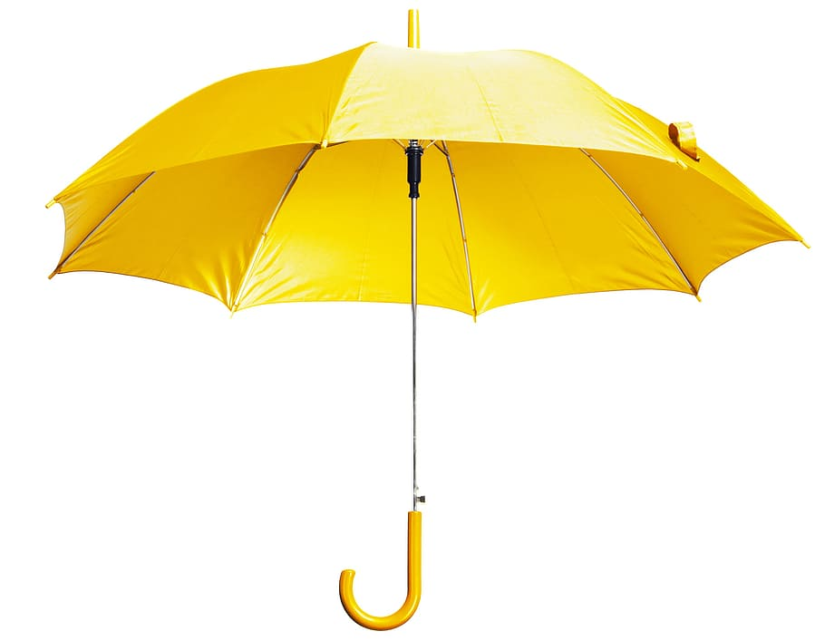
What is University Advancement?
FSU Foundation
Advancement Services
Fundraising across ALL of FSU’s entities
Alumni Relations/FSU Alumni Association
Communications
Events
Corporate and Foundation Relations
(In partnership with University Research)

Slide 3
FY23 Fundraising Totals
DSO | FISCAL YEAR 2023 | FISCAL YEAR 2022
FSU Foundation | $70,750,010 | $95,097,025
Alumni Association | $630,313 | $860,278
Seminole Boosters | $77,715,604 | $32,382,916
Research Foundation | $1,212,832 | $1,718,427
The John and Mable Ringling Museum of Art | $2,592,217 | $2,198,012
TOTAL | $152,800,975 | $132,256,659
Notes:
Second best aggregated year historically since 1963
Fourth best Foundation fundraising year (2022, 2016, 2008)

Slide 4
University Endowment Summary
$947M
6/30/22: $898M
Notes:
The June 30, 2023 total university endowment balance is $947 million and is comprised of:
FSU Foundation ($723M)
FSU Research Foundation ($140M)
Seminole Boosters ($82M)
Ringling Foundation ($2M)
Just to illustrate the improvement in the market over the past quarter, you can see that our total endowment was at $898 million as of June 30, 2022. Since then, we have a experienced a 7.3% positive investment return for fiscal year 2023, which underperformed the benchmark of 8.9%.
Based on NACUBO’s expected long-term annual return rate of 7.5% and annual endowed gifts of $15 million, we are on track to reach a $1 billion endowment between January and March of 2025.
IF NEEDED
Our benchmark is a blend of the Morgan Stanley Capital International, S&P, Bloomberg, Russell, and other indexes that represent a “passive” investment approach.
Compared to other foundations in the state of Florida, FSU also had the best return during FY 2021 at 41.2%. The University of South Florida had the next best return at 35.1% and the remaining schools had returns from 35.07% down to 26.8%. We also had the best return during FY 2022, with a return of -0.9% (UF was at -6.0%). We are still waiting on return information for all SUS schools for FY 2023, but will have that information by the October BOT meetings.

Slide 5
Alumni Participation Rate (APR)
FY | ALUMNI OF RECORD | APR
FY18 | 241,633 | 18.24%
FY19 | 239,518 | 18.13%
FY20 | 261,426 | 14.89%
FY21 | 269,418 | 12.62%
FY22 | 240,547 | 12.31%
FY23 | 243,546 | 15.4%
FY24 | ~246,000 | 17%
Notes:
The increase of the alumni participation rate from FY22 to FY23 (15.4%) is due to strategic investments, data analytics and collaboration.
By creating the Fun with Fractions group, we brought in key stakeholders to identify solutions. This included representation from the Seminole Boosters, Alumni Association, Foundation, and Office of Institutional Research.
The first part involved ensuring that we were capturing the data in the most effective way. This involved using USWNR definition of what is considered a contactable alum and then creating a formula that we felt confident met this criteria.
The formula: Alumni (USNWR criteria less standard exclusions) AND 5x consecutive year: (no events) + (no tickets) + (no gifts) + (Fnd appeals) + (AA appeals) + (SB – appeals)
The second part was identifying opportunities to increase participation in both active and passive methods.
Solutions:
Event registration gift add-on function
Select athletic ticket gift add-on function
Increase in new annual giving campaigns that: leveraged philanthropic commerce and participation asks of $5
An entire shift in strategy using the engagement center (student callers) to push just participation (BEST performing strategy!)
Increase in license tag promotion
Shift in FSU’s Great Give goals (dollars to donors). This campaign is the largest donor acquisition tool.

Slide 6
Policy Working Group Progress
FSU’s Naming Policy
Completed the initial review of policy.
Small team completed rewrite based on the working groups recommendations and comments.
Working group will reconvene for review, present to President, Provost and University Board of Trustees.
FSU’s Gift Acceptance & Counting Policies
Completed the initial review of the policy.
Convene small team to begin rewrite.
Once rewrite is complete, working group will reconvene for review, present to President, Provost and University Board of Trustees.
Notes:
Completed working groups - moving to internal work and next steps will be for Marla, Provost, and President to go through the policies. Following this, Advancement Committee will review and then pass to UBOT for final review and approval.

Slide 7
University Advancement FY24 Fundraising Goal Setting Process
Same mathematical approach across all Colleges, Schools and Units based on the pipeline of each fundraiser
Five universal metrics
Transparency and Accountability
Working towards an annual 7% growth rate with a sprinkling of aspirational

Slide 8
FY24 Goals for Colleges, Schools, & Units
College of Business
$14,200,000
College of Arts and Sciences
$7,600,000
College of Communication and Information
$1,200,000
College of Criminology and Criminal Justice
TBD
Dedman College of Hospitality
$920,000
College of Education & Health & Human Sciences
$17,340,000
Leadership Annual Giving
$125,000
Gift & Estate Planning
$9,000,000
College of Fine Arts
$2,410,000
Opening Nights
$400,000
Jim Moran College of Entrepreneurship
$840,000
College of Motion Picture Arts
TBD
Academic Affairs
$10,000,000
College of Social Work
$2,000,000
Panama City Campus
$1,200,000
College of Nursing
$1,154,000
Division of Undergraduate Studies
$2,572,000
College of Law
$2,140,000
Division of Student Affairs
$1,795,000
College of Music
$3,054,000
The John and Mable Ringling Museum of Art
$17,012,00
FAMU-FSU College of Engineering
$680,000
College of Social Sciences & Public Policy
$2,475,000
University Libraries
$665,000
College of Medicine
$3,615,000
Notes:
Academic Affairs, Gift & Estate Planning, and Leadership Annual Giving: These three boxes are pulled to the top of the slide deck intentionally. I wanted to make sure to differentiate them. Once they secure commitments, it won’t necessarily go to their box, it will likely be assigned to other colleges, schools, and units’ box(es) (i.e. Academic Affairs/Colette has a bunch of plans that have a Social Work campaign so when booked they would go there but we can still track what Colette brought it just don’t want to double count.)
ACTION NEEDED: Marla and Theresa M. need to meet to discuss how Marla envisions this. How we are reporting it out? Frequency? This way we can have Jeff’s team create us a report we trust.
College of Criminology and Criminal Justice and College of Social Work’s goals rely on Annual Giving’s efforts. Opening Nights’ goal relies on Caroline assisting.
ACTION NEEDED: Marla needs to have further conversations with Ringling and Social Sciences and Public Policy.
Marla and Mark Terman need to complete Emily’s updated PD so her goals can reflect her efforts. Right now they reflect what they originally submitted.
Marla, Katherine and Dean Chapin need to discuss naming opportunity prospect. Currently, it’s not reflected in pipeline. Dean Chapin has concerns about documenting it. TM suggestion: Potentially an super anonymous record might solve some concerns?

Slide 9
FY24 Goal for University Advancement
$97,000,000
60% or higher closure confidence with discount applied: $96,154,640
60% or higher closure confidence with NO discount: $133,150,600
HISTORICAL: FY 2011–FY 2023
 | WITH ALL FYS | REMOVED BEST FY
Average | $72,966,090 | $65,154,814
Notes:
Sarishni and Theresa met to confirm Annual Giving numbers. I then added in DO(s) major gift dollars booked goal to her annual giving total. Then Sarishni and I came up with each college/unit rounded total.
ACTION NEEDED FROM MARLA:
Please have her confirm she is okay with our rounding. Document attached of all FY24 College/Unit Goals.
Marla needs to have further conversations with Ringling and Social Sciences and Public Policy. (referenced in last UBOT slide notes)
Marla and Mark Terman need to complete Emily’s updated PD so her goals can reflect her efforts. Right now they reflect what they originally submitted.
Marla, Katherine and Dean Chapin need to discuss naming opportunity prospect. Currently, it’s not reflected in pipeline. Dean Chapin has concerns about documenting it. TM suggestion: Potentially an super anonymous record might solve some concerns?

Slide 10
FSU’s Campaigns
GOAL: $?B
GOAL: $1B
RAISED: $1.15B
GOAL: $600M
RAISED: $630M
GOAL: $200M
RAISED: $301M
CONNECT
5 YRS
FY 2000–2005
INVESTMENT IN LEARNING 7 YRS
FY 1991–1998

Slide 11
Campaign Planning
Develop University Strategic Plan
Develop University Research Strategic Plan
Develop University Priorities
Develop Colleges, Schools and Unit Priorities
Determine Fundraising Goals for Each

Slide 12
University Priority One
University Priority Three
University Priority Four
University Priority Two
Campaign Planning
Gift & Estate Planning
College of Arts and Sciences
College of Business
College of Communication and Information
College of Criminology and Criminal Justice
Dedman College of Hospitality
College of Education & Health and Human Sciences
FAMU-FSU College of Engineering
Opening Nights
Jim Moran College of Entrepreneurship
College of Law
College of Medicine
College of Motion Picture Arts
College of Music
College of Nursing
College of Social Work
Panama City Campus
College of Social Sciences and Public Policy
Academic Affairs
Division of Undergraduate Studies
University Libraries
Division of Student Affairs
The John and Mable Ringling Museum of Art
College of Fine Arts
Leadership Annual Giving

Slide 13
Campaign Timeline
2024
2025
2026
2027
2028
2029
2030
2031
2032
J | F | M | A | M | J | J | A | S | O | N | D
J | F | M | A | M | J | J | A | S | O | N | D
Leadership Giving “Silent” Phase 7/1/2024–6/30/2028
Inclusive of campaign reach-backs from 7/1/2018-6/30/2024
Community Phase 07/01/2028–06/30/2032
Leadership Briefings & Feasibility Study 01/01/2024–04/30/2024
FSU Forward Presidential Gatherings, In-State and Regional Events
Campaign Community Engagement Regional Community Celebrations, Volunteer Cabinet, etc.
Public Launch Celebration
Closing Campaign Celebration
Trainings Developed
Trainings Developed Cabinet Trainings Begin
Volunteer Trainings Pre-Launch Celebration
Volunteer Training Modules for Community Phase
Announce current fundraising totals after the Leadership Giving “Silent” Phase.

Slide 14
Critical Next Steps Development of University Priorities Development of Campaign Case Statement Conduct Campaign “Leadership Briefings” Launch Campaign Feasibility Study Determine Campaign Volunteer Structure

Slide 15
Questions?
Thank You

