Slide 1
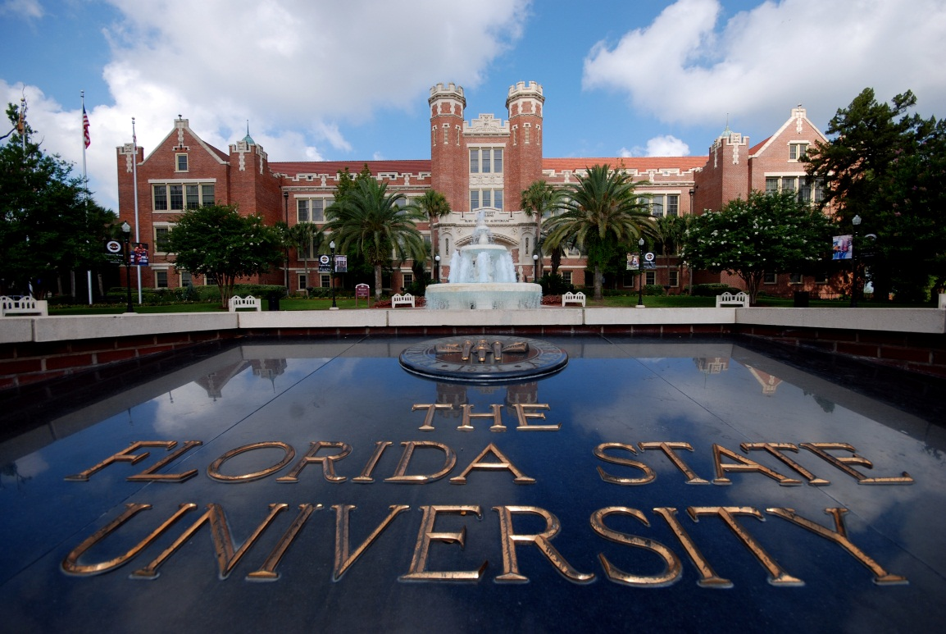
Tom Jennings, Ph.D. Vice President for University Advancement and President, FSU Foundation
FLORIDA STATE UNIVERSITY

Slide 3
6th annual
36 hour online giving campaign
9:00 am Thursday – 9:00 pm Friday
Connect with #FSUGreatGive
Greatgive.fsu.edu
Featured projects highlighted on SparkFSU
Notes:
Office of University Advancement:
FSU Foundation, which focuses on fundraising for the University’s academic programs;
Seminole Boosters, which supports athletics and student athletes;
The FSU Alumni Association, which focuses its efforts on “friend-raising”;
John and Mable Ringling Museum of Art Foundation in Sarasota; and
The FSU Real Estate Foundation, charged with accepting gifts of property.
What is a DSO and how is it established?
To create a DSO, the University President recommends to the Board of Trustees that an organization that meets the requirements of Florida Statute 1004.28 be designated a Florida State University Direct Support Organization.
The DSO’s sole purpose is to support the mission of the University by providing resources.
The goal of the Office of University Advancement is to provide oversight for the DSOs and, by working together, develop a University-wide strategy for all advancement efforts.
The Foundation Board is a good example of how each of our DSOs work collaboratively, as we have representatives from each of our DSOs.
Five of the University’s 13 DSOs report to University Advancement.

Slide 4
Online/Credit Card gifts focus
Also OK to Phone with C/C, send Check or sign up for Payroll deduction (by 3/31)
Gifts support academic programs, scholarships, and student activities
Notes:
Office of University Advancement:
FSU Foundation, which focuses on fundraising for the University’s academic programs;
Seminole Boosters, which supports athletics and student athletes;
The FSU Alumni Association, which focuses its efforts on “friend-raising”;
John and Mable Ringling Museum of Art Foundation in Sarasota; and
The FSU Real Estate Foundation, charged with accepting gifts of property.
What is a DSO and how is it established?
To create a DSO, the University President recommends to the Board of Trustees that an organization that meets the requirements of Florida Statute 1004.28 be designated a Florida State University Direct Support Organization.
The DSO’s sole purpose is to support the mission of the University by providing resources.
The goal of the Office of University Advancement is to provide oversight for the DSOs and, by working together, develop a University-wide strategy for all advancement efforts.
The Foundation Board is a good example of how each of our DSOs work collaboratively, as we have representatives from each of our DSOs.
Five of the University’s 13 DSOs report to University Advancement.

Slide 5
Marketing:
F/S will receive postcard in mailbox today/tomorrow
Eblast/Important Announcement Thursday and Friday
Signage and tabling events on campus
Social Media—Retweet/Repost
Notes:
Office of University Advancement:
FSU Foundation, which focuses on fundraising for the University’s academic programs;
Seminole Boosters, which supports athletics and student athletes;
The FSU Alumni Association, which focuses its efforts on “friend-raising”;
John and Mable Ringling Museum of Art Foundation in Sarasota; and
The FSU Real Estate Foundation, charged with accepting gifts of property.
What is a DSO and how is it established?
To create a DSO, the University President recommends to the Board of Trustees that an organization that meets the requirements of Florida Statute 1004.28 be designated a Florida State University Direct Support Organization.
The DSO’s sole purpose is to support the mission of the University by providing resources.
The goal of the Office of University Advancement is to provide oversight for the DSOs and, by working together, develop a University-wide strategy for all advancement efforts.
The Foundation Board is a good example of how each of our DSOs work collaboratively, as we have representatives from each of our DSOs.
Five of the University’s 13 DSOs report to University Advancement.

Slide 6
2016 FSU’s Great Give:
Raised $208,549
28% increase over year prior
1729 donors
40% increase over year prior
F/S giving was 23.2% of total
$48,477 total
Notes:
Office of University Advancement:
FSU Foundation, which focuses on fundraising for the University’s academic programs;
Seminole Boosters, which supports athletics and student athletes;
The FSU Alumni Association, which focuses its efforts on “friend-raising”;
John and Mable Ringling Museum of Art Foundation in Sarasota; and
The FSU Real Estate Foundation, charged with accepting gifts of property.
What is a DSO and how is it established?
To create a DSO, the University President recommends to the Board of Trustees that an organization that meets the requirements of Florida Statute 1004.28 be designated a Florida State University Direct Support Organization.
The DSO’s sole purpose is to support the mission of the University by providing resources.
The goal of the Office of University Advancement is to provide oversight for the DSOs and, by working together, develop a University-wide strategy for all advancement efforts.
The Foundation Board is a good example of how each of our DSOs work collaboratively, as we have representatives from each of our DSOs.
Five of the University’s 13 DSOs report to University Advancement.

Slide 8
Raise the Torch Overview
July 1, 2010-June 30, 2018
Goal $1 billion
Advancement DSOs:
FSU Foundation, Seminole Boosters, Alumni Association, Real Estate Foundation
Other Fundraising Entities
Ringling Museum, Research Foundation
Notes:
Office of University Advancement:
FSU Foundation, which focuses on fundraising for the University’s academic programs;
Seminole Boosters, which supports athletics and student athletes;
The FSU Alumni Association, which focuses its efforts on “friend-raising”;
John and Mable Ringling Museum of Art Foundation in Sarasota; and
The FSU Real Estate Foundation, charged with accepting gifts of property.
What is a DSO and how is it established?
To create a DSO, the University President recommends to the Board of Trustees that an organization that meets the requirements of Florida Statute 1004.28 be designated a Florida State University Direct Support Organization.
The DSO’s sole purpose is to support the mission of the University by providing resources.
The goal of the Office of University Advancement is to provide oversight for the DSOs and, by working together, develop a University-wide strategy for all advancement efforts.
The Foundation Board is a good example of how each of our DSOs work collaboratively, as we have representatives from each of our DSOs.
Five of the University’s 13 DSOs report to University Advancement.

Slide 9
Campaign Timeline and Goal
Campaign total as of 9/30/16:
$938,972,249
% of campaign goal: 94%
% of time elapsed: 78%
Campaign Timeline: July 2010 – June 2018
Notes:
Through June 18th remember

Slide 10
Campaign Timeline and Goal
Campaign total as of 3/27/17:
$???,???,???
% of campaign goal: ??%
% of time elapsed: 84%
Campaign Timeline: July 2010 – June 2018
Notes:
Through June 18th remember

Slide 11
Campaign Progress
Notes:
Office of University Advancement:
FSU Foundation, which focuses on fundraising for the University’s academic programs;
Seminole Boosters, which supports athletics and student athletes;
The FSU Alumni Association, which focuses its efforts on “friend-raising”;
John and Mable Ringling Museum of Art Foundation in Sarasota; and
The FSU Real Estate Foundation, charged with accepting gifts of property.
What is a DSO and how is it established?
To create a DSO, the University President recommends to the Board of Trustees that an organization that meets the requirements of Florida Statute 1004.28 be designated a Florida State University Direct Support Organization.
The DSO’s sole purpose is to support the mission of the University by providing resources.
The goal of the Office of University Advancement is to provide oversight for the DSOs and, by working together, develop a University-wide strategy for all advancement efforts.
The Foundation Board is a good example of how each of our DSOs work collaboratively, as we have representatives from each of our DSOs.
Five of the University’s 13 DSOs report to University Advancement.

Slide 12
The Finish Line is in Sight…
Dec. 2015: $100 million gift commitment Spring 2016: Explored idea of raising goal
Fall 2016: Stopped messaging $$ total
Spring 2017: Will achieve billion dollar goal; Focus marketing on 2 priorities; Continue unit fundraising
June 2018: Campaign ends
Sept. 2018: Campaign Celebration
Notes:
Office of University Advancement:
FSU Foundation, which focuses on fundraising for the University’s academic programs;
Seminole Boosters, which supports athletics and student athletes;
The FSU Alumni Association, which focuses its efforts on “friend-raising”;
John and Mable Ringling Museum of Art Foundation in Sarasota; and
The FSU Real Estate Foundation, charged with accepting gifts of property.
What is a DSO and how is it established?
To create a DSO, the University President recommends to the Board of Trustees that an organization that meets the requirements of Florida Statute 1004.28 be designated a Florida State University Direct Support Organization.
The DSO’s sole purpose is to support the mission of the University by providing resources.
The goal of the Office of University Advancement is to provide oversight for the DSOs and, by working together, develop a University-wide strategy for all advancement efforts.
The Foundation Board is a good example of how each of our DSOs work collaboratively, as we have representatives from each of our DSOs.
Five of the University’s 13 DSOs report to University Advancement.

Slide 13
Florida Universities: 2016 contributions (Cash or Cash Equivalents)
Florida $244 million
Miami $236 million
FSU $75 million
USF $45 million
FIU $28 million
UCF $22 million
Source: the Council for Aid to Education

Slide 14
University Advancement
Standard review of Naming Policy
Successful database security testing
Synchronizing disbursement process with OMNI
Annual DSO Staff Training featuring nationally recognized non-verbal communications expert, Dr. Jack Brown.
COLLEGETOWN
16

Slide 15
FSU Foundation
Mailed 995 Endowment Reports to Donors
Cambridge & Associates retained as
Investment Council
Recent Donor Events:
Naples, JAX, Coral Gables, & Ft. Lauderdale
February 23 - Westcott Society Luncheon
March 24-25 - Women for FSU’s “Backstage Pass”
March 30-31 – “Great Give”
COLLEGETOWN
16

Slide 16
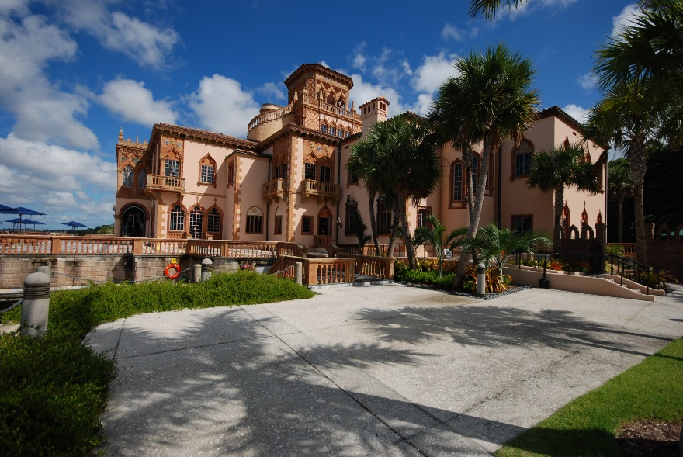
Real Estate Foundation
New Staff Position to focus on donor solicitations and securing gifts of real estate.
Acquired key properties at College/Copeland
Continue to refine and enhance Southwest District Plan
Ongoing due diligence of strategic properties
COLLEGETOWN
16

Slide 17
Seminole Boosters
Fundraising
Exceeded campaign goal with over $300M in gifts and pledges
Very Successful FY 16
March 17 Ticket Priority Deadline
April 7-9 FSU Spring Weekend/Board Meeting
Spring Tour Dates: March 11-June 3rd
Throughout Florida + NYC and Louisville
COLLEGETOWN
16

Slide 18
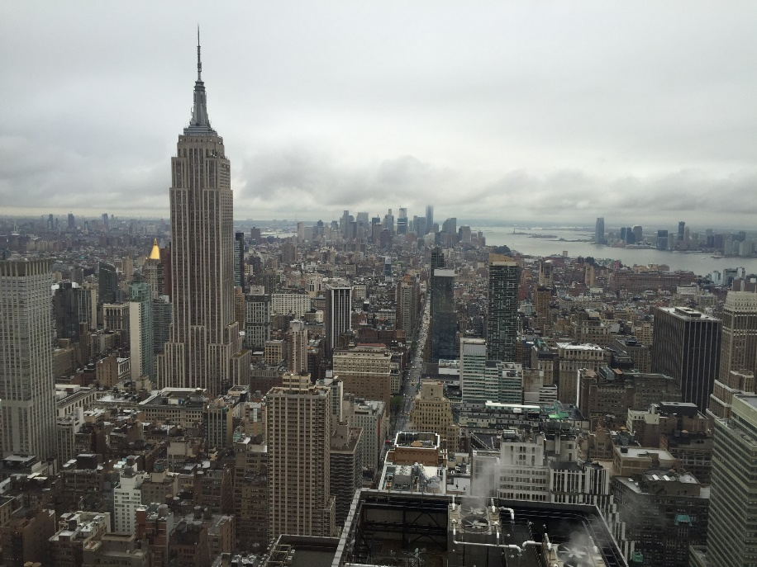
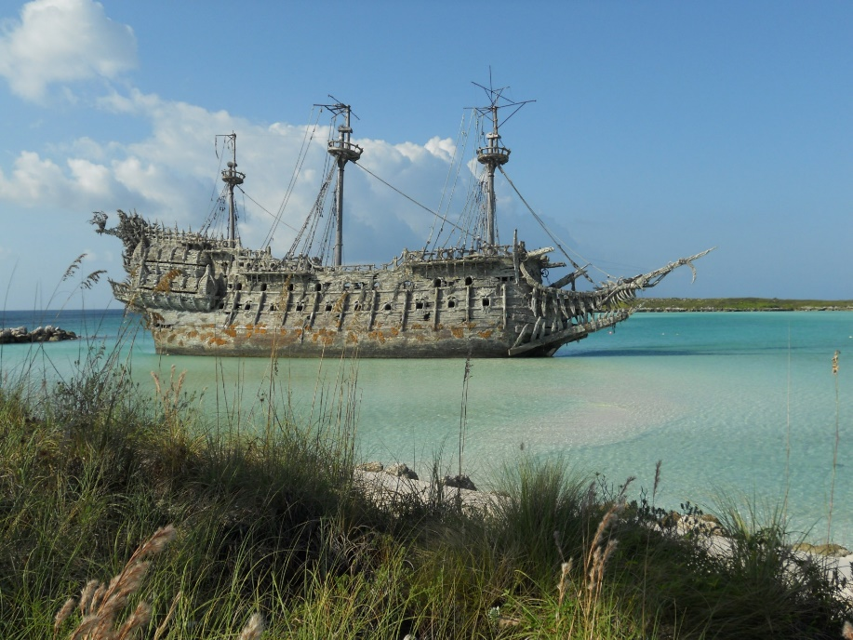
FSU Alumni Association
March 14-16 Nole Networking
April 6-8 Leadership Conference
April 12 Circle of Gold-FSU First Ladies
May 11 NYC event
Oct 27-30 Seminoles at Sea
COLLEGETOWN
16

Slide 19
Grand Award for Fundraising Publications
Raise the Torch spring newsletter
Award of Excellence for External Relations Engagement Program
Vires, Artes, Mores recognition society

Slide 20
Tax laws-Possible Changes
Proposed Changes to Charitable Deductions on IRS Individual Tax Forms
Proposed Elimination of Estate Tax
Congressional Scrutiny of Endowments
Deductibility of Gifts for Athletics

Slide 21
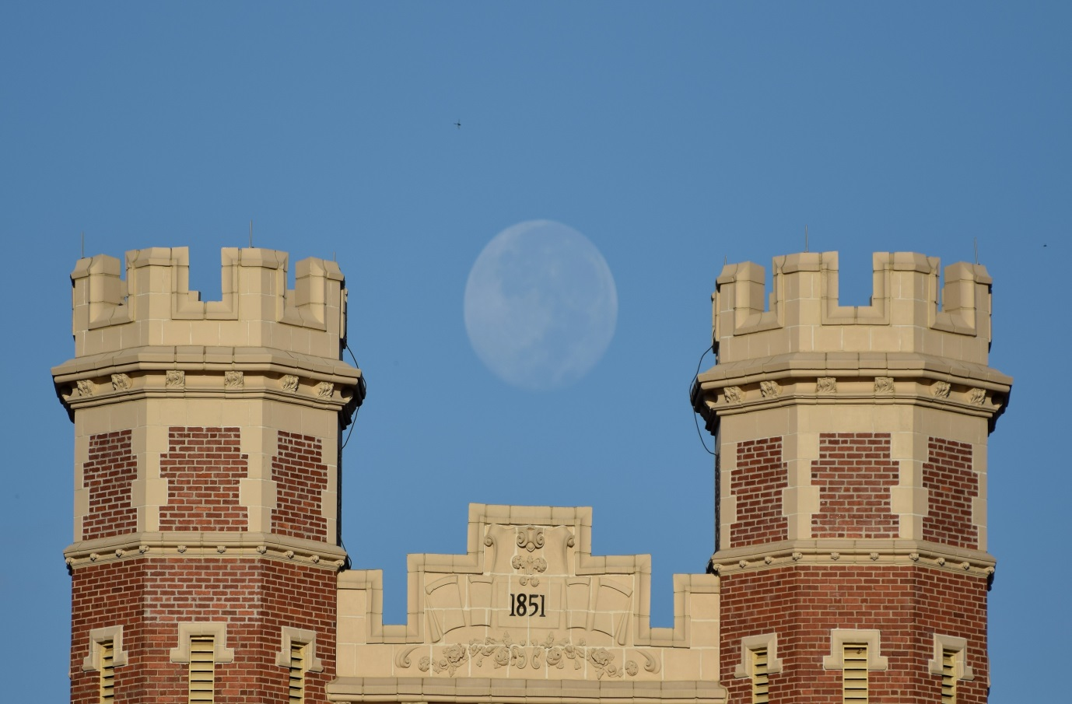
Tom Jennings, Ph.D. Vice President for University Advancement and President, FSU Foundation
THE FLORIDA STATE UNIVERSITY

