Slide 1
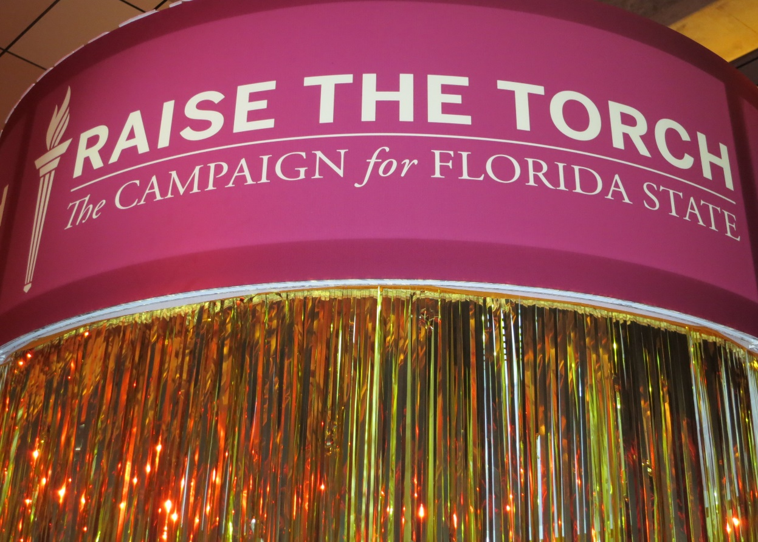
Tom Jennings, Ph.D. Vice President for University Advancement and President, FSU Foundation
FLORIDA STATE UNIVERSITY

Slide 2
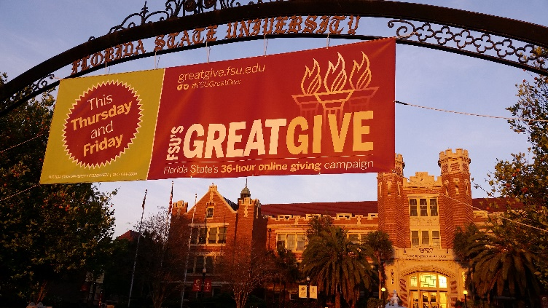
The Finish Line is in Sight
FY2017-18 Campaign priorities:
CARE Program
Faculty Endowment Support
College/Unit Initiatives
June 30, 2018 - Campaign Ends
Sept 21. 2018 - Campaign Celebration
Notes:
Office of University Advancement:
FSU Foundation, which focuses on fundraising for the University’s academic programs;
Seminole Boosters, which supports athletics and student athletes;
The FSU Alumni Association, which focuses its efforts on “friend-raising”;
John and Mable Ringling Museum of Art Foundation in Sarasota; and
The FSU Real Estate Foundation, charged with accepting gifts of property.
What is a DSO and how is it established?
To create a DSO, the University President recommends to the Board of Trustees that an organization that meets the requirements of Florida Statute 1004.28 be designated a Florida State University Direct Support Organization.
The DSO’s sole purpose is to support the mission of the University by providing resources.
The goal of the Office of University Advancement is to provide oversight for the DSOs and, by working together, develop a University-wide strategy for all advancement efforts.
The Foundation Board is a good example of how each of our DSOs work collaboratively, as we have representatives from each of our DSOs.
Five of the University’s 13 DSOs report to University Advancement.

Slide 3
2017 Fundraising Performance
$128 million in gifts and pledges:
FSU Foundation $65.9 million
Seminole Boosters $50.7 million
Research Foundation $7.2 million
Ringling Foundation $2.4 million
Real Estate Foundation $1.3 million
Alumni Association $.7 million
Notes:
Through June 18th remember

Slide 4
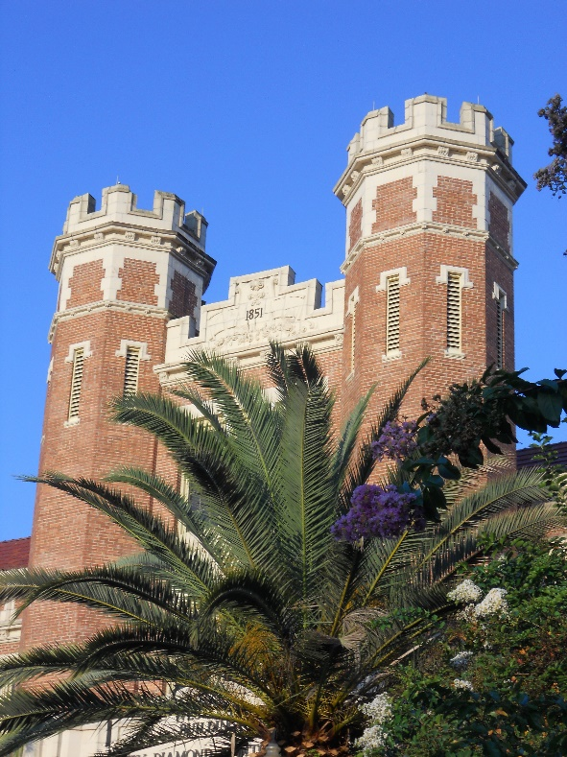
Campaign Annual Totals
FY11 $94M
FY12 $91M
FY13 $99M
FY14 $108M
FY15 $115M
FY16 $225M
FY17 $128M
Notes:
Through June 18th remember

Slide 5
Alumni Giving Rates for 2016-17*
FSU 19.5%
Miami 13.8%
UF 11.6%
USF 9.9 %
UCF 7.5%
FAMU 6.1%
FIU 4.1%
UWF 3.9%
FAU 3.0%
*2-year average; #9 nationally among publics
Notes:
Through June 18th remember

Slide 6
Alumni Giving – Top 40 Public
Institution with Ranking | Alumni Giving
10 - University of Wisconsin-Madison (Madison, WI) | $108,828,870
27 - Texas A&M University (College Station, TX) | $97,465,521
1 - University of California-Berkeley (Berkeley, CA) | $95,699,932
18 - University of Texas at Austin (Austin, TX) | $87,018,572
2 - University of California-Los Angeles (Los Angeles, CA) | $78,200,642
16 - University of Washington (Seattle, WA) | $72,760,771
5 - University of North Carolina at Chapel Hill (Chapel Hill, NC) | $72,212,478
16 - Ohio State University (Columbus, OH) | $70,752,777
2 - University of Virginia-Main Campus (Charlottesville, VA) | $65,764,874
33 - University of Iowa (Iowa City, IA) | $65,476,583
33 - Michigan State University (East Lansing, MI) | $62,780,509
14 - University of Florida (Gainesville, FL) 20 - Purdue University (West Lafayette, IN) | $62,025,092 $49,826,680
38 - North Carolina State University at Raleigh (Raleigh, NC) | $49,401,905
27 - Virginia Polytechnic Institute and State University (Blacksburg, VA) | $42,008,277
10 - University of Illinois at Urbana-Champaign (Champaign, IL) | $39,536,135
18 - University of Georgia (Athens, GA) | $39,535,113
20 - University of Maryland-College Park (College Park, MD) | $36,232,953
24 - University of Pittsburgh-Pittsburgh Campus (Pittsburgh, PA) | $35,400,490
7 - Georgia Institute of Technology-Main Campus (Atlanta, GA) | $33,790,455
6 - College of William and Mary (Williamsburg, VA) | $30,730,633
38 - Florida State University (Tallahassee, FL) | $25,762,995
30 - Miami University-Oxford (Oxford, OH) | $18,314,641
23 - Clemson University (Clemson, SC) | $15,421,806
20 - University of Connecticut (Storrs, CT) | $12,084,234
8 - University of California-Santa Barbara (Santa Barbara, CA) | $7,911,353
27 - University of Massachusetts Amherst (Amherst, MA) | $7,794,269
38 - University of Vermont (Burlington, VT) | $7,453,177
30 - University of Delaware (Newark, DE) | $7,414,826
33 - Colorado School of Mines (Golden, CO) | $6,815,719
10 - University of California-Davis (Davis, CA) | $6,123,956
10 - University of California-San Diego (La Jolla, CA) | $3,526,214
36 - SUNY at Binghamton University (Binghamton, NY) | $2,802,187
9 - University of California-Irvine (Irvine, CA) | $2,512,971
30 - University of California-Santa Cruz (Santa Cruz, CA) | $1,958,656

Slide 7
Endowment per FTE Student Top 40 Public Universities
Institution | Per FTE Student
2 - University of Virginia-Main Campus (Charlottesville, VA) | $251,788
18 - University of Texas at Austin (Austin, TX) | $234,176
24 - University of Pittsburgh-Pittsburgh Campus (Pittsburgh, PA) | $108,406
5 - University of North Carolina at Chapel Hill (Chapel Hill, NC) | $105,385
1 - University of California-Berkeley (Berkeley, CA) | $103,398
6 - College of William and Mary (Williamsburg, VA) | $99,246
2 - University of California-Los Angeles (Los Angeles, CA) | $90,249
27 - Texas A&M University (College Station, TX) | $89,140
7 - Georgia Institute of Technology-Main Campus (Atlanta, GA) | $82,918
10 - University of Wisconsin-Madison (Madison, WI) | $70,553
30 - University of Delaware (Newark, DE) | $60,844
33 - Michigan State University (East Lansing, MI) | $58,872
16 - University of Washington (Seattle, WA) | $53,035
33 - University of Iowa (Iowa City, IA) | $45,111
14 - University of Florida (Gainesville, FL) | $44,229
33 - Colorado School of Mines (Golden, CO) | $43,966
20 - Purdue University (West Lafayette, IN) | $39,927
38 - University of Vermont (Burlington, VT) | $39,398
38 - North Carolina State University at Raleigh (Raleigh, NC) | $35,429
10 - University of California-San Diego (La Jolla, CA) | $35,383
10 - University of Illinois at Urbana-Champaign (Champaign, IL) | $32,503
18 - University of Georgia (Athens, GA) | $29,295
16 - Ohio State University (Columbus, OH) | $29,036
23 - Clemson University (Clemson, SC) | $28,692
10 - University of California-Davis (Davis, CA) | $27,613
27 - Virginia Tech (Blacksburg, VA) | $26,949
30 - Miami University-Oxford (Oxford, OH) | $20,634
9 - University of California-Irvine (Irvine, CA) | $15,956
38 - Florida State University (Tallahassee, FL) | $15,817
20 - University of Maryland-College Park (College Park, MD) | $14,163
20 - University of Connecticut (Storrs, CT) | $13,088
8 - University of California-Santa Barbara (Santa Barbara, CA) | $11,993
27 - University of Massachusetts Amherst (Amherst, MA) | $11,225
30 - University of California-Santa Cruz (Santa Cruz, CA) | $9,189
36 - SUNY at Binghamton University (Binghamton, NY) | $7,505

Slide 8
FSU Foundation
FY2017 Highlights:
Planning for New Building on College Avenue
Increased number of donor visits by 85%
Forwarded $43M in private support to FSU
Predictive Modeling Project
Endowment return: 11.9%
Foundation Board nominations due Nov. 10
COLLEGETOWN
16

Slide 9
FSU Alumni Association
“Moonshot” Initiative – Goal to Increase Alumni Membership from 7% to 10% of FSU Alumni.
Major Events:
Inspire Award-FSU Women of Distinction-Tampa
66th Annual Kickoff Luncheon
Circle of Gold Induction Dinner - October 6
Seminoles at Sea - October 27-30
Young Alumni Awards Dinner - November 3
Homecoming & Emeritus Reunion Nov. 17-19
COLLEGETOWN
16

Slide 10
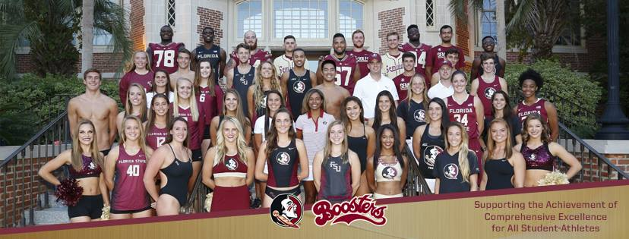
Seminole Boosters
Staff Changes/Additions
Fundraising Priorities:
Annual Fund
Phase II Basketball Improvements
Jack Nicklaus designed Golf Course
Student-Athlete Scholarships
Scoreboards for Softball, Soccer, Track, Tennis, Beach Volleyball and Swimming & Diving
Communications Center for ACC Network
Dick Howser Stadium ticket office pavilion, grandstand and lights
Softball dugout adjustment; grandstands; awnings; batting cage roof extension
Football Operations Bldg/Moore Center refurbishment (feasibility study in progress)
COLLEGETOWN
16

Slide 11
FSU Real Estate Foundation
Gateway District Concept Approved
Staff changes/additions
Recent Key Acquisitions:
Lynn Haven property
O’Connell Property – College of Business site
Campus Christian Fellowship Building
COLLEGETOWN
16

Slide 12
264
12

Slide 13
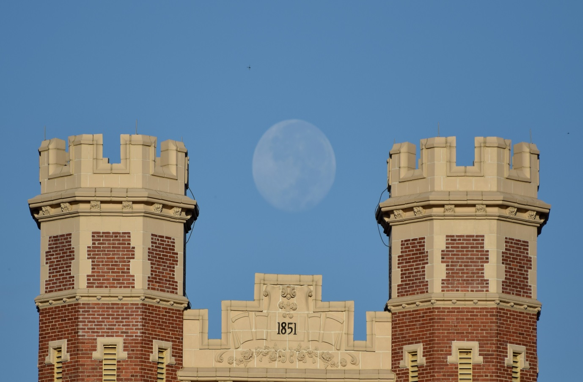
Tom Jennings, Ph.D. Vice President for University Advancement and President, FSU Foundation
FLORIDA STATE UNIVERSITY

