Slide 1


New Faculty Orientation:
Fall 2023
Joshua Morgan & Katie-Dean Moore
Office of the Vice President for Faculty Development and Advancement
Audio is available on each slide in the upper right-hand corner

Slide 2
Academic Integrity at FSU
Educational & non–adversarial process
FDA helps to resolve allegations/misconduct
Due process is essential
  Option A: Informal, educational resolution
    Option A may not involve a misconduct grade penalty!
  Option B: Formal escalation to FDA
    Option B may involve a grade penalty
    Still be educational & consider remediation resources
Students may not drop/withdraw from/change the grading basis of course when misconduct has been alleged
Notes:
Grade penalties may not be applied in cases of alleged academic dishonesty unless they are implemented via a formal process. This protects the instructor from grade appeals and litigiousness grounded in failing to adhere to University policy.
Instructors reserve the right to listen to a student's explanation, weigh the preponderance of evidence, and determine whether an informal warning is more educational than pursuing formal allegations.
In such cases, you can implement a re–do of the assignment within a specified deadline; based on the student's re–submission, a grade can then be given (with no penalties; just a routine evaluation of the work based on assignment parameters/rubrics/learning objectives).

Slide 3
How FDA Helps
Consulting with instructors
Checking for prior violations
Prompting students to respond to allegations
Troubleshooting online/digital exam breaches
Enforcing policy & sanction accountability
Notes:
Mention holds, records audits, & reinstating in courses (i.e., no drops/withdrawals/changing grading basis of course)

Slide 4
Academic Honor Policy
Faculty are responsible for prioritizing integrity
Setting behavioral expectations
Designing/revising courses to prioritize integrity
Consulting about distance–learning best practices
Auditing assessments for efficacy & any breaches
Implementing the policy consistently (not arbitrarily)
Location of all documents, forms, & guides:
  https://fda.fsu.edu/academic-resources/academic-integrity-and-grievances/academic-honor-policy

Slide 5
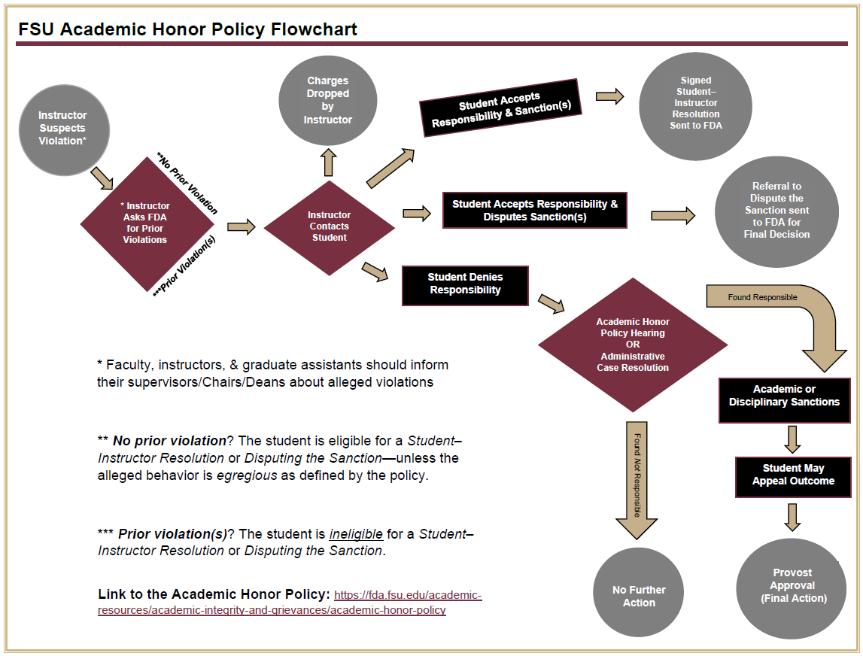

Slide 6
Allegation Discussions with Students:
Best Practices
Discuss via recorded Zooms or email
Share relevant evidence with students
Allow 5 class days to choose a resolution
Enter “Incomplete” or “I” final grades when cases are unresolved between semesters; this is important for due process!
Graduate assistants: Must consult instructors of record regarding incident management

Slide 7
Resolving Allegations
Remember: Be educational & non–adversarial as you emphasize accountability
Student–Instructor Resolution (S.I.R.)
Student admits to misconduct; accepts the instructor’s sanctions
AHP Hearing
Student denies misconduct or has a prior violation; instructor presents the case before a students & faculty panel
Disputing the Sanction (D.T.S.)
Student admits to misconduct but does not accept the proposed sanction; OFDA reviews the case & issues a final decision
Administrative Case Resolution (A.C.R.)
Student’s case is straightforward (based on the evidence) and/or the student admits to misconduct—yet they are ineligible for both SIR & DTS options; ACR expedites the process in lieu of a hearing
Important Note: AHP hearings are also used when alleged behavior is egregious (egregiousness is defined by the policy, not by instructors’ individual perceptions)

Slide 8
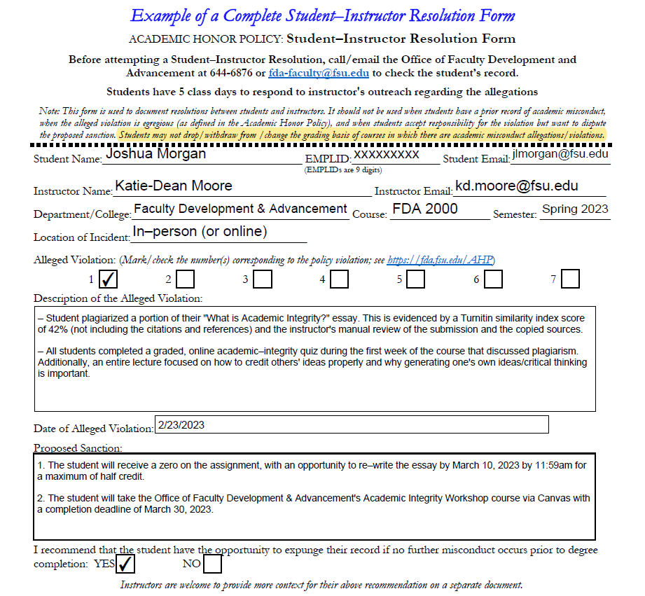
Refers to Charge #1: Plagiarism,
not the number of violations!
Notice the contextual detail & prevention methods that support the allegations
Redemption opportunities & educational sanctions may be offered
Early expungement is only available to students with a single offense!

Slide 9

Prevention:
Course Design
Week 1: Mandatory Syllabus/Integrity Quiz
Set expectations early
Encourage accountability
Provide Frequent, Low–Stakes Assessments
  Foster mastery & self–efficacy
  Reduce performance anxiety
  Enhance capacity to appreciate the subject
Grade Major & Minor Milestones (i.e., Scaffold)
Review annotated bibliographies
Consult about topic narrowing & thesis writing
Reward polished drafts that show growth
Implement Distance–Learning Best Practices
Randomize question–bank items & question order
Present one exam question at a time
Restrict post–exam viewing of correct answers
Convey Relevance Regularly
“Why is this important?”
“How does this relate personally?”
“What current events are teachable moments?”
Administer Brief Exam Access
  Ideally, only 1-2 days of exam access
  Limit their exam time within reason
  Unless otherwise accommodated…
Diversify Assessment Formats & Types
  Allow open–note/open–book exams
  Create select–all–that–apply questions
  Partial credit for partial correctness
  Use audio–visual software (e.g., Zoom) to facilitate oral exams, quizzes, & interviews
  Revise assessments to gauge procedural knowledge for job scenarios
Notes:
Proactive2-1000x550.jpg (1000×550) (compexit.co.uk)

Slide 10
Prevention: Dialogue
Encourage Proactive Communication
e.g., timely notice regarding illness, environmental concerns, accommodations, grief/loss, mental health considerations, etc.
Prepare Students to Verify Claims
Set expectations about doctors’ notes and the stipulations for excused absences in your 1st day lectures, syllabi, & Canvas announcements
Email FDA to Facilitate an AHP Presentation
Especially if you need an alternate lecture or if class was going to be cancelled for some reason
Be Approachable, Empathetic, & Professional
Students often struggle to exercise their new freedoms responsibly…
Remember: Educational sanctions address ethical decision making; harsh grade penalties alone do not always teach the intended lessons…

Slide 11

Resources
The Academic Honor Policy Webpage
FSU Libraries Citation Guides
FSU Libraries Technology Rentals
FSU English Dept.’ Plagiarism Activities
iThenticate
GPTZero: https://gptzero.me/
ZeroGPT: https://www.zerogpt.com/
Writer: https://writer.com/ai-content-detector/
Content at Scale:https://contentatscale.ai/ai-
content-detector/

Slide 12


Questions?
Email jlmorgan@fsu.edu & kd.moore@fsu.edu
  Thank you!

