Slide 1
2024-2025 Promotion & Tenure Staff Review
Melissa Crawford, Faculty Administrator
Office of Faculty Development & Advancement
April 10, 2024

Slide 2
What will we discuss?
Generating and Preparing the eBinder
Organizing the eBinder – What’s new this year? (Nothing ☺)
Online system refresher - how to navigate the online system on behalf of the candidate.

Slide 3
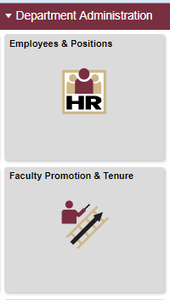
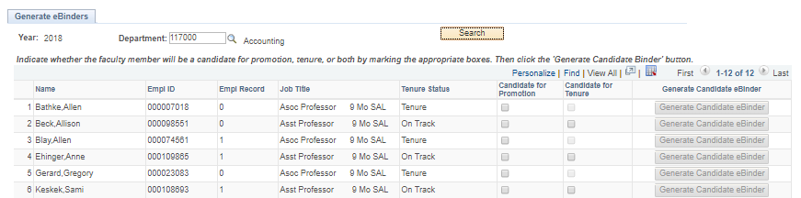
Generating and Preparing the eBinder
Only the department/school or college delegate can generate the eBinder.
Once generated the candidate and delegate can upload materials.
Department Administration -> Faculty Promotion and Tenure -> Generate Candidate eBinder -> Search for Department and press Search.

Slide 4
Preparing the eBinder
Before generating any eBinders, ask your department chair or dean who will be going up this year.
Please go ahead and create eBinders for your faculty as soon as you know they are going up.
Details are in the P&T memo and the Staff Quick Start Guide on the FDA website
https://fda.fsu.edu/faculty-development/promotion-and-tenure
The candidate, the department chair or dean and the delegate can and should participate in the process of building the eBinder.
Candidates can upload their own materials (except for the outside letters) or you can upload materials for them. Talk to your candidates before you upload anything.

Slide 5
How do I get to my eBinders?
OMNI-HR to Department Administration to Faculty Promotion & Tenure
Click on Prepare/Update eBinder
All eBinders in your department and/or college will appear.
You may filter by department or status as well.

Slide 6
Organizing the eBinder (RED, candidate responsibility)
Section 1: Summary Cover Sheets
Includes votes for promotion and tenure
Early tenure agreements
Agreements to adjust tenure status
Staff or candidate will “submit” eBinder and the delegate will then review it and click “submit” again.
Candidate and chair/dean will electronically sign (click submit) to signal that they have reviewed the contents of the eBinder.
Negative Reasons for promotion/tenure (2021)

Slide 7
Organizing the eBinder (RED, candidate responsibility)
Section 2: General Information
Chair’s and/or Dean’s Letters
Interdisciplinary Letter (if applicable)
Response to these letters (if applicable)
SIGNED Department and College Summaries
SIGNED Tenured Faculty Summary (if applicable)
Outside Letters and coversheets
CV from FEAS+ (finalized, should not say DRAFT at the top) (See FEAS+ and ORCID handout.)
In Press Acceptances (no conditional acceptances)

Slide 8
Organizing the eBinder (RED, candidate responsibility
Section 3: Evidence of Achievement
Major accomplishments (1 page limit)
Discussion of teaching, research and service (6 pages limit)
SPCI reports (from FEAS+)
Sample Syllabi
Scholarly or Creative Works (PDF only)
Section 4: Evaluative Materials
SIGNED annual evaluation forms (no narratives)
3rd or 2nd and/or 4th year reviews (summary narrative)(next slide)
Progress towards promotion and/or tenure letters

Slide 9
3rd Year Reviews
Assistant Professors hired July 1, 2019 or later shall receive a tenure review in their third year.
Assistant Professors hired before July 1, 2019 and who have not yet had a 2nd-year review may choose between a 2nd and 4th year set of reviews or a 3rd year review.
Assistant Professors hired before July 1, 2019 and who have already had a 2nd year review shall have a 4th year review.

Slide 10
Organizing the eBinder (RED, candidate responsibility)
Section 5: Late Additions (optional)
Proof of article accepted for publication
Documentation of a new grant approval
Documentation that a creative activity has been accepted for viewing
Only delegates and FDA can upload into this section
Late additions can be added up until eBinders go to University P&T Committee for review.

Slide 11
Common Mistakes
Must be a finalized and unaltered CV from FEAS. Should not say DRAFT at the top.
CV missing one-sentence description of each published work since employment at FSU, or since last promotion at FSU.
CV missing co-authors.
In-press acceptances not actually saying the work was accepted (no conditional acceptances).
Three years only for:
Courses taught (except in rare circumstances)
Student responses to SPCI #13
SPCI summary forms (from FEAS+)
All assistant and associate professors should have annual progress towards promotion and/or tenure letters.
All summaries from committee votes must be signed.
All annual evaluation forms must have complete signatures. (see next slide)

Slide 12
Common Mistakes – Annual Evaluation Forms

Slide 13
Clarifications
Abstentions are limited to situations involving real or perceived conflicts of interest (familial relations or substantial professional or financial entanglements that prevent judging the candidate objectively). All abstentions should be subtracted from the number of eligible voting faculty on the Summary Cover Sheets.
Absences from campus that result in a failure to ballot during the review process should be recorded as “absent,” not as an “abstention.”

Slide 14
Staff Quick Start Guide…
has instructions on how to generate/create an eBinder and
has instructions on how to help candidates prepare or update their eBinder.
If you are a new delegate for this year, please let me know. If I get any requests, I can hold another interactive training/refresher for delegates this summer.

Slide 15
Sample eBinders
If you want to be added to the “Promotion and Tenure Sample Binder” Canvas organization site, please send an email with your FSUID to mucrawford@fsu.edu.

Slide 16
Questions?
Melissa Crawford – mucrawford@fsu.edu
http://fda.fsu.edu/faculty-development/promotion-and-tenure
FEAS+/ORCID Questions
Tiffany Phillips – tphillips@fsu.edu
https://feas.fsu.edu
https://orcid.fsu.edu/

