Slide 1
Preview of FSU’s Next Comprehensive Campaign
Marla Vickers, ’00, MBA, CFRE Vice President of University Advancement

Slide 2
FY24 Fundraising Totals (as of 3/29/24)
DSO | PREVIOUS FISCAL YEAR TO DATE 2023 | FISCAL YEAR TO DATE 2024
FSU Foundation | $53,645,258 | $41,544,751
Alumni Association | $517,726 | $242,598
Seminole Boosters | $49,205,979 | $49,766,969
Research Foundation | $1,084,832 | $2,259,414
The John and Mable Ringling Museum of Art | $1,998,911 | $2,557,931
TOTAL | $106,452,705 | $96,371,664
Notes:
Fundraising Numbers as of 3/29/24
Likelihood Percentages to close FY24
100% likelihood - $2,496,377.89
80% Likelihood - $29,476,447.30
60% Likelihood - $48,304,500.00
40% Likelihood - $12,525,500.00
20% Likelihood - $13,395,000.00
Total - $106,277,825.19

Slide 3
Comprehensive Campaign
Comprehensive Campaign = One university-wide campaign, encompassing fundraising priorities across all of FSU’s colleges, schools and units + athletics
Academics, Seminole Boosters and The Ringling are unified and coordinated in their approach
We work as one Advancement team to achieve FSU’s campaign fundraising and engagement goal!

Slide 4
Campaign Timeline
2024
2025
2026
2027
2028
2029
2030
2031
2032
J | F | M | A | M | J | J | A | S | O | N | D
J | F | M | A | M | J | J | A | S | O | N | D
Leadership Giving “Silent” Phase 7/1/2024–6/30/2028
Inclusive of campaign reach-backs of $50K+ from 7/1/2018-6/30/2024 (FY19-FY24)
Community Phase 07/01/2028–06/30/2032
Leadership Briefings & Feasibility Study 03/01/2024–05/31/2024
FSU “Comes to You” Presidential Gatherings, In-State and Regional Events
Campaign Community Engagement Regional Community Celebrations, Volunteer Cabinet, etc.
Public Launch Celebration
Closing Campaign Celebration
Launch of
Campaign Planning Taskforce
Volunteer Trainings Developed Cabinet Trainings Begin
Volunteer Trainings Pre-Launch Celebration
Volunteer Training Modules for Community Phase
Announce current fundraising totals after the Leadership Giving “Silent” Phase.

Slide 5
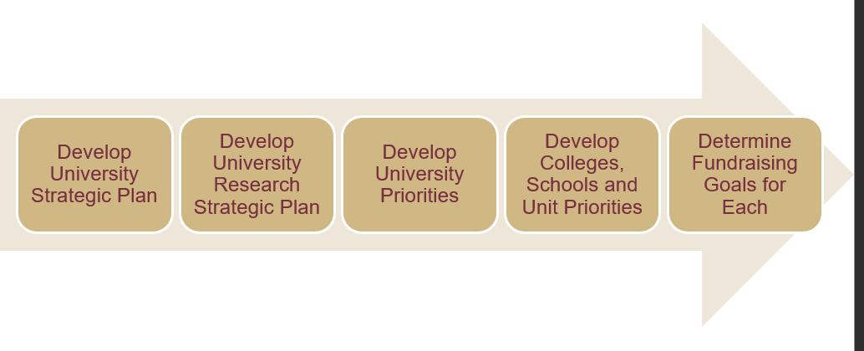
Campaign Planning

Slide 6
Campaign Priority-Setting
University Priority One
University Priority Three
Athletics
University Priority Two
University Libraries
College of Arts and Sciences
College of Business
College of Communication and Information
College of Criminology and Criminal Justice
Dedman College of Hospitality
College of Education, Health and Human Sciences
FAMU-FSU College of Engineering
College of Fine Arts
The Graduate School
College of Nursing
Jim Moran College of Entrepreneurship
College of Law
College of Medicine
College of Motion Picture Arts
College of Music
College of Social Sciences & Public Policy
Panama City Campus
The John and Mable Ringling Museum of Art
Division of Undergraduate Studies
Athletics
Division of Student Affairs
Opening Nights
College of Social Work

Slide 7
Alumni Engagement Positions
5 alumni engagement positions embedded in the colleges/schools/units
College of Social Work
Division of Undergraduate Studies
College of Engineering
College of Education, Health, and Human Sciences
Music
2 more alumni engagement positions to post and hire
College of Fine Arts
College of Nursing
With these positions, we’re standardizing and operationalizing CASE best practices for alumni engagement and alumni engagement metrics.

Slide 8
Alumni Engagement
Philanthropic
Financial support that is meaningful to the donor and supports the institution’s mission and goals.
Experiential
Meaningful experiences that inspire alumni, are valued by the institution, promote its mission, celebrate its achievement, and strengthen reputation.
Volunteer
Formally defined and rewarding volunteer roles that are endorsed by and valued by the institution.
Communication
Interactive, meaningful and informative communication that supports the institution’s mission, strategic goals, and reputation.

Slide 9
Campaign Next Steps
April 2024 – June 2024
Finalization of University Priorities Finalization of Campaign Case Statement Conduct Campaign Feasibility Study Leadership Briefings with President McCullough 1:1 Donor Conversations with Huron (formerly GG+A) Broad-based Online Donor Survey with Huron Announce Campaign Planning Taskforce

Slide 10
What can YOU do?
Champion the campaign university priorities and your area’s campaign fundraising priorities
Identify key faculty within your college that can represent your area on the road to promote the campaign
Integrate your area’s campaign fundraising priorities into your area’s omnichannel messaging
Encourage faculty and staff giving within your college

Slide 11
Questions?
Thank You

