Slide 1
Update from the Provost
Deans and Department Chairs Meeting
October 17, 2023
Notes:
Good morning, everyone. I’m glad to see you all here today and spend some time together. I’d like to thank President McCullough for his updates and for his leadership.
Thank you to everyone here for all you are doing. We’re in the throes of a very busy semester, but it’s never been more exciting to be a Seminole and I so appreciate everything you do for your department, your college, and our university.

Slide 3
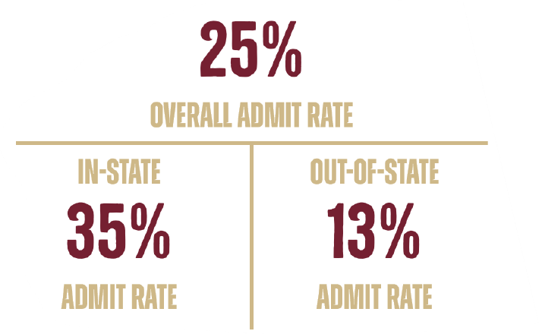
Student Success
2023 Application Numbers
74,500+ | Applied
18,000+ | Admitted
6,000+ | Enrollment

Slide 4
Student Success
ADMITTED STUDENT PROFILE
FALL 2023 | SUMMER 2023
GPA | GPA
4.3 – 4.6 | 4.1 – 4.5
SAT | SAT
1340 – 1450 | 1230 – 1320
ACT | ACT
29 – 33 | 26 – 30
*Represents the middle 50% of admitted students.

Slide 5
Rankings
53rd Among national universities (both public and private) Highest-ever USNWR ranking | 23rd Among national public universities According to new USNWR methodology | 11th Among top national public universities Online rankings platform NICHE
Notes:
Last month, U.S. News and World Report released their 2024 rankings.
As many of you know, this year, U.S. News retooled its methodology. They altered 22 metrics in weight or by adding or removing different factors. They removed four key factors from its formula in which FSU has previously scored well — class size, alumni giving rates, the percentage of faculty with a terminal degree, and students’ high school standing.
We scored our highest-ever ranking among national universities (both public and private) at No. 53, up two spots from last year. However, we fell four spots to No. 23 among national public universities in the new calculation.
This drop among public universities is despite improving in nearly all previous metrics. Based on the previous methodology, we estimate that FSU would have placed No. 16 among public universities.
Earlier this fall, the online rankings platform Niche ranked Florida State No. 11 on its list of top national public universities, up two places from No. 13 last year. Niche combines verifiable data from the U.S. Department of Education with user input — reviews and ratings from current students, alumni and parents.

Slide 6
What [really] Matters?
Strategically investing in areas that will contribute to student success and help advance our goals as we strive for even greater academic and research excellence.
Notes:
Of course, what the President and I know to be true is that rankings and methodologies are divergent — and they only scratch the surface of what makes FSU exceptional. They do not define our mission.
We are focused on what matters – strategically investing in areas that will contribute to student success and help advance our goals as we strive for even greater academic and research excellence. These are the areas that are most important to our students, their parents, and the Florida taxpayers.

Slide 7
Ongoing Efforts
SACSCOC Submission | Quality Enhancement Plan | Republic of Panama
Notes:
We recently submitted our SACSCOC Compliance Certification Report. Just to give you an idea of the Herculean task it is, FSU’s report is 649 pages long with many thousands of pieces of supporting files. The report also includes faculty rosters with the credentials of 4,320 instructors of record.
Areas reviewed include governance, financial and physical resources, institutional planning and effectiveness, student achievement, educational policy, faculty, academic and student support services, among others.
The report reflects the work of a university workgroup involving all areas of campus over multiple years.
Piers Rawling will be sharing more with you about our Quality Enhancement Program, but that’s a very important process we’re working through.
As part of that, I’ll be traveling to our campus in the Republic of Panama later this year. We have a wonderful international program that affords so many wonderful opportunities to our students.
These types of work products require a coordinated effort of so many of you and our other colleagues across campus, so thank you again for everything you do to help facilitate that.

Slide 8
College Expansion
Notes:
This summer, the former College of Education and the former College of Health and Human Sciences merged to form the (now-officially named) College of Education, Health, and Human Sciences.
The Faculty Senate approved the expanded college’s name last month.
This expansion process involved formal input from faculty and staff of both colleges, as well as input from the College of Health and Human Sciences’ Dean’s Advisory Council and the College of Education’s Dean’s Circle. Additional focus group meetings were conducted by the Vice President of Research Stacey Patterson and the Vice President for Faculty Development and Advancement Janet Kistner.
After collecting responses and input from these groups, I recommended, and President McCullough approved, the expansion of the college.
The College of Education, Health, and Human Sciences is now one of the largest colleges on campus. I appreciate Dean Damon Andrew’s work and leadership throughout this process and am excited about what’s ahead.

Slide 9
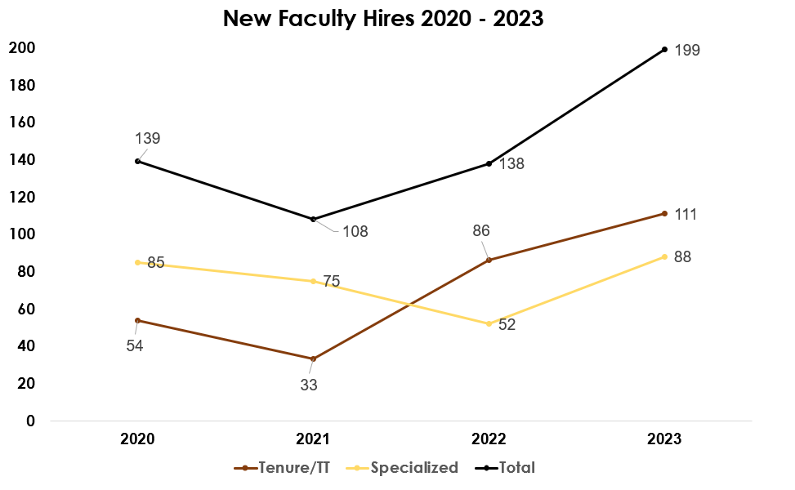
Faculty Hiring
Notes:
I’m happy to report that we are still experiencing robust faculty recruitment.
You can see here our recent increases in numbers of faculty, especially those in tenured/tenure-earning positions.

Slide 10
Tenured/Tenure-Track Faculty Attrition
Year | Voluntary Separations | Retirements
2023 | 37 | 27
2022 | 26 | 21
2021 | 23 | 23
2020 | 10 | 17
2019 | 19 | 23
2018 | 22 | 14
2017 | 24 | 17
Notes:
As far as faculty attrition goes, we’ve seen a slight, but not dramatic, rise in faculty departures, and perhaps not greater than expected in these post-pandemic times.
I can’t stress enough how grateful I am to each of you as Deans, Directors, and Department Chairs for all you do in the search, hiring, and retention process.

Slide 11
Questions?
Notes:
Thank you. I’m happy to take any questions you have.

