Slide 1
Deans & Chairs
Kyle Clark
Senior Vice President for
Finance & Administration

Slide 2
2024 Operating Budget

Slide 3


Operating Budget Timeline
Budget entry training
BOT materials are assembled
Evaluation of budget entry, results in enhancements for next year
New budget requests are compiled for review
Component unit budgets are compiled
BOG detailed budget & position reports are prepared
Board of Governors approves
the budget
Requests for new budget allocations
Detailed budget reviews occur
January
March
May
July
September
February
April
June
August
Budget training, workshop, & entry dates are announced
High-level budget calcs including tuition & fees are finalized
Operating budget presented to Board of Trustees
Operating budget submitted to the Board of Governors
Parties responsible for each budget are confirmed
Budget entry occurs
BOT approves operating budget
Budget entry workshops are held
New budgets are booked in OMNI

Slide 4
2023-2024 Total Operating Budget Summary
 | 2022-2023 | 2023-2024
Education & General - State Support | $683,959,780 | $805,183,345
Education & General - Tuition and Fees | 241,625,270 | 238,918,305
Designated | 95,991,035 | 97,154,941
Auxiliary | 397,783,219 | 425,239,039
Debt Service | 45,902,557 | 27,542,774
Restricted | 484,109,658 | 520,128,750
Capital Projects | 293,579,238 | 347,411,462
Component Units | 123,927,812 | 164,801,025
Total | $2,366,878,569 | $2,626,379,641

Slide 5
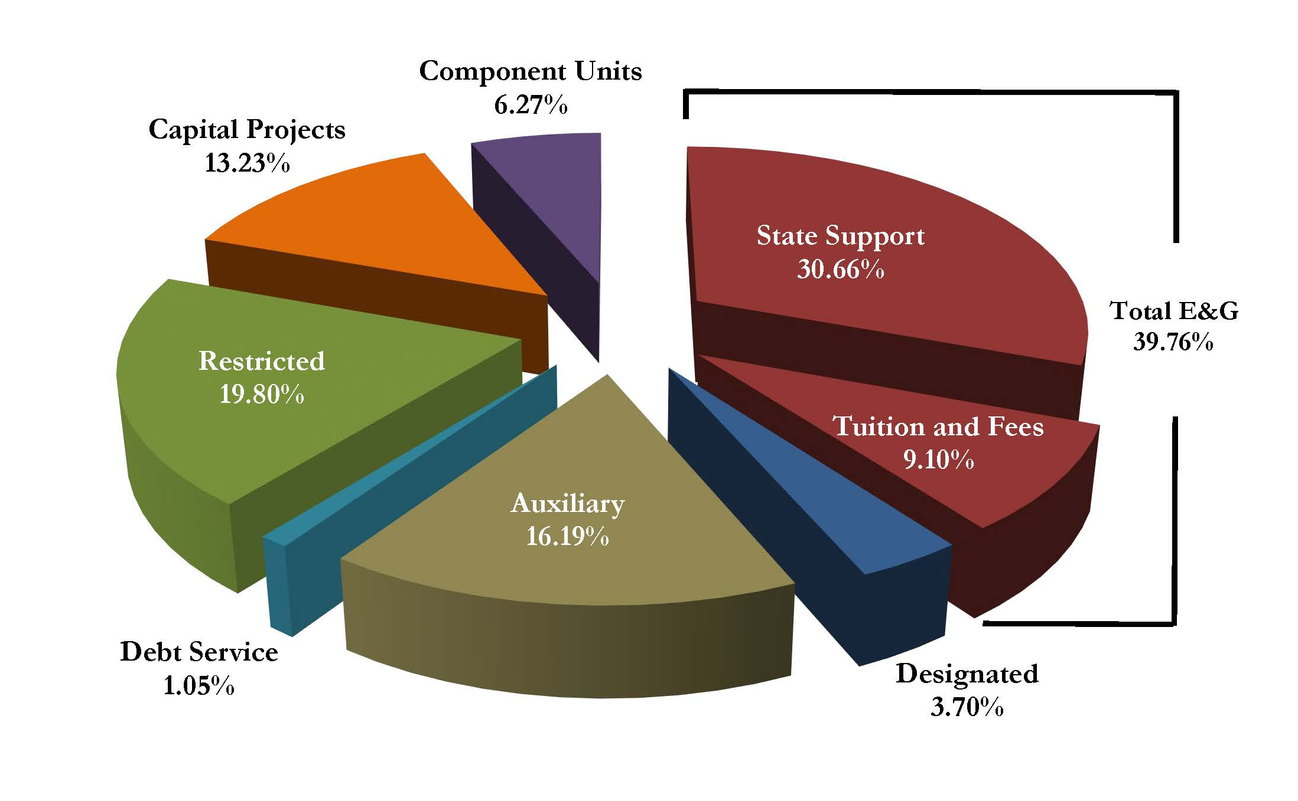
2023-2024 Total Operating Budget Summary

Slide 6
Capital Project Budget Highlights
  Dittmer Building - $40M
  Kellogg Building - $2.3M
  Academic Support - $30M
  College of Engineering - $20M
  Veterans Legacy Complex - $10M
  Panama City Health - $4M
  Arts District - $1.47M

Slide 7
2023-2024 Capital Projects
PROJECT | AMOUNT
Legacy Hall – College of Business | $40,000,000
Interdisciplinary Research & Commercialization Building | $35,000,000
FSU/TMH Academic Health Center | $25,000,000
Football Operations Facility | $20,000,000
Doak Campbell Stadium Seating Enhancements | $15,000,000
Doak Campbell Stadium Improvement Project | $10,000,000
Mag Lab Primary Electrical | $10,000,000
Student Union | $7,406,732
Dittmer Building | $5,000,000
Kellogg Remodel | $5,000,000
Tucker Center Deferred Maintenance | $5,000,000
All Others – over 200 projects under $5M | $170,004,730
TOTAL | $347,411,462

Slide 8
Total Budget Top Spending Categories
Category | E&G | Designated | Auxiliary | Restricted | Total
Wages & Benefits | $717,229,036 | $43,128,030 | $191,725,229 | $182,915,557 | $1,134,997,852
Capital Projects | - | - | - | - | $347,411,462
Financial Aid | $42,335,084 | $44,784,616 | $12,282,094 | $204,064,096 | $303,465,890
Equipment & Supplies | $52,149,756 | $11,378,260 | $86,347,114 | $60,130,608 | $210,005,738
Component Units | - | - | - | - | $164,801,025
Total Top Categories |  |  |  |  | $2,160,681,967

Slide 9
Finance and Administration Updates

Slide 10
Legislative Changes
Per new legislation passed this spring, the spending of E&G-carryforward funds is no longer restricted to “non-recurring” items.
  E&G-carryforward funds may once again be spent on salaried employees, long-term contracts, etc.
  The university is still required to develop a carryforward spending plan.
  The 2024 plan is pending Board of Governors approval.
Legislation passed this spring increased the limit on E&G salaries and wages from $200,000 to $250,000 annually.
  Selected faculty are still exempt from this limit.
  Departmental personnel must manage funding splits to ensure compliance with this law.

Slide 11
Financial Aid & Payment Card Industry
Streamlined and made more transparent the process by which department-funded financial aid is requested through Student Business Services.
Dedicated one FTE position to improve the overall graduate student financial experience by managing the graduate tuition payment plan, graduate fee relief program, and central integrations for the graduate health subsidy.
Ability to accept in-person and/or online credit card payments with less Payment Card Industry (PCI) burden.

Slide 12
Travel Changes
For university travel involving flights with at least one segment of eight hours or more, Business Class travel (or its equivalent) is now reimbursable for all trip segments.
The maximum allowable tip for taxi/rideshare expenses has been increased to 20%.
Per State of Florida law, the maximum base lodging rate has been increased to $225 from $175. Any base lodging rates above $225 may require justification.
  New drop down menu available to select most common justifications.

Slide 13
Procurement Updates
The threshold for requiring formal solicitations (ITB/ITN) increased from $75,000 to $150,000.
The small/micro purchase threshold was increased from $10,000 to $25,000 to accommodate inflationary pressures and increase flexibility. FSU was the first institution in Florida to increase this threshold.
We added additional flexibility to our internal policy relative to quotes on procurement.
FSU now has the ability to consider both quantitative and qualitative factors on capital project procurement.

Slide 14
Organizational Updates
New Associate Vice President for Facilities and Chief Facilities Officer – Mike Jednak
New Chief Construction Officer – Sadie Greiner

Slide 15
Project Updates

Slide 16
Interdisciplinary
Research & Commercialization
Building
GSF: 116,000
Estimated Project Budget: $130M
Funding: State Appropriated, CF, & Non-Appropriated
Schedule: Substantial Completion – Fall 2024
A new facility to house interdisciplinary teams creating a collaborative environment to conduct research and develop commercialization opportunities to bring products to market. Facility will include research labs, collaboration spaces, administrative spaces, and building support functions. Facility will house the Quantum Sciences initiative as well as researchers in the disciplines of biomedical engineering, chemistry, and chemical engineering.
Project Partners:
Design: HGA Architects, Boston, MA
Contractor: Whiting-Turner, Tampa, FL
Owner's Rep: Cumming Group
Project Status: Construction

Slide 17
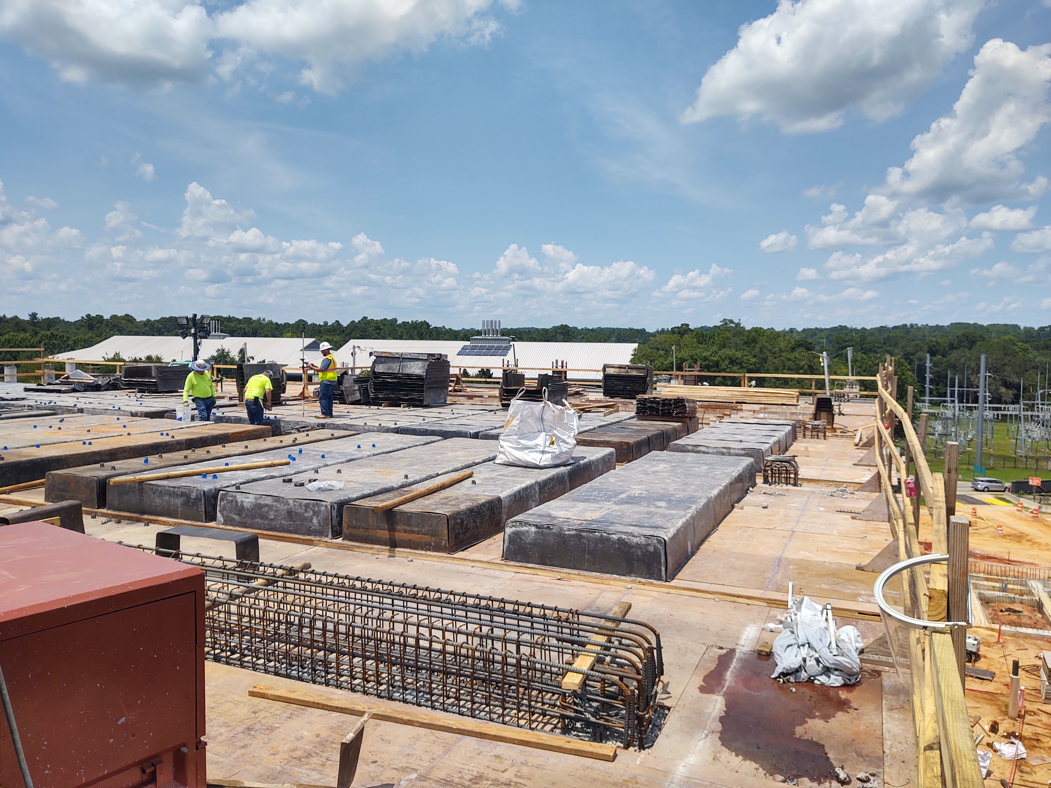
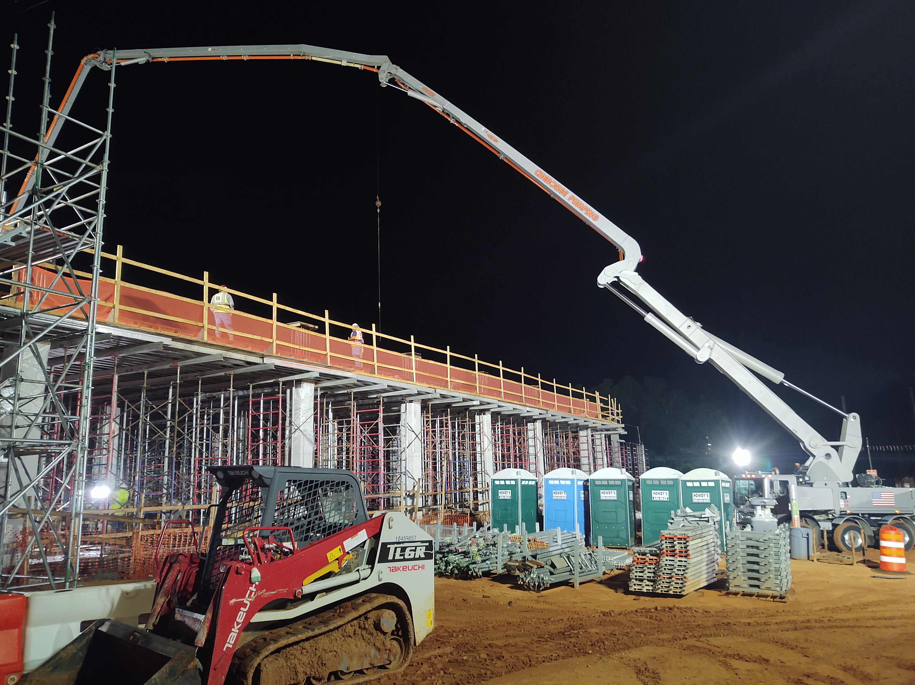
Interdisciplinary
Research & Commercialization
Building

Slide 18
Interdisciplinary
Research & Commercialization
Building
Project Status: Construction

Slide 19
College of Business, Legacy Hall
GSF: 219,000
Estimated Project Budget: $160M
Funding: State Appropriated, CF, & Non-Appropriated
Schedule: Substantial Completion – Fall 2025
  Foundation systems and site construction in progress
Provides a multi-functional and collaborative environment for students, faculty, and staff to teach, research and learn. Facility will include classroom, instructional, seminar, multi-purpose event, technology, distance learning, Institute/Center, administrative, and café space. The new building is located between Madison and Gaines along MLK Jr. Blvd and will create a prominent east campus gateway.
Project Partners
Design: Goody Clancy Architects, Boston, MA
Contractor: Culpepper Construction Company, Tallahassee, FL
Project Status: Construction

Slide 20
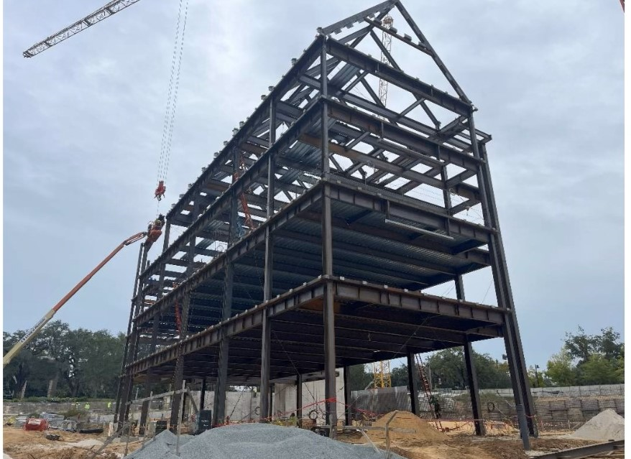
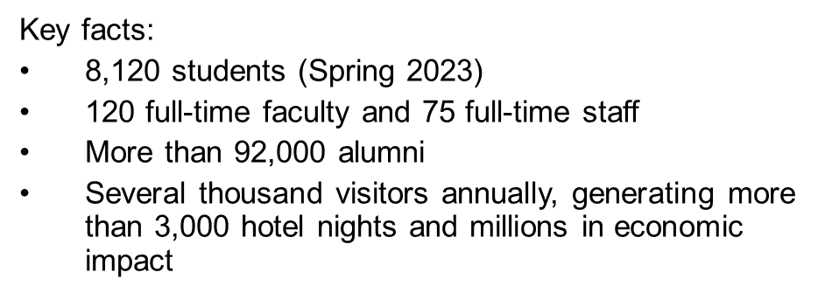
College of Business, Legacy Hall
Project Status: Construction

Slide 21
College of Business, Legacy Hall
Project Status: Construction

Slide 22
Kellogg Remodel and Expansion – Phase 1
GSF: 27,750
Project Budget: Phase 1 - $10M
Funding: State Appropriated and CF
Schedule: Phase 1 - Substantial Completion – Fall 2024
  Phase 2 & 3 - TBD
Remodel and renovate space within the Kellogg Building for the College of Criminology. This project is anticipated to include three phases. The first phase will remodel and renovate the 4th floor and address building envelop deferred maintenance issues associated with this level. Future phases are intended to renovate the remaining floors. There will be newly remodeled and renovated space for teaching, learning, research, administrative and ancillary activities. This is a three phase project.
Project Partners:
Design: Lewis + Whitlock, Tallahassee, FL
Construction: Allstate Construction, Tallahassee, FL
Project Status: Design

Slide 23
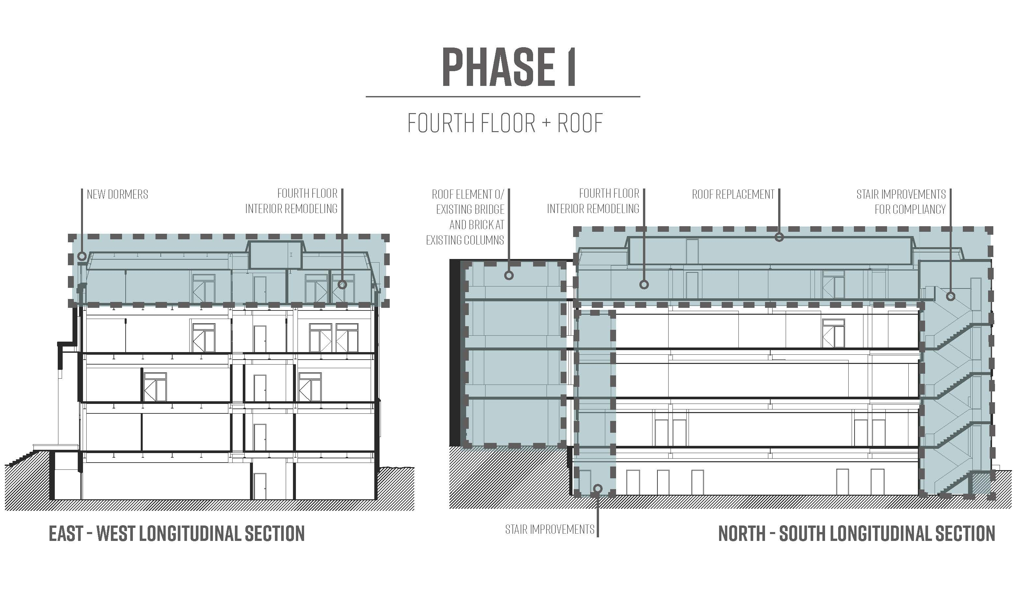
Kellogg Remodel and Expansion – Phase 1
Project Status: Design

Slide 24
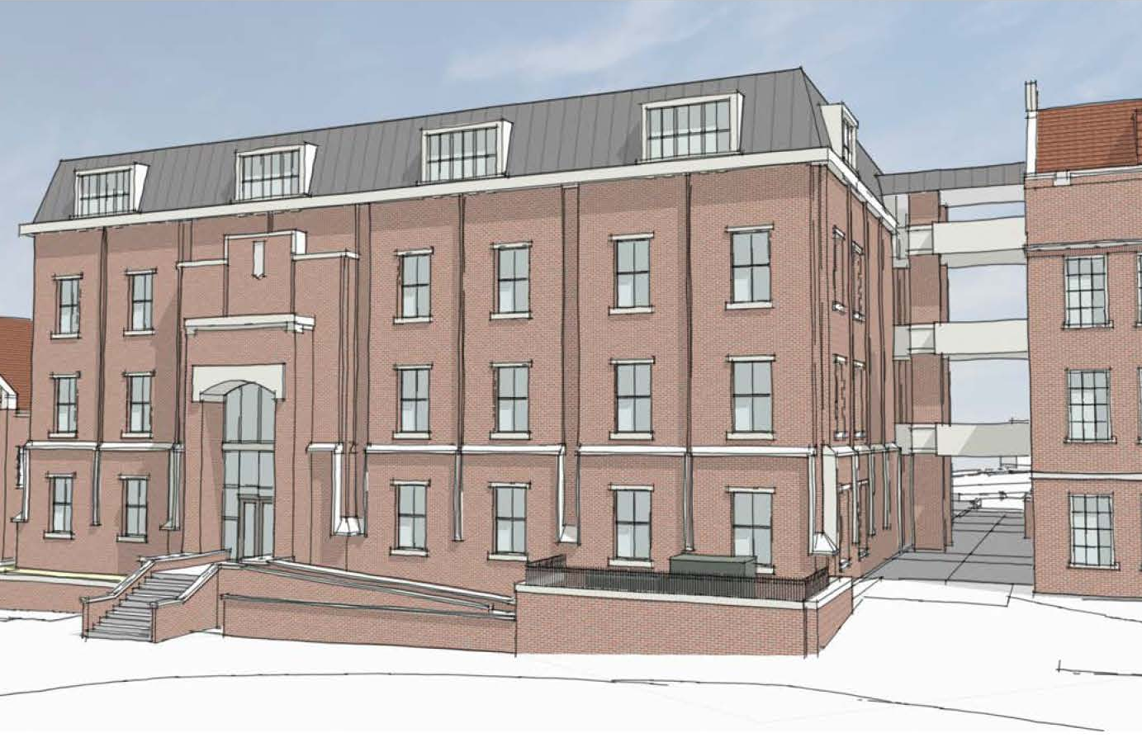
Kellogg Remodel and Expansion – Phase 1
Project Status: Design

Slide 25
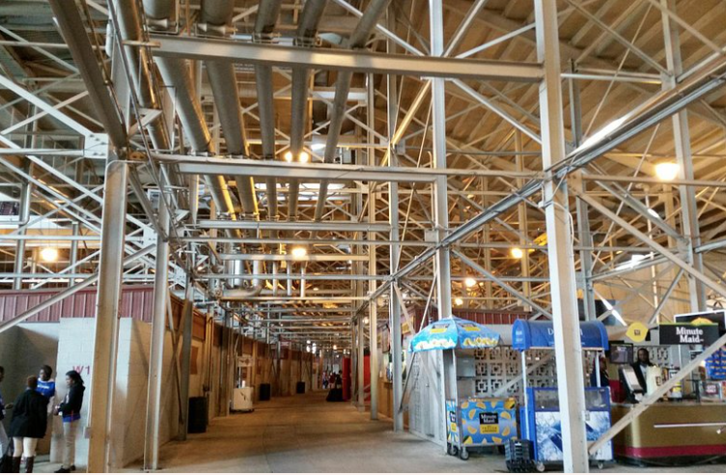
Doak Campbell Stadium Improvements
Project Budget: $20M
Funding: Blueprint
Schedule: Project Substantial Completion – Spring 2025
  Phase 1 Construction to begin July 2023
  Phase 2 Construction to begin December 2023
  Addresses life safety, structural and building code deficiencies. Project scope will be limited to issues presented to the Blueprint Board. Project scope will not include deficiencies incorporated into the seating project in the west and south ends.
Project Partners: (Design-Build Delivery)
Design Professional – Gilchrist Ross Crowe, Tallahassee, FL
Contractor – RAM Construction, Tallahassee, FL
Project Status: Design

Slide 26
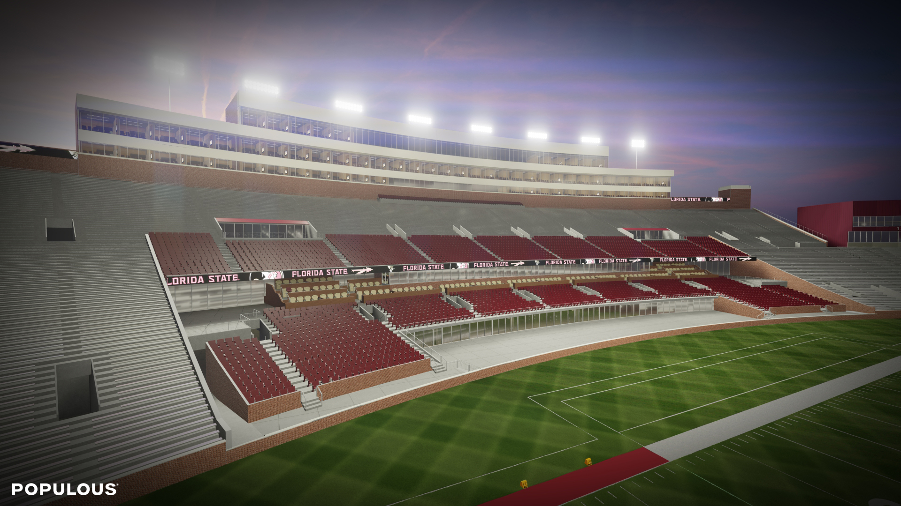
Doak Campbell Premium Seating Enhancements
Project Budget: $268,000,000
Funding: Private Booster Funds
Schedule: Substantial Completion – Summer 2025
  Targeted Construction to begin January 2024
Remodels the west and south stands of Doak Campbell Stadium. The project will introduce more diverse premium seating options on the west sideline including founder’s suites, founder’s loge boxes, club seats, and upgraded chair back seating. The south end zone Dunlap Champions Club will be remodeled to expand seating options to include lounge chair seating, loge boxes, ledge seating, standing porch seating and club seats. Additionally, existing life safety, structural and code deficiencies will be addressed in areas impacted by the project.
Project Partners:
Design Professional – Populous, Kansas City, MO
Contractor – Manhattan/Culpepper Joint Venture
Project Status: Design

Slide 27
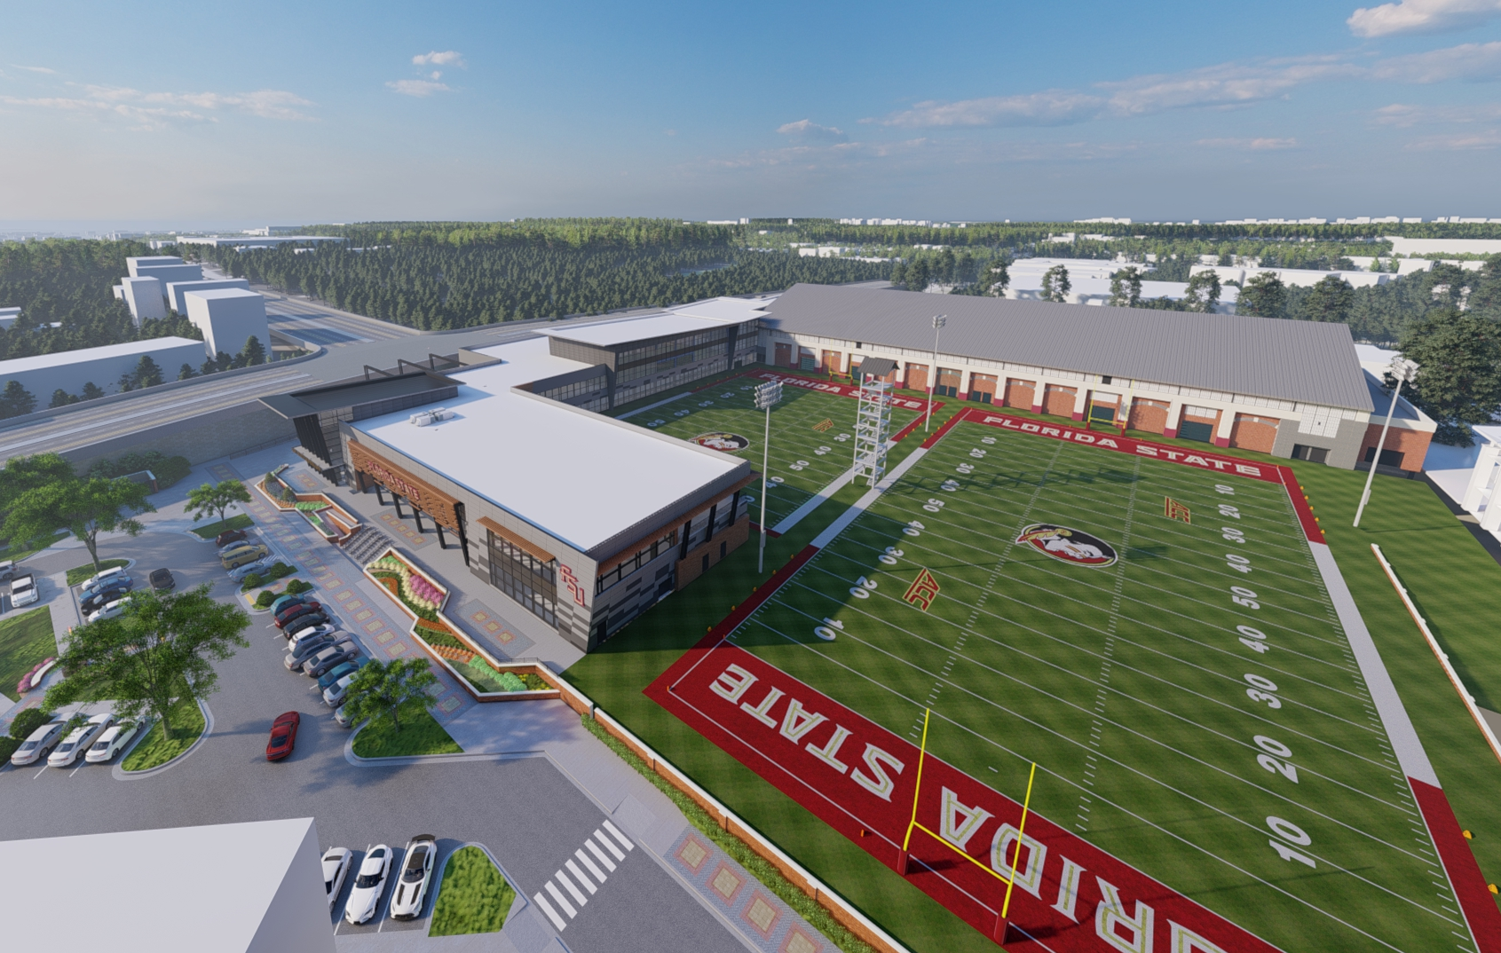
Dunlap Football Center
GSF: 150,000
Project Budget: $138,000,000
Funding: Private Booster Funds
Schedule: Substantial Completion – Summer 2025
  Phase I – East Annex Construction: Jan. 2023 – July 2023
  Phase II – DCF West Wing Construction: Start Winter 2023
Constructs a new facility providing space for team segment/position rooms, team meeting rooms, locker rooms, equipment area, nutrition area, hydrotherapy area, trophy/display areas, players' lounge, coaches offices, meeting rooms, conditioning areas, a new weight room connecting to the existing IPF and other gameday and support spaces. The project will also include exterior site work for hardscape, plaza space, parking adjustments, and practice field repair work required.
Project Partners:
Design Professional – Populous, Kansas City, MO
Contractor – Childers Construction, Tallahassee, FL
Project Status: Phase I – Construction & Phase II – Design

Slide 28
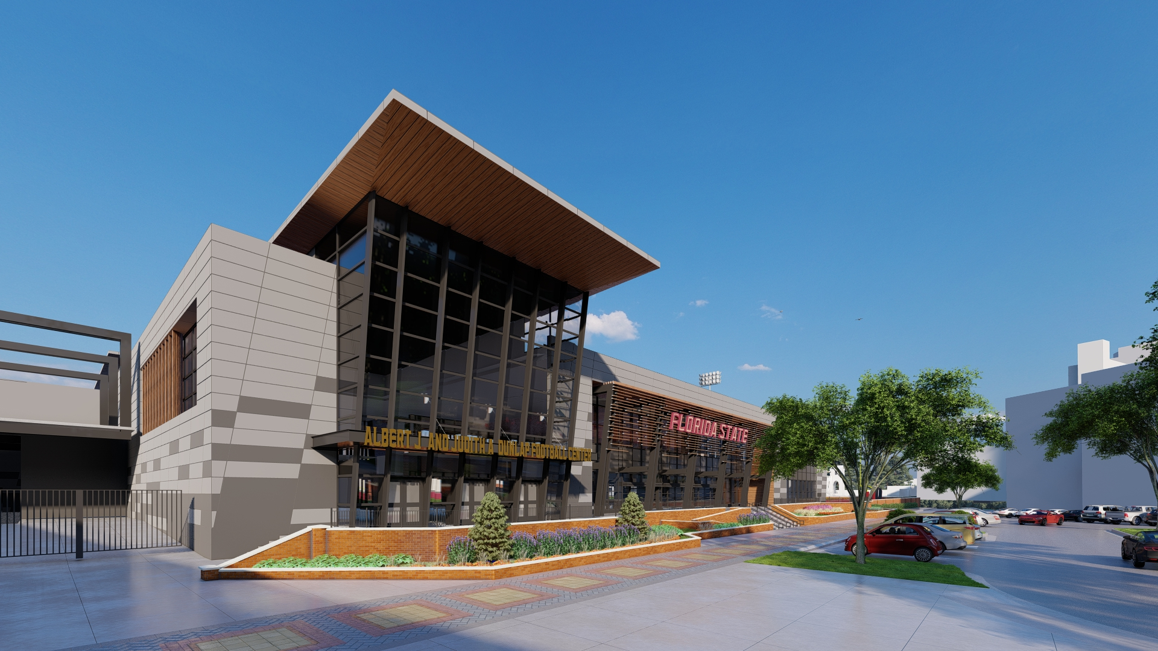
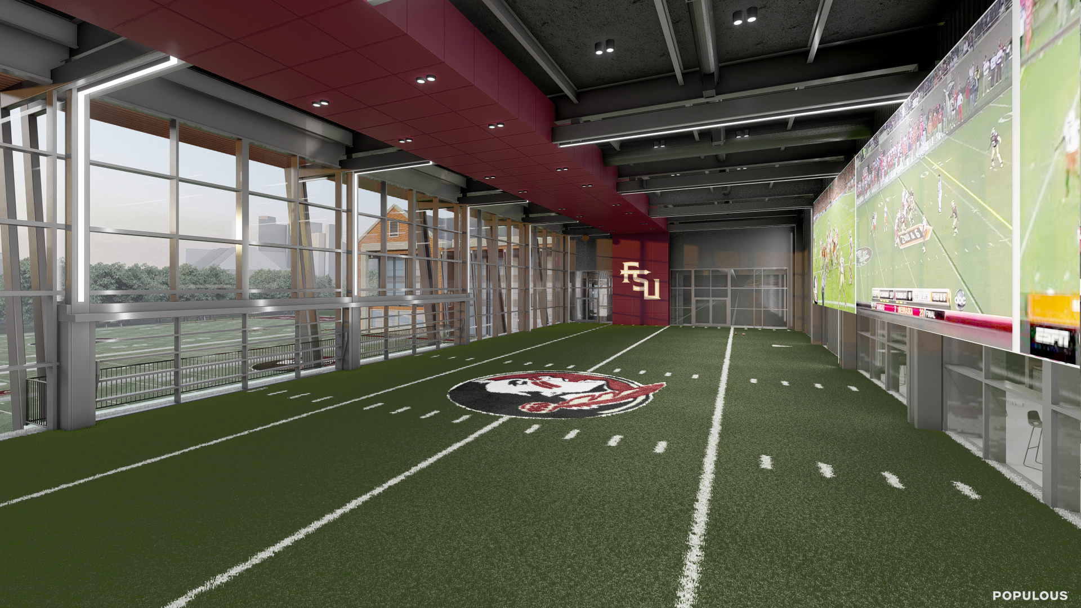
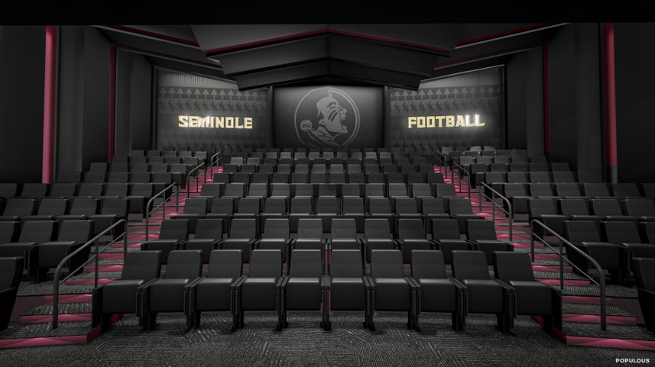

Slide 29
FSU/TMH Academic Health Center
GSF: 100,000
Project Budget: $125M
Funding: State Appropriated
Schedule: Substantial Completion – Fall 2026
The new Academic Health Center will accommodate both dry and wet labs, clinical, administrative, teaching, and research spaces. The facility will offer space to be utilized by a blend of TMH Family Medical Residency Program, the College of Nursing, the College of Medicine, and research laboratories. Current program allows for 19 PI's for research, 114 research graduate students, and 28 exam rooms for the Family Medical Residency Program.
Project Partners:
Design: HOK, Tampa, FL
Contractor: Receiving Proposals
Owner's Rep: Cumming Group
Project Status: Programming

Slide 30
FSU/TMH Academic Health Center
Other Impacts
Planning process led by the Vice President for Research, College of Medicine, College of Nursing, and College of Engineering is complete.
FSU Family Medicine clinic will see approximately 10,000 patients per year
150 graduate and post doc students
25 research groups
Educational and training simulation laboratory for nursing and medical students
Goal of doubling National Institute of Health funding over the next 5 years
  More faculty, staff, graduate students and post docs
  Additional training and development of future health care workers
  Developing technology of the future of Medicine
Project Status: Design

Slide 31
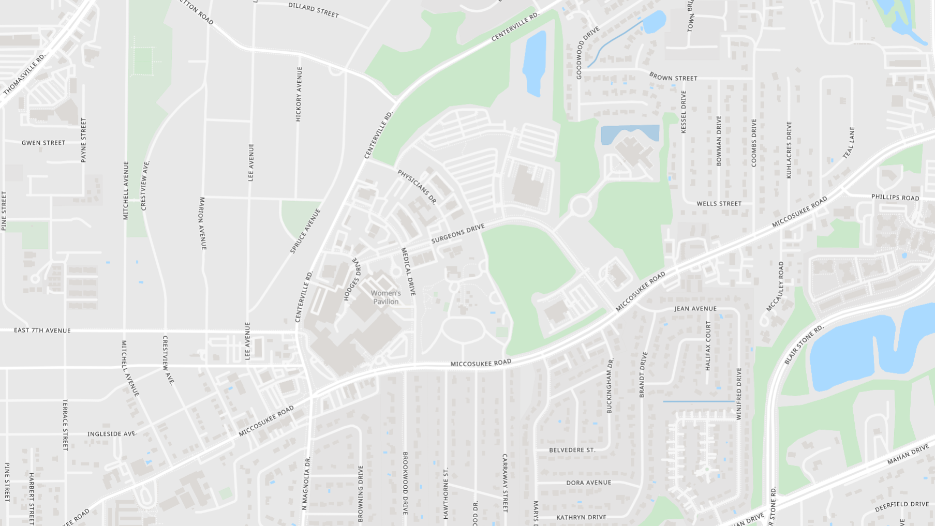
FSU/TMH Academic Health Center
TMH

Slide 32
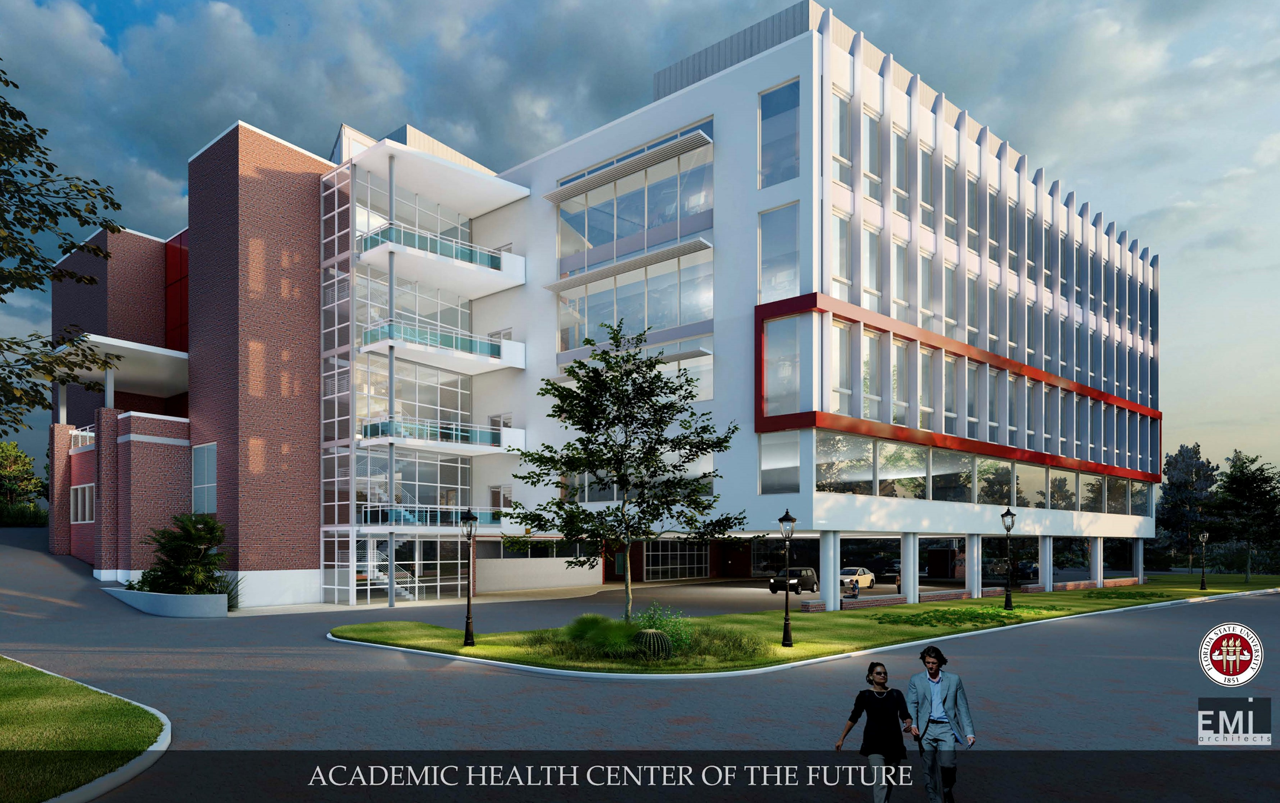
FSU/TMH Academic
Health Center

Slide 33
Questions and Answers

Slide 34
Travel Questions
Not sure if you drive but the price of gas has been higher :) The reimbursement rate for mileage has been 0.445/mile since as long as I can remember. Its easier and cheaper for the state if I drive my own car and get reimbursed. Will this rate ever change? It costs the university MORE for me to get a rental and costs time/effort.
  There is no requirement by the university for travelers to rent a car rather than take their personal vehicle when traveling for university business. Rather, the Travel policy indicates that, “Travelers are to choose the most practical and economical mode of transportation and are to generally travel the most direct route. Consideration is to be given to the total cost to the University, considering time of the traveler, impact on the productivity of the traveler, cost of transportation, and per diem or subsistence required.” Providing a rental car option is intended to be for the employee’s benefit so that they do not have to put the wear, tear, and liability on their own vehicle. Travelers should keep in mind that the State rental contract includes collision and comprehensive coverage insurance, in the event that they are involved in any kind of accident.
  According to State of Florida law, the University must comply with the state established per diem rates including those of mileage

Slide 35
Travel Questions
Relating to Rentals - AVIS has been a terrible partner to FSU. We were better off with an Enterprise location on campus. How do we improve rental options for faculty/staff with an on campus location that serves our needs better?
  While AVIS/Budget provides the most economical means of renting a vehicle for university business, there are other options available on university contracts – including Enterprise/National and Hertz. If there are specific issues with AVIS, it would be very helpful if those could be detailed so we can try and address them.

Slide 36
Travel Questions
Relating to Rentals - AVIS has been a terrible partner to FSU. We were better off with an Enterprise location on campus. How do we improve rental options for faculty/staff with an on campus location that serves our needs better?
  While AVIS/Budget provides the most economical means of renting a vehicle for university business, there are other options available on university contracts – including Enterprise/National and Hertz. If there are specific issues with AVIS, it would be very helpful if those could be detailed so we can try and address them.
  As for an on-campus location, this was something that was spearheaded with Enterprise before; however, Enterprise was not happy with the volume at that location and were looking to close it prior to COVID.

Slide 37
Deans & Chairs
Kyle Clark
Senior Vice President for
Finance & Administration

