Slide 1
Student Success Update Joe O’Shea and Karen Laughlin
Deans and Chairs Meeting
October 21, 2016
Notes:
Take deeper dive on the student driven metrics

Slide 2
What is Student Success?
Traditional definitions in literature and policy have defined it as retention and graduation rates
Metrics for our state performance and preeminence funding, as well as for U.S. News and World Report rankings
Notes:
The term student success has become really common in both the academic literature of higher education and policy. Student success is broader than
Preeminence
(a) An average weighted grade point average of 4.0 or higher on a 4.0 scale and an average SAT score of 1800 or higher on a 2400-point scale or 1200 or higher on a 1600-point scale for fall semester incoming freshmen, as reported annually.
(b) A top-50 ranking on at least two well-known and highly respected national public university rankings, including, but not limited to, the U.S. News and World Report rankings, reflecting national preeminence, using most recent rankings.
(c) A freshman retention rate of 90 percent or higher for full-time, first-time-in-college students, as reported annually to the Integrated Postsecondary Education Data System (IPEDS).
(d) A 6-year graduation rate of 70 percent or higher for full-time, first-time-in-college students, as reported annually to the IPEDS.
Metrics Common to all Institutions 1. Percent of Bachelor's Graduates Employed and/or Continuing their Education 6. Bachelor's Degrees Awarded in Areas of Strategic Emphasis 2. Median Wages of Bachelor’s Graduates Employed Full-time in Florida 7. University Access Rate (Percent of Undergraduates with a Pell-grant) 3. Average Cost per Bachelor’s Degree 8a. Graduate Degrees Awarded in Areas of Strategic Emphasis 8b. Freshman in Top 10% of Graduating High School Class – for NCF only 4. Six Year Graduation Rate (Full-time and Parttime FTIC) 9. Board of Governors Choice 5. Academic Progress Rate (2nd Year Retention with GPA Above 2.0) 10. Board of Trustees Choice

Slide 3
Note: Academic year represents graduation year
Notes:
(4-year 62% and 6-year 79%)
• Increased our four year graduation rate from 56.3%forour 2007 cohort to 62.4% for our 2011 cohort
• Increased six-year graduation rates from 73.6% in our 2004 admissions cohort to 79.4% in our 2009 cohort
Worked hard to advance this and pick low hanging fruit over the years with significant advancement in student support

Slide 4
Student Success 2.0
Extended to post-graduate success
Enrollment in graduate school/job (metrics)
Fuller understanding also captures students’ full educational growth, regardless of background
From our highest (e.g., honors) to our lowest-achieving students
Notes:
But success as persistence is a bit anemic, so conceptions have broadened to include post-graduate success and also to full educational growth for all students, including honors and other high-achieving students (could be measured via NSSE).
Even when seen in terms of progress to degree completion, we have seen that we need to engage the full range of our student population.

Slide 5
Student Success Efforts
Continue to Elevate Admissions & Recruitment
Promote Students’ Full Educational Growth
Improve Graduation Rates/Career Success
Notes:
Some key efforts we are working on now:
Address on front end; bring in better students and students who are set up to succeed at FSU
Give them an awesome education while here
Graduate them and launch them out into the world

Slide 6
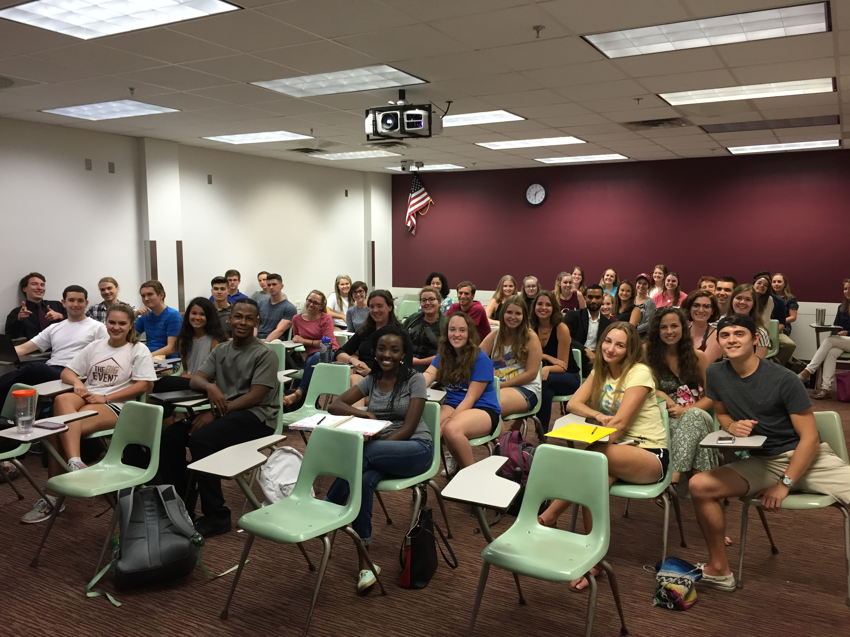
Elevate Admissions & Recruitment
Moving to holistic review for transfer admissions
More personalized recruitment of high-achieving FTICs (selectivity metric: #34 now)
VIP tours of FSU and Tallahassee
Student outreach to high schools
Faculty and Community Partners
Survey (thank you!)
Notes:
Not automatic admissions; Red flags are tons of hours (transferring over 90 hours, ask for justification for why), attending several institutions; applying some of the same admissions procedures to transfers that they would to incoming students. Fall 2017
Student Selectivity US NEWS and WORLD REPort (still have work to do to get the highest achieving students, UCF is getting more of the 1400+ SAT)
Benaquisto Scholars (national merit) get full scholarship from State of Florida now
Love to have some of you involved in you are interested.
What does it mean to go to school in Tallahassee, not just what it means to go to FSU
Student selectivity #34 and# 83 nationally

Slide 7
Promote Students’ Full Educational Growth
Improved student support
Advising
Mapping
Tutoring, peer assisted study sessions (PASS) and progress reports
Analytics
How can you help?
Notes:
Continue to improve Advising/mapping/other support services. Tutoring and other peer support efforts
embed what is known as High-Impact Practices, engage all students—high-achievers and those who are challenged or just want additional help .
Understand that these efforts are not “coddling” students. Often they help first-generation & other students navigate the “hidden curriculum” & complex bureaucracy of a big research university—leveling the playing field for those who do not enter with intuitive understanding & helping them become more self-sufficient.

Slide 8
Student Support
Advising
Ensure that departmental/college advisors receive formal training, participate in CIA
Foster teamwork across the advising site
Communicate—within your site and proactively with students
Expect use of shared notes feature in CC
Notes:
Advising is complex—helps students navigate the “hidden curriculum.” Training is available through UGS and is expected for ALL advisors—allows access to upgraded advising platform, “Campus Connect”! We expect advisors to convey and help implement university priorities.
AF is happy to support departments, but help us be part of the overall departmental team. Include interaction with faculty where this is warranted (for good referrals—career/grad school advice, etc.)
Inform the advisors about activities, curriculum changes, research opportunities and other things you want to promote.
Expect advisors to be as proactive as possible in reaching out to students & enter notes in CC so they can be shared

Slide 9
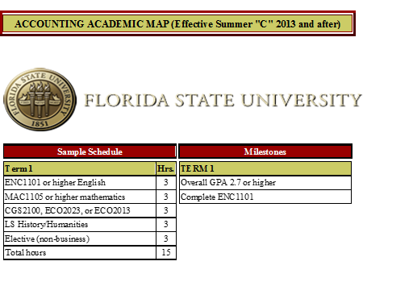
Student Support
Mapping
Review and update academic maps
Check and conform to mapping policies
Notes:
Active Mapping Oversight Committee will be communicating with you soon about policies to ensure consistency and clear understanding across units (HS AAs, mapping and major changes) and review of, possible changes to map formats
Want Mapping to HELP students progress (not be an obstacle) & help units manage curriculum effectively & efficiently

Slide 10
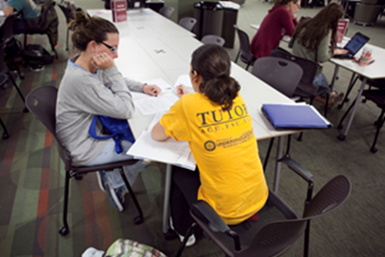
Student Support
Tutoring, PASS and faculty outreach
Encourage faculty to refer students
Expand participation in PASS
Encourage response to progress report requests
Notes:
Refer students for tutoring AND AS tutors
Now offering PASS in CHM1045, MAC1105, ACG2021—want to expand to other courses
5x attendance improves student performance, often by 1 letter grade
CC now enables electronic requests for progress reports for CARE as well as Athletics

Slide 11
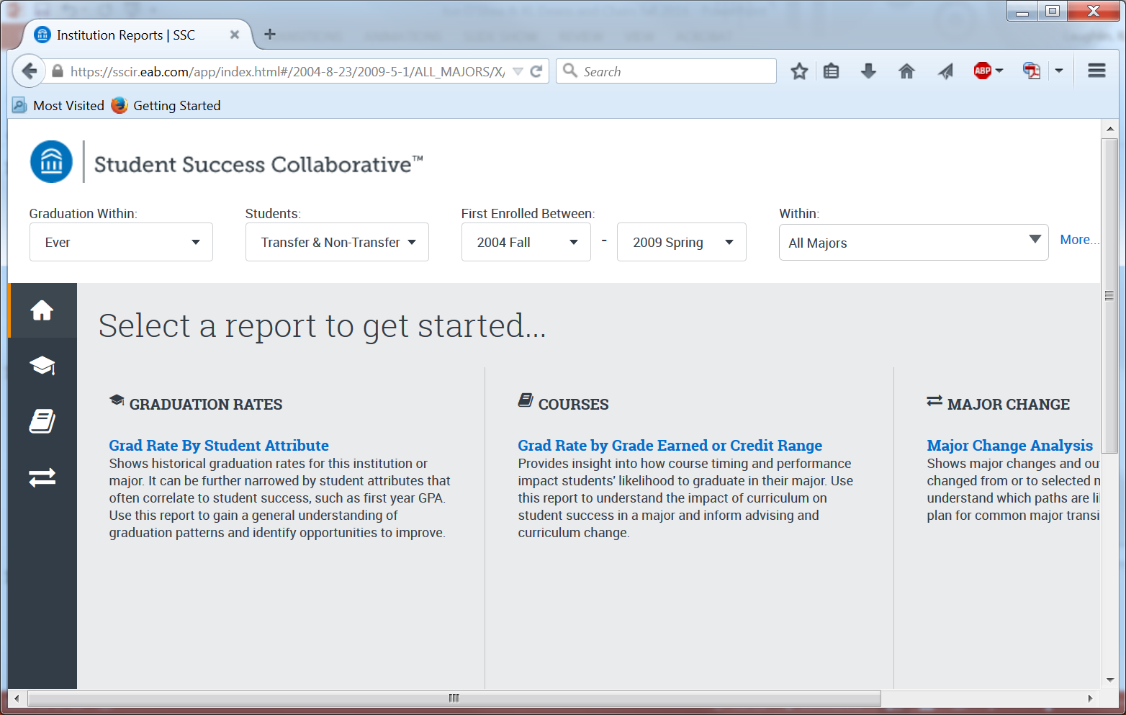
Student Support
New Analytics available
Notes:
Training on using these tools will be coming soon. Based on 10 years of our data.
“Institution Reports” allow you to look at graduation rates by major/college and compare to campus wide or other units, filter according to various students attributes.
Also allow you to look at specific courses and graduation data by grade earned and other factors (to help identify grades that are best predictors of success)
And major changing patterns—flow in and out of your majors

Slide 12
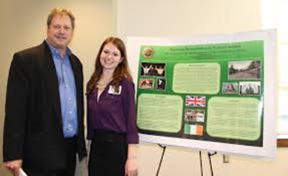
Promote Students’ Full Educational Growth
Increase student engagement
High-impact practices in and out of the classroom
e.g., internships, service-learning, international study, undergraduate research, innovation/entrepreneurship (i.e. “formative experiences”)
Support instructors and elevate pedagogy to support student learning
Notes:
****JR Harding to help make FSU university of choice for students with disabilities****
High impact practices improve learning, retention and graduation rates, and attract good students
Engaged and Experiential Learning, (also writing intensive, capstone, collaborative projects, freshmen experiences etc.))
New Innovation Center in Shores Building 1st floor currently being planned

Slide 13
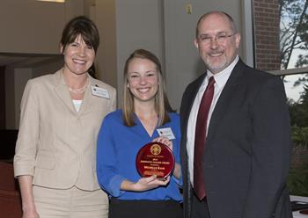
Center for Teaching Excellence (CTE)
Promote robust teaching and learning community
Support instructors broadly at FSU through multiple forms of engagement (best practices)
e.g., consultations, workshops, faculty learning communities, course and program redesign, institutes, events, assessment, etc.
Guided by faculty advisory board
Currently searching for director
Notes:
How improve student learning in classrooms? Reimagined teaching and learning center. Invite you to help shape the future of the center; please let me know your thoughts. Range from individual consultations, observations, workshops, faculty learning communities, institutes, assessment support, events, awards, etc.
Promote teaching for student success

Slide 14
Elevate Graduation Rates/Career Success
Graduation Specialists Initiative
Director hired; work with high-hour students, both incoming and current, and departments
Expanded Career Center Liaisons
FSUshadow – job shadow program
Promote Combined Bachelor’s/Master’s Degrees
Notes:
Launch them well. Get to graduation and onto graduation school or career.
Graduation Specialists to Partner with Colleges, ease advising burden of these often high-need students, cross college that are really taxing to the system.
FSUshadow launching this year, winter and spring breaks, one or a couple day shadow, “take a Nole to work”; career exposure (learn) and could lead to internships, etc.
Promote combined degrees, especially as we have more students coming to FSU with really high hours, 300 with high school AAs last year and growing

Slide 15
Discussion
How could we improve our recruitment of high-achieving students? How could your unit help?
How could your unit help further enhance students’ academic engagement?
What should the Teaching Center do at FSU, and how could it support your unit?
How could we increase the number and size of combined degrees at FSU?
Notes:
Questions for Groups for Dean’s and Chairs:
How the teaching center might support your unit?
Combined Degrees?
How your unit might help elevate our students selectivity scores and and recruit more top students?

