Slide 1

Faculty Promotion and Tenure
Workshop
April 8, 2015
Binder Review
Andrea Novak, Ph.D.
Office of Faculty Development and Advancement

Slide 2
Who is responsible for preparing the binder?
The Department Chair (or Dean in colleges without departments) is responsible for preparing the binder.
The Candidate must also participate in this process.
The Chair and the Candidate must sign the summary cover sheets.
  The Candidate’s signature certifies that he/she has reviewed the binder and that the contents are valid and accurate.
  The chair’s signature certifies that the binder complies with University procedures and has been reviewed by the candidate.

Slide 3
Creating a Successful Binder:
Use P&T Memo, Attachment I
Use the Binder Checklist

Slide 4
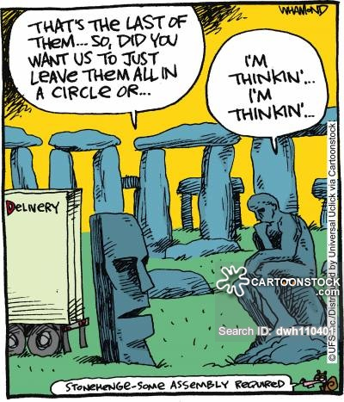
Cartoonist: Whamond, Dave
Retrieved from cartoonstock.com

Slide 5
Labeling the Main Binder:
  Label front cover and spine
  Complete name of candidate
  Name of the Department and College
  Promotion and/or Tenure Requested

Slide 6
Summary Cover Sheet for Promotion:
  Indicate if 5th or 7th year and give
  justification if 5th or 7th
  Include votes, signatures & annual percent of effort
  If negative votes, include Reason for Negative Committee Review Ballots & Reasons for Negative Ballots for Promotion and Tenure
  Employee ID number

Slide 7
Summary Cover Sheet for Promotion:

Slide 8
Summary Cover Sheet for Tenure:
  Indicate if 5th or 7th year and give justification for 5th or 7th
  Include votes, signatures & annual percent of effort
  If negative votes, include Reason for Negative Committee Review Ballots & Reasons for Negative Ballots for Promotion and Tenure
  Agreement to Adjust Tenure or Early Tenure, if applicable
  Employee ID number

Slide 9
Summary Cover Sheet for Tenure:

Slide 10
Dean’s Letter - First paragraph must address:
  College Committee vote & Area Committee Vote, if applicable
  Tenured Faculty Vote (if not in Chair’s letter)
  Agreement to adjust years of tenure service credit, if applicable
  Reason for 5th or 7th year promotion

Slide 11
Dean’s Letter
It is my pleasure to write this letter in support of nomination for promotion from Assistant Professor to Associate Professor and the granting of tenure. Her nomination received unanimous support from the Committee on Promotion and Tenure in the College of . The faculty within the Department of also voted unanimously in support of Assistant Professor nomination for promotion and tenure.

Slide 12
Department Chair’s Letter - First paragraph must address:
  Departmental Committee and Tenured Vote
  Payment of honoraria to outside letter writers, if applicable
  Candidate’s Response to the Department Chair’s Letter (optional)

Slide 13
Chair’s Letters
I am writing this letter as the department chair's evaluation of the credentials of as she goes forward for promotion to associate professor with tenure. On September 15, 2014,a vote of the Departmental Promotion and Tenure Committee was taken pertaining to promotion to associate professor with tenure. From the three members of committee eligible, all three voted in favor of advancing her binder to the next level. The three tenured faculty also met on September 15, 2014 and all voted in favor of advancing the binder.

Slide 14
Summary of Meeting (One for Each Candidate):
  Departmental P&T Committee Summary of Discussion
  Tenured Faculty Member Committee Summary of Discussion
  Area P&T Committee Summary of Discussion, if applicable
  College P&T Committee Summary of Discussion

Slide 15
Summary of Meeting
Example:
Summary of Meeting
The P&T committee reviewed the candidate ________ for promotion (and/or tenure). A majority of the committee expressed that the candidate’s binder provided evidence that the candidate (did not meet/met/exceeded/far exceeded) the norm for his or her discipline in the area of research (similar sentences can be used for teaching and service). Comments were made regarding the candidate’s strength/weakness in the area of ___, as evidenced by ____.

Slide 16
New 2015-2016
Abstentions:
  A faculty member who accepts election to a promotion and tenure committee at any level accepts the responsibility of reviewing and evaluating all files considered by the committee.
  Abstentions are limited to situations involving real or perceived conflicts of interest (familial relations or substantial professional or financial entanglements that prevent judging the candidate objectively). All abstentions should be subtracted from the number of eligible voting faculty on the Summary Cover Sheets.

Slide 17
Outside Letters:
  Cover Sheet for Outside Letters Section
  One copy of a signed letter sent to outside reviewer
  Cover sheet for each outside letter
  Original signed letter from outside reviewer (if email and no signature, include copy of email, electronic signatures are accepted)
  P&T criteria from bylaws may be sent to outside reviewers—not required (New 2015-2016)

Slide 18
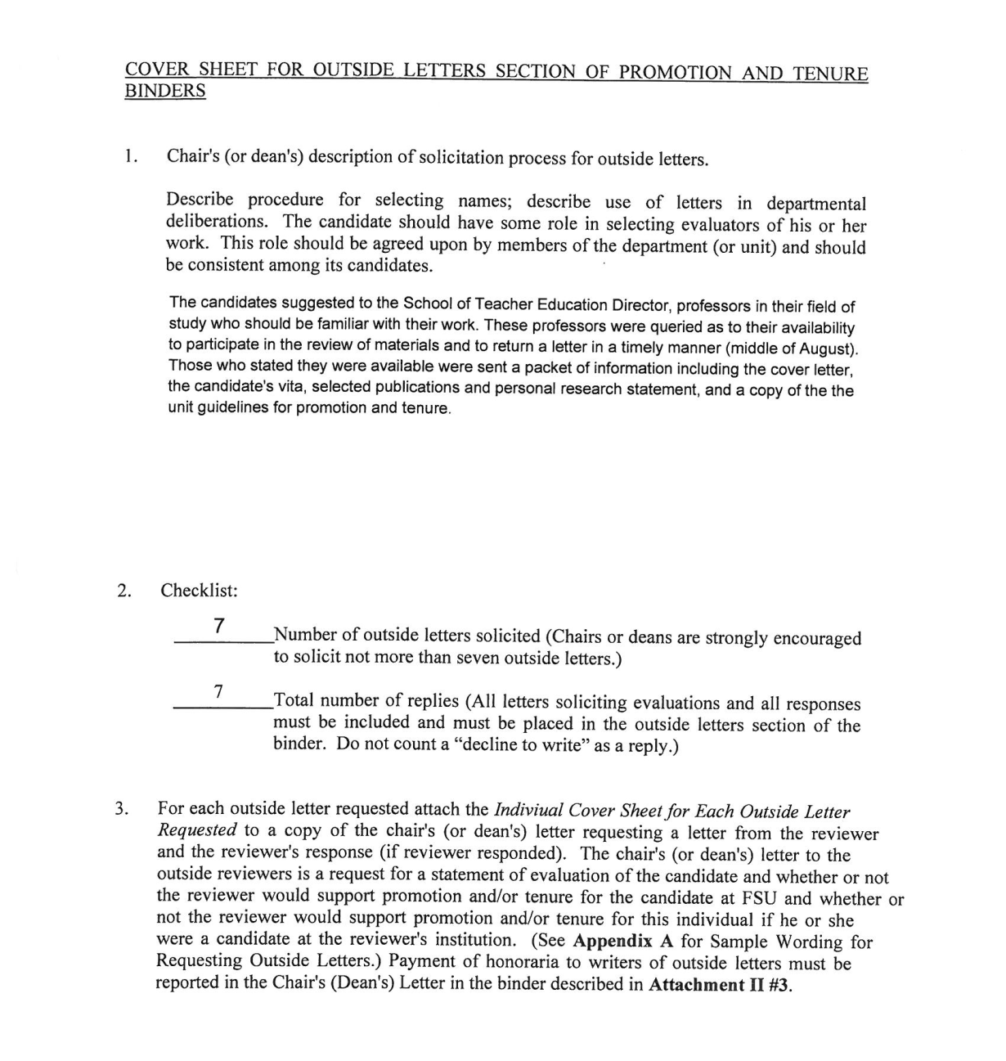
Cover Sheet for Outside Letters

Slide 19
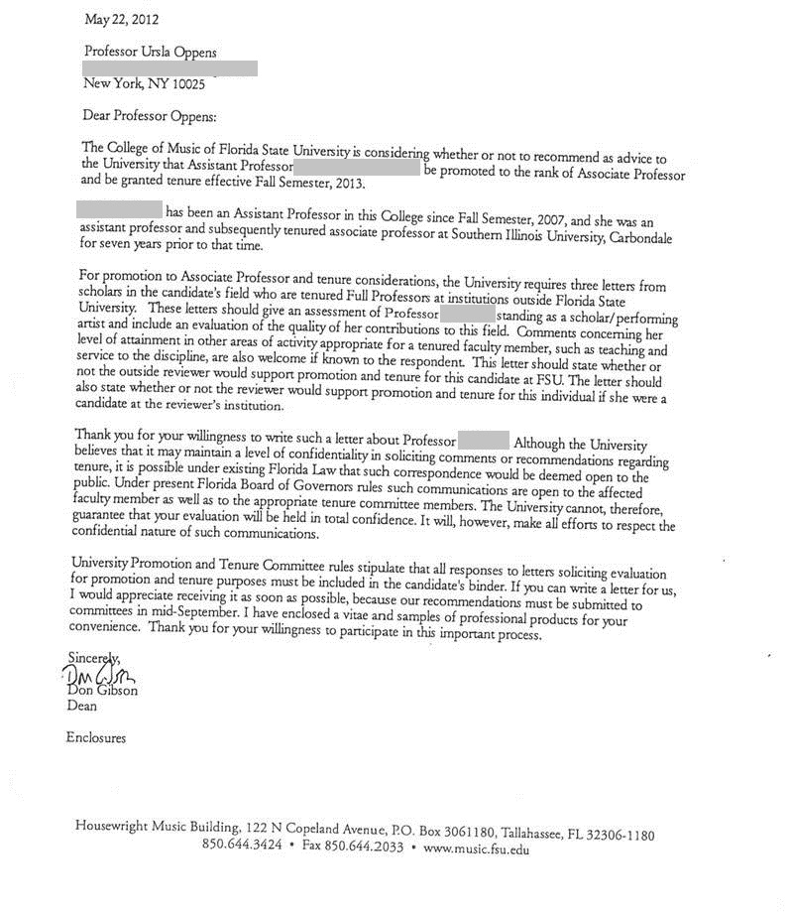
Signed Copy of Letter Sent to Outside Reviewer

Slide 20
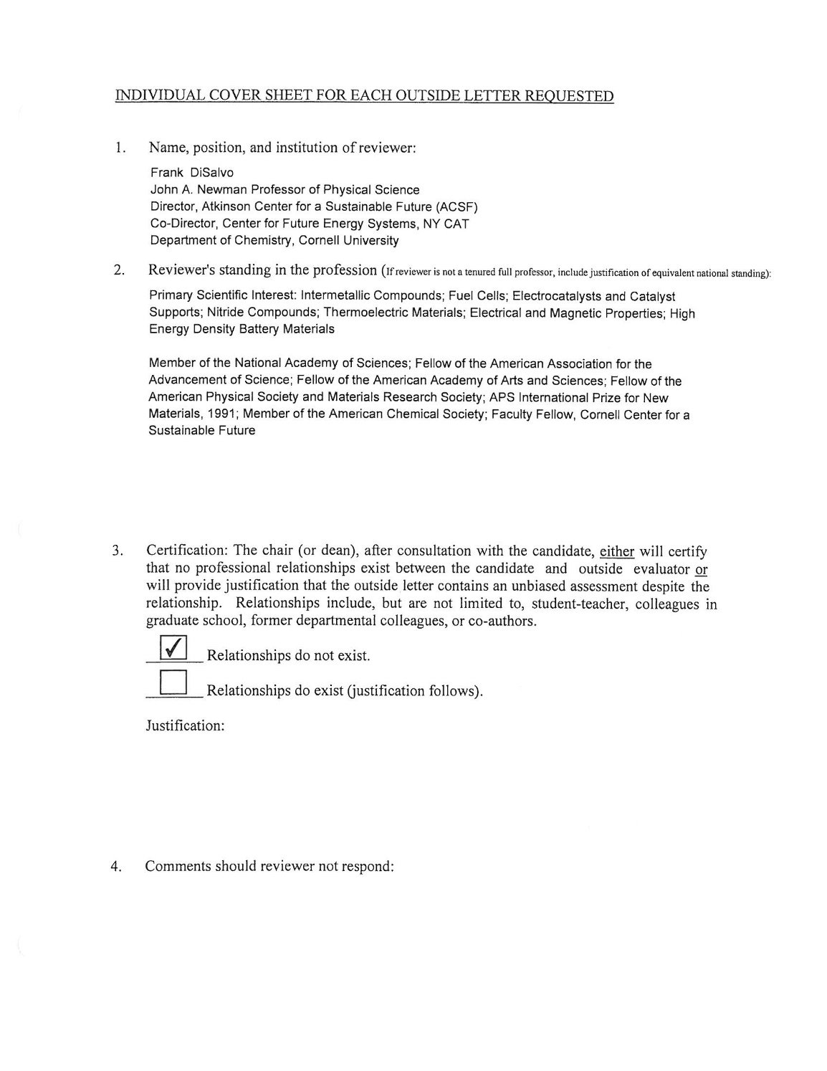
Cover Sheet for Each Outside Letter

Slide 21
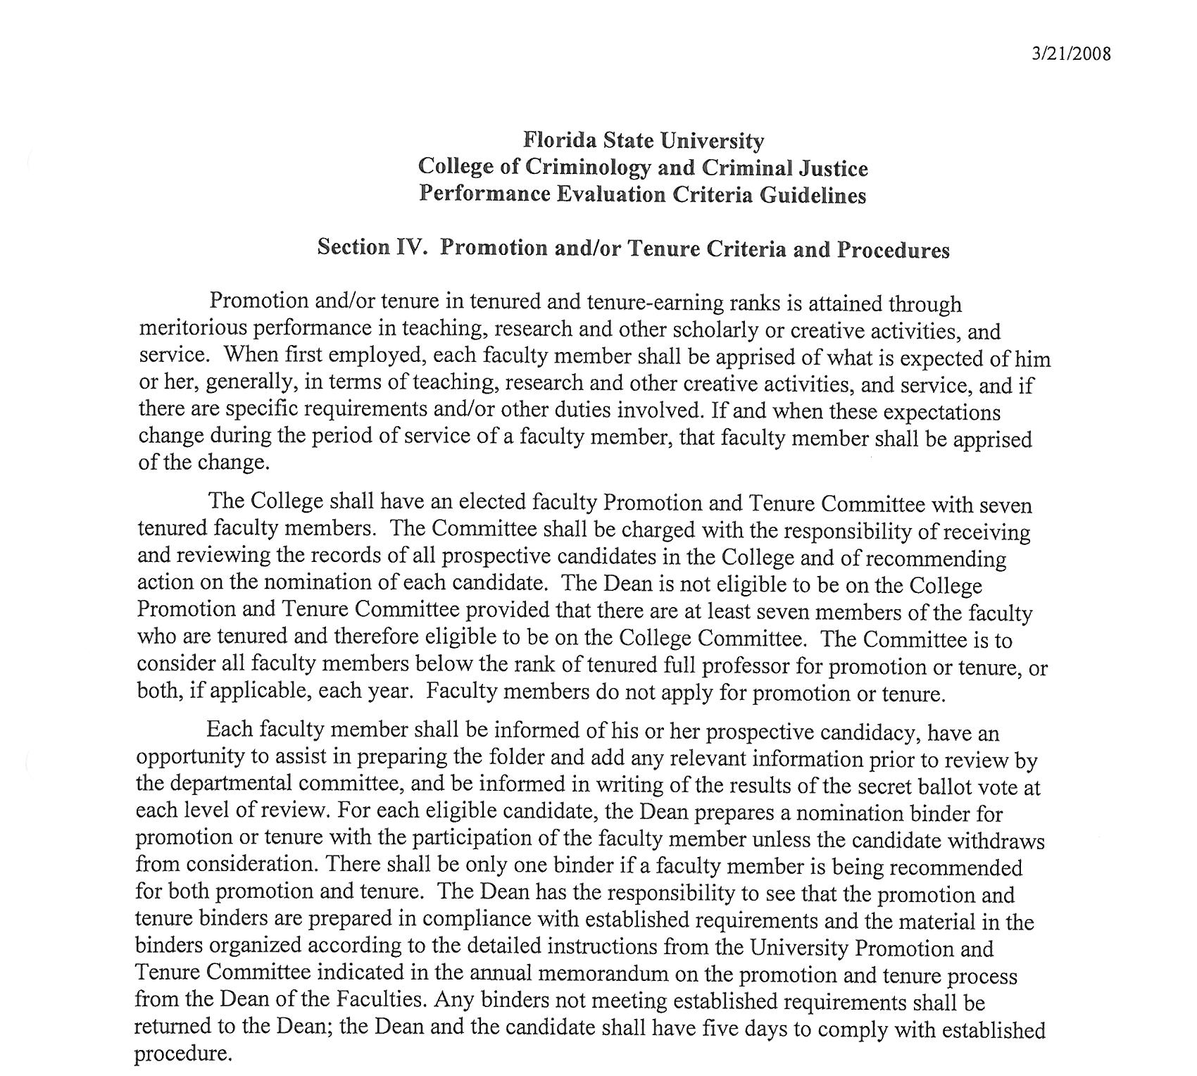
Department/College P&T Criteria
P&T criteria found in Bylaws

Slide 22
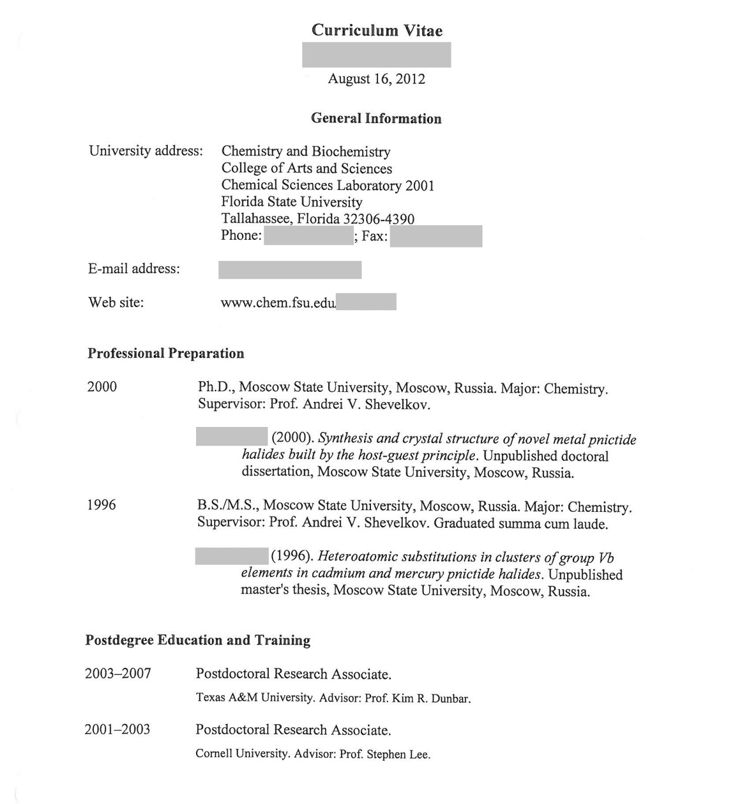
FEAS Curriculum Vitae
New policy to count work in year of candidacy

Slide 23
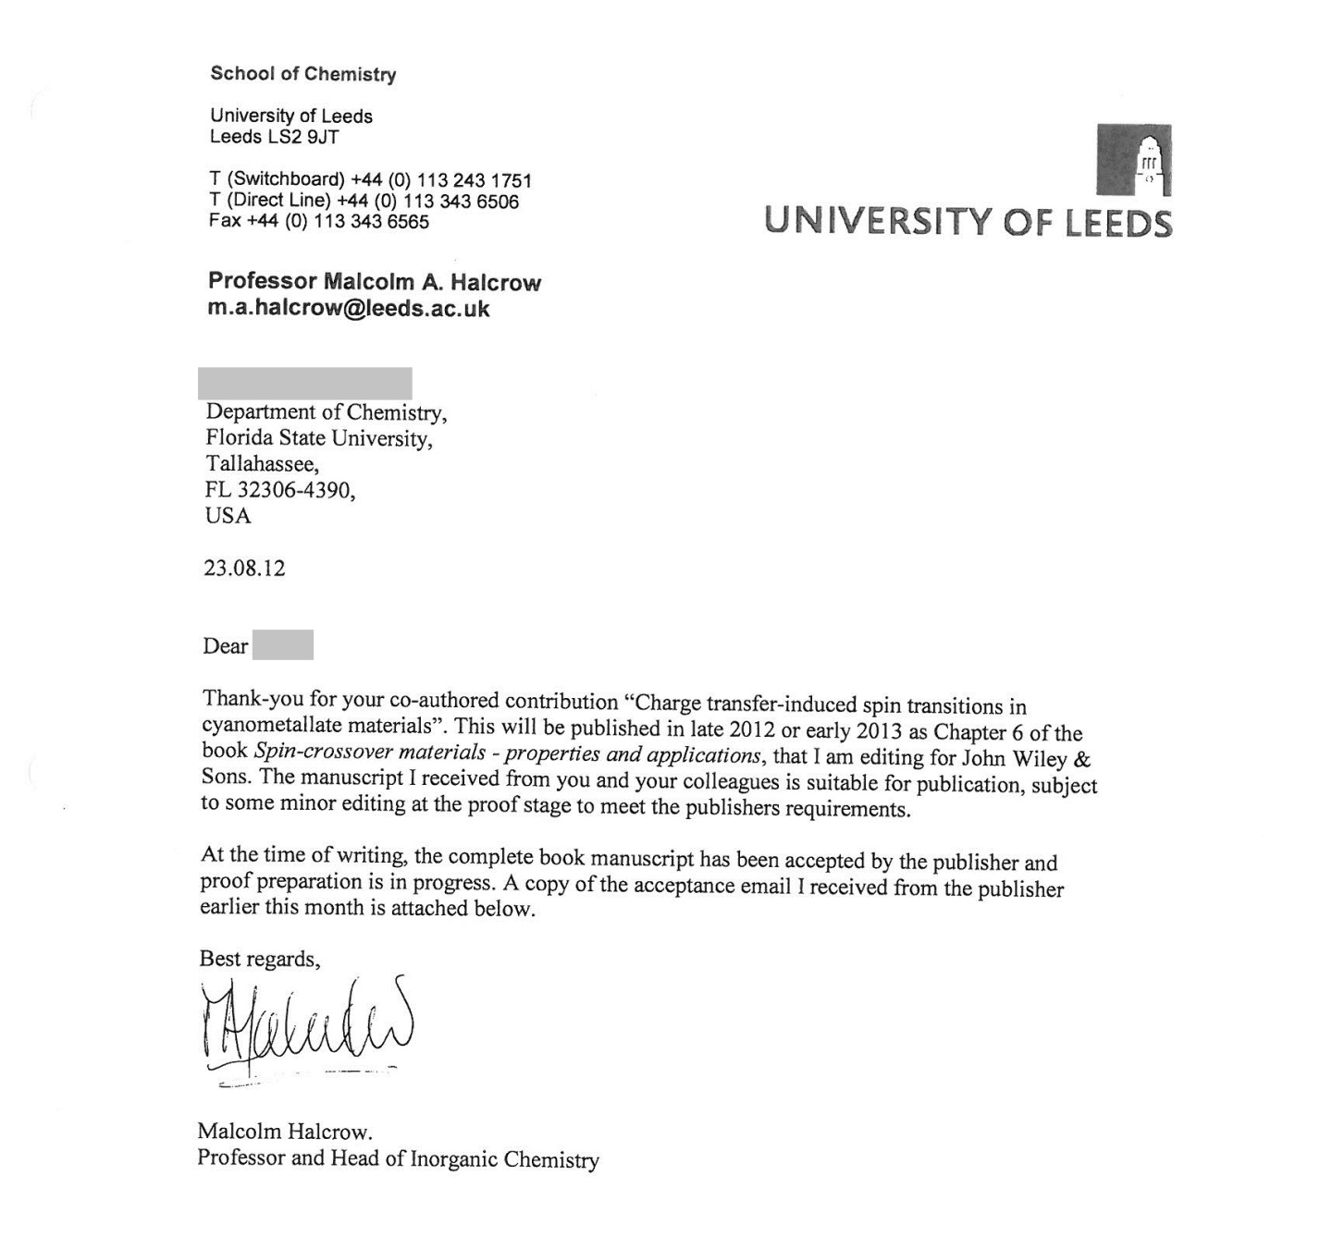
In Press Acceptance

Slide 24
FEAS Form for Courses Taught

Slide 25
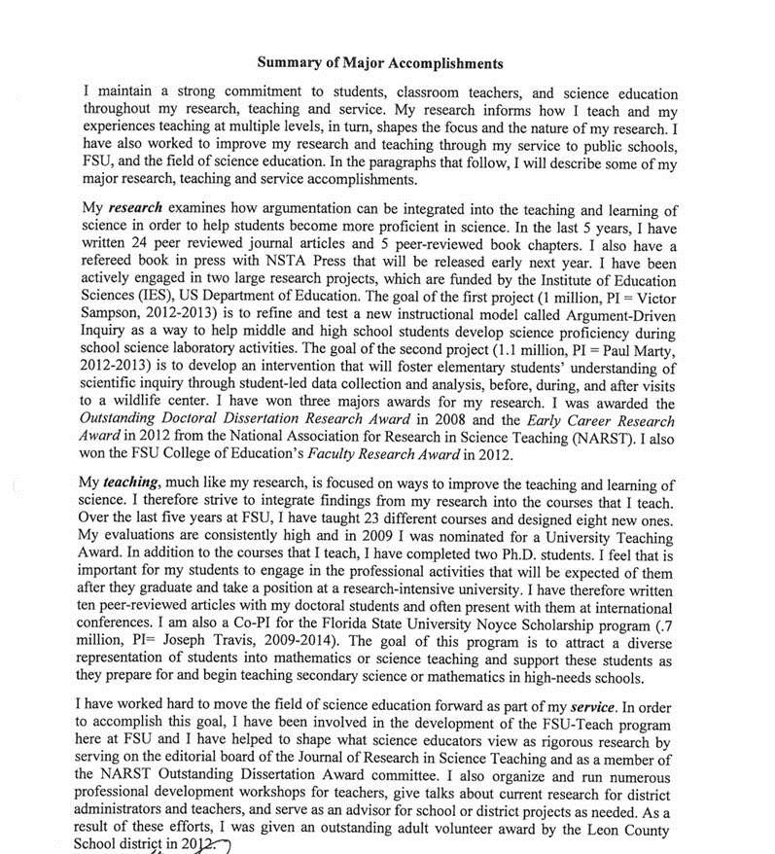
Candidates Summary of Major Accomplishments:
  One page
  Student comments are not included

Slide 26
Discussion of Teaching, Research and Service:
  Maximum of 6 pages
  Free response comments from SPCI or any other source are not included.
  Statements or letters from FSU colleagues as evidence of teaching may be included as part of the 6 pages.

Slide 27
Other Evidence
5 pages maximum
Free response comments from SPCI should not be used
Peer evaluations could be used

Slide 28
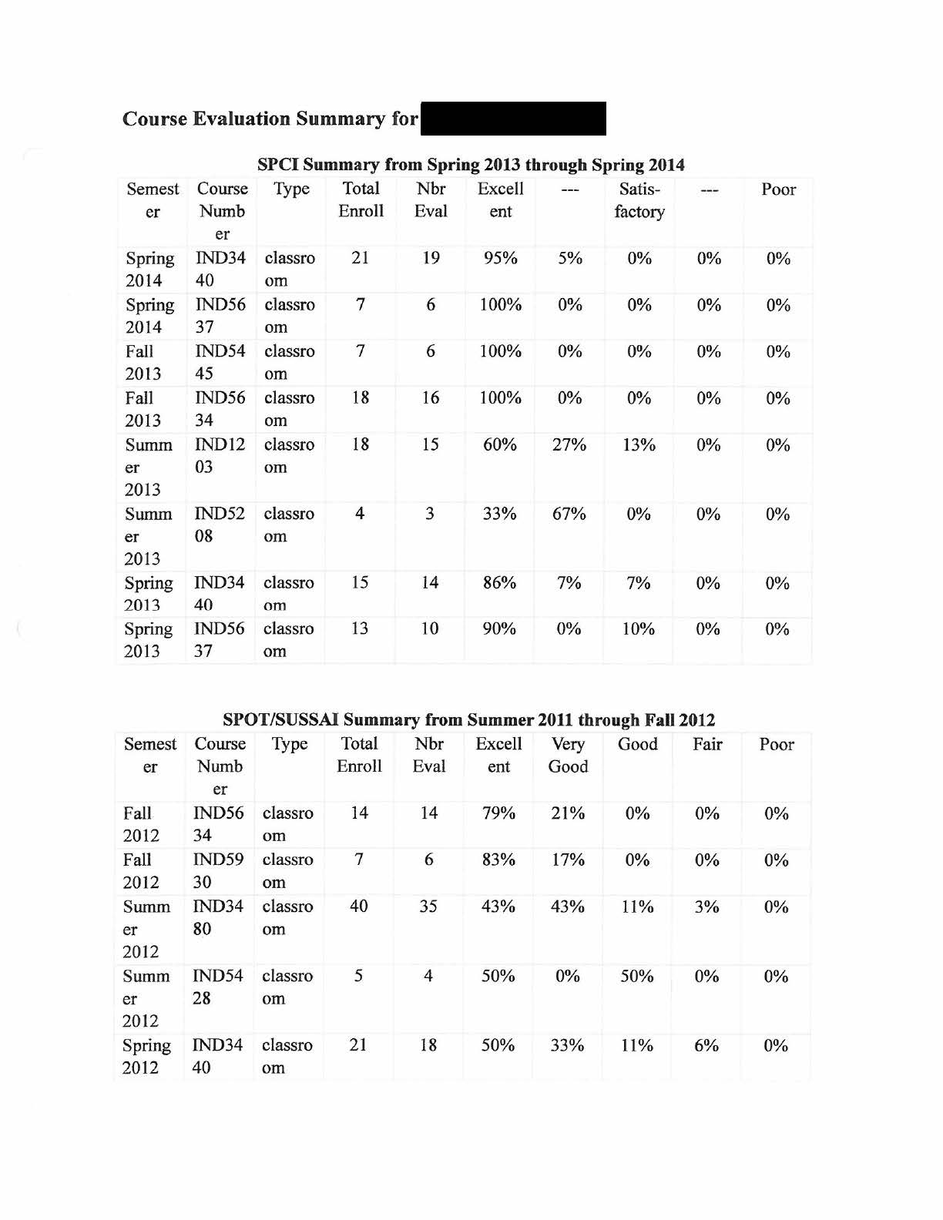
Student Responses to # 8 from SPOT or #13 from SPCI
*As of spring 2013, SPOT/SUSSAI’s #8 is SPCI’s #13

Slide 29
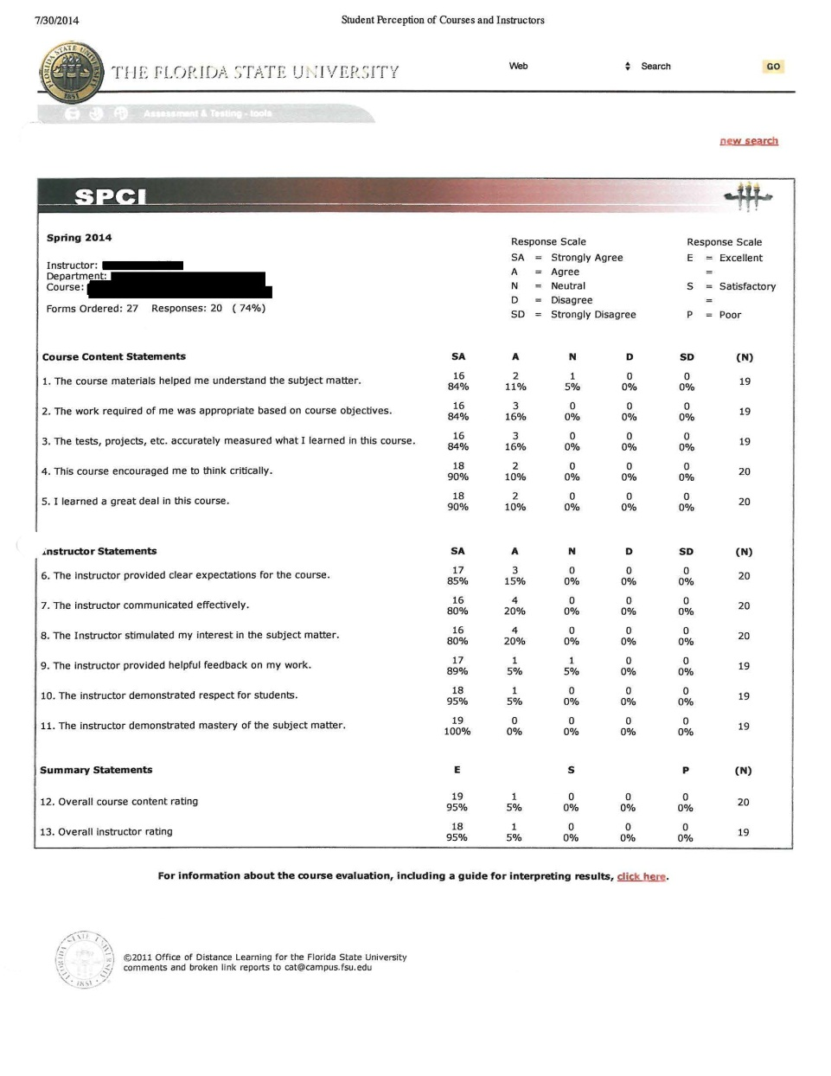
SPOT/SPCI Summary Forms

Slide 30
One or two syllabi
One or two scholarly or creative works
Other evidence (optional; maximum 5 pages)
Third and/or Second/Fourth Year Reviews

Slide 31
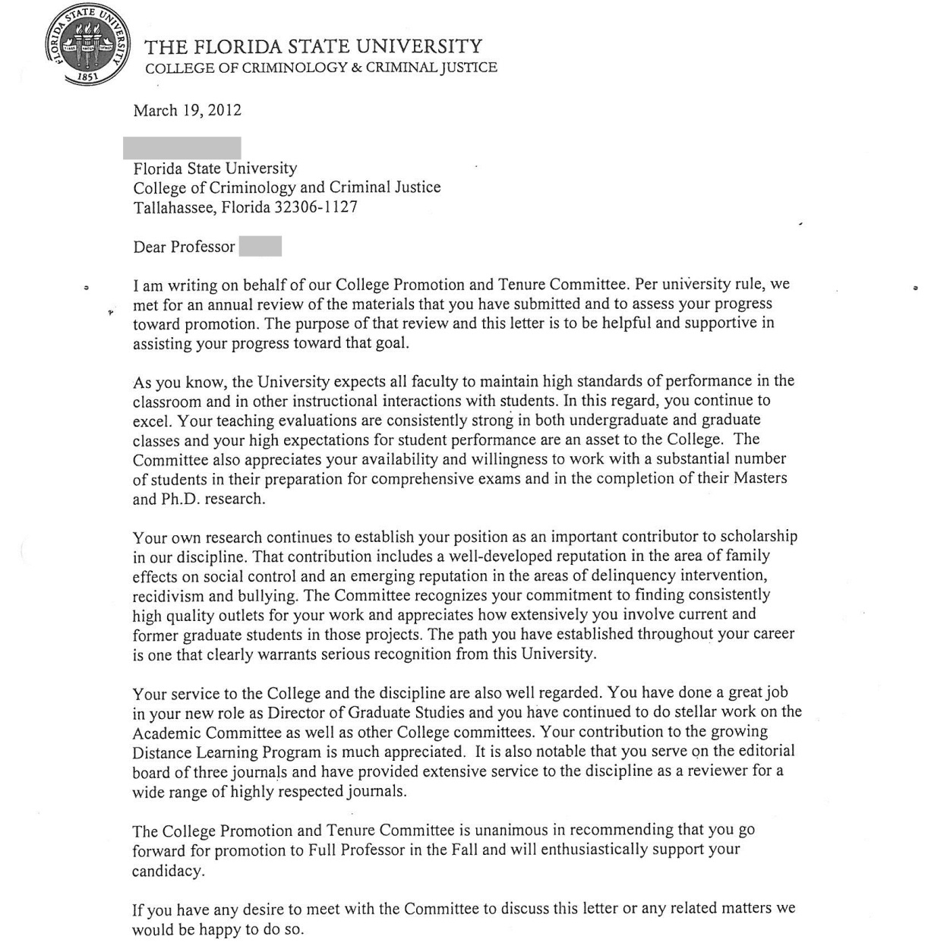
Progress Towards Promotion and/or Tenure Letters

Slide 32
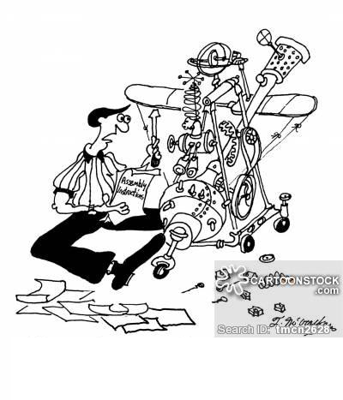
Cartoonist: McCracken, Theresa
Retrieved from cartoonstock.com

