Slide 1
Academic Honor Policy and Grade Appeals System
Jennifer N. Buchanan, Ph.D.
Associate Vice President for Faculty Development and Advancement

Slide 2
Purpose
Show how survey information gathered from FSU students can inform us about student and instructor attitudes and behaviors
Discuss how you can prevent academic dishonesty in your class

Slide 3
Purpose continued
Show you the highlights of the Academic Honor Policy and the Grade Appeals process
Introduce Ms. Ann DelRossi, Academic Affairs Coordinator in the Office of Faculty Development and Advancement

Slide 4
Academic Integrity Survey
Students today report cheating less than those in 2003, with the exception of one behavior.
Faculty, Orientation, TAs, and the Student Handbook are their primary sources of information.
Students and faculty disagree on what constitutes “serious” cheating

Slide 5
Ways Students Reported Cheating in 2015 vs. 2003
Working on assignments together (28% v. 65%)
Receiving requests to copy homework (26%)
Working on an assignment with others using digital means (24%)

Slide 6
Ways Students Reported Cheating in 2015 vs. 2003 continued
Copying a few sentences from internet without citation (23% v. 39%)
Getting questions or answers about test beforehand (22% v. 29%)
Receiving unpermitted help on an assignment (20% v. 19%)

Slide 7
Ways Students Reported Cheating in 2015 vs. 2003 continued
Copying a few sentences from written source without citation (17% v. 34%)
Copying (by hand or in person) another student’ s homework (16%)
Copying (digitally) someone’s homework (12%)

Slide 8
Facebook
Recently, instructors have discovered instances of students creating course-based Facebook groups and using them to collaborate on homework and/or quizzes.
If you assign individual work outside of class, please articulate your policy regarding collaboration clearly and be explicit about how it applies to study groups on Facebook and elsewhere online. For more information, see: http://fda.fsu.edu/Academics/Academic-Honor-Policy.
2015 Survey Results

Slide 9
Online Courses
2015 Survey Results – frequency of reported cheating behaviors (from an average of 5% of all types of cheating during f-t-f exams to 22% collaborating with others, 25% getting unauthorized help, and 62-65% consulting unauthorized materials during online exams).
Resources – Testing Center offers proctored services to students who are both on and off campus: https://distance.fsu.edu/students/distance-learning-exams.
Support for online course development from ODL at: https://distance.fsu.edu/.

Slide 10
Faculty-Student Opinion Differences
Students rated the severity of penalties as higher (63% high/very high) than did faculty (21% high/very high)
Students overestimate instructors’ understanding of policies (79% high/very high) compared to the level of understanding reported by faculty (35% high/very high)

Slide 11
Faculty-Student Opinion Differences
Students see most cheating behaviors as less serious than do faculty members, especially when they involve collaboration that hasn’t been authorized by the instructor.

Slide 12
Honor Code Assumptions
Only 34% of students agree that they should be responsible for monitoring others’ integrity
Students more likely to report fellow students in 2015 than in 2003 (63% vs. 80% very unlikely/unlikely to report)
They are less likely to report close friends (96% very unlikely/unlikely)

Slide 13
Conclusions and Themes
Today’s students are acting with more integrity in the classroom than those in 2003.
Some unauthorized collaboration happens, especially between friends (FB or otherwise), who don’t believe that doing homework together is wrong.
Students assume you know more than you do about academic integrity.

Slide 14
Conclusions and Themes continued
Students look to you for cues about whether cheating will be tolerated and don’t want you to!
Students will hesitate to inform you
Prevention is important
Our involvement is critical
Important to address use of social media (esp. FB) and online testing issues

Slide 15
Preventing Academic Dishonesty
Reconsider assigning individual graded homework and make rules on collaboration clear
Syllabus: http://facsenate.fsu.edu
Teaching meaning of plagiarism, esp. paraphrasing versus quoting
“Turn-it-in.com,” “SafeAssign” and other resources – make available
Mutual respect between student and instructor and confident verbal reinforcement

Slide 16
Preventing Test Cheating
Making cheating more difficult
Following through (learn policy)
Have a plan for test-time (verify independently)
Emphasize “Complicity” charge
Confident verbal reinforcement

Slide 17
Policy Specifics
Instructors play central role
Procedural Notes (check for prior record)

Slide 18
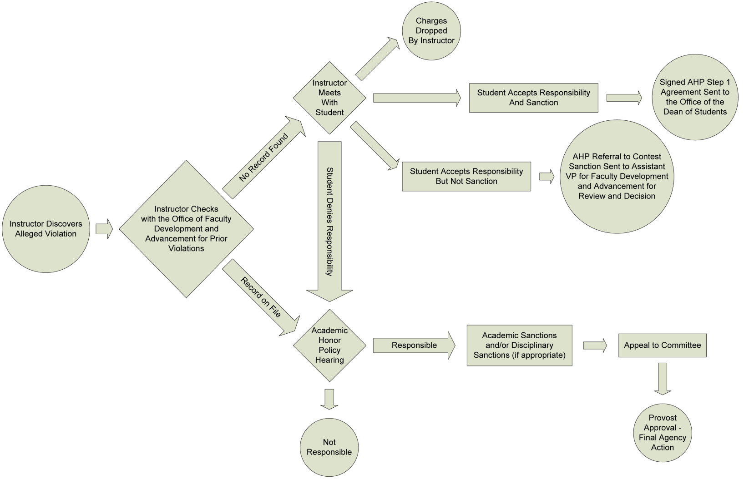
Florida State University Academic Honor Policy (AHP)

Slide 19
Charges
Plagiarism
Cheating
Unauthorized group work
Fabrication, falsification, & misrepresentation

Slide 20
Charges continued
Multiple Submission
Abuse of academic materials
Complicity in academic dishonesty
Attempting to commit an offense

Slide 21
Graduate Student Issues
Prelims, comps, thesis or dissertation treated as egregious and sent to Step 2
Charging decision made by committee comprised of department chair, outside member, and faculty member appointed by dean

Slide 22
Academic Honor Policy By Academic Year (Since New Policy Effective Fall 2005)
Number of Cases

Slide 23
Cases and Outcomes
Through July 28, 2014

Slide 24
Grade Appeals System
Also involves integrity
Emphasizes centrality of instructor judgment in grading process
Grade must be imposed in an arbitrary, capricious, or discriminatory manner to be overturned

Slide 25
Grade Appeals System continued
Starts with evaluation (grading) standards expressed in syllabus
Minimize exposure through consistency

Slide 26
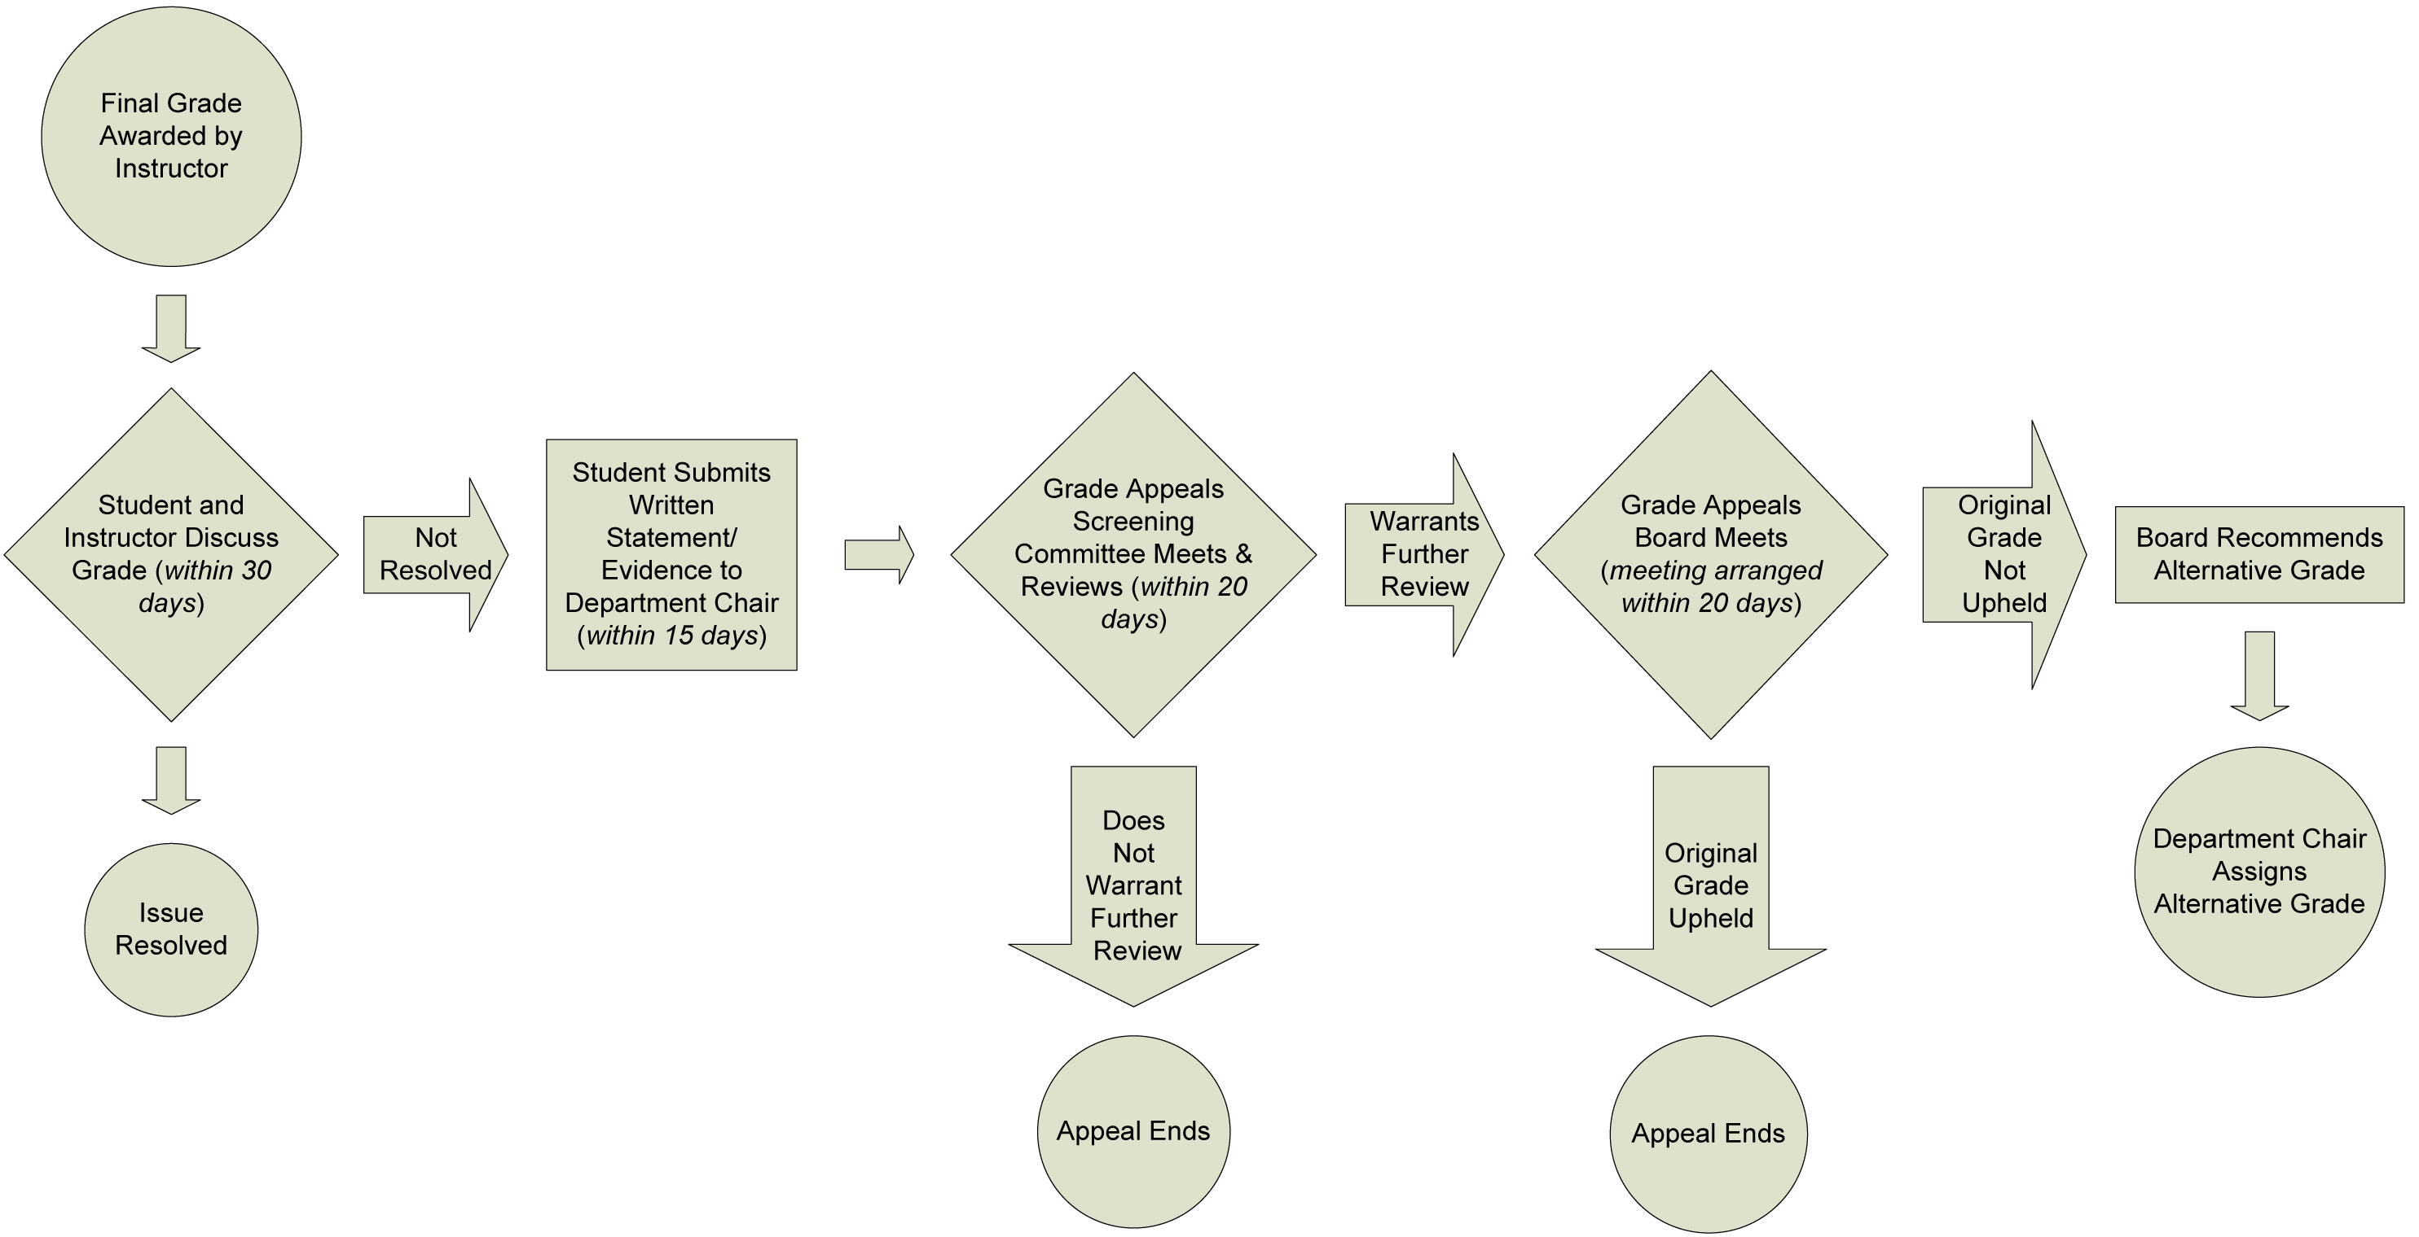
Grade Appeals System

Slide 27
Resources in your Department
Your supervising faculty member should always be informed about any allegations that arise in your class.
Your department chair should also be informed by either your supervising faculty member or by you.
Either of them can inform you of typical penalties in the department and can sit in when you meet with students.

Slide 28
University Resources
Office of Faculty Development and Advancement: http://fda.fsu.edu under Academics – Academic Honor Policy, Grade Appeals System, annual Important Policies and Procedures Memo, or at 850-644-6876.
(Ann DelRossi, Ameko Dillard, Melissa Crawford)
Students should be referred to the Dean of Students Department at 644-2428.

Slide 29
University Resources continued
Important Policies and Procedures memo contains important information for instructors. Found on http://fda.fsu.edu under Academics.
ODL resources at: https://distance.fsu.edu/.

